Slide 1
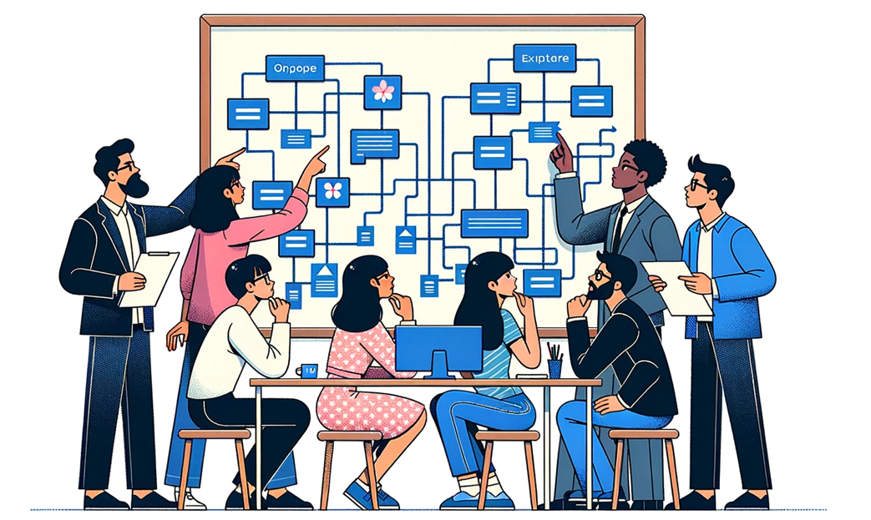
Generative Patterns for AI
Foundations of AI Acceleration
Dan McCreary and Steve Peterson
November 2023
Notes:
Dan

Slide 2
Talk Description
Generative AI is by far the most impactful technology in the last ten years. It dominates the priority list of almost every CIO in the world.
This session will review key architectural patterns that organizations are using to safely harness the power of Generative AI to build intelligent search, chatbots and agents as well as performing a variety of tasks on unstructured text.
We will cover the key use case taxonomies that are emerging and the architectural patterns we need to support these initiatives. If implemented, these patterns can accelerate the process of building intelligent agents for all knowledge workers.
Notes:
Dan

Slide 3


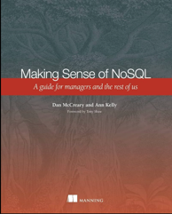


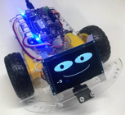


Background for Dan McCreary
Solution architect with over 35 years working with data
Worked for Bell Labs and Steve Jobs at NeXT
Author of a book on database selection “Making Sense of NoSQL”
Promoter of XML and graph query standards (GQL)
Former Distinguished Engineer working for Optum (UHG)
Built the worlds largest healthcare knowledge graph
Lead the “Generative AI Center of Excellence” at Optum
Worked with over 250 healthcare uses cases – 50 which were funded and over 10 in production
Blogger: http://medium.com/@dmccreary
Big fan of AI, robotics, MicroPython, and STEM education
Advocate for neurodiversity
Notes:
Steve

Slide 4

Background for Steve Peterson
Steve Peterson
Senior Director of Enterprise Architecture
Rodan + Fields.
Steve brings over three decades of expertise in spearheading enterprise architecture initiatives. His career has seen pivotal roles at industry giants such as IBM, Be The Match, UnitedHealthcare (UHC) & Optum, and AT&T. At UHC, Steve's visionary leadership in Enterprise Architecture was evident as he crafted strategic roadmaps, particularly emphasizing innovations in integration, chatbots, and Natural Language Processing.
Notes:
Steve

Slide 5
Outline
What
Why
Concepts
Patterns
Examples
Resources
What is an architectural pattern?
Why are they important for discussing architecture tradeoffs?
Building on Enterprise Integration Patterns (EIP)
Key concepts
Large-language model
Embedding
Vector store
Key patterns:
Finetuning
Prompt Enrichment (RAG)
Embeddings
Concept Index (vector store)
Supporting Website: https://dmccreary.github.io/genai-arch-patterns/
Notes:
Dan

Slide 6


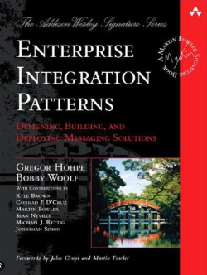
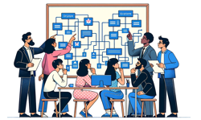
What is an Architectural Pattern?
1979
A general, reusable solution to a commonly occurring problem in software architecture within a particular context
A named way of moving from problem to solution
1994
2003
2014
2023
GenAI
Patterns
Notes:
Dan

Slide 7
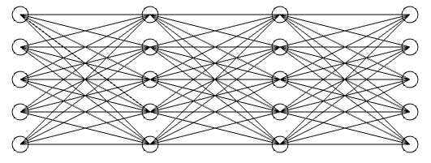
Abstractions and Subsystems
Architectural patterns are reusable high-level abstractions that provides a set of predefined subsystems, their responsibilities, and rules for organizing the relationships between them.
Prompt
Response
Large-Language
Model
Notes:
Steve

Slide 8


Patterns and Bandwidth
Architecture patterns help in laying out the structure for a software system and provide a vocabulary for discussing system design
Precise design patterns create high-bandwidth discussions that help architects quickly understand design tradeoffs
Notes:
Steve Create an image of two business professionals standing in an open space. They are standing far apart. The Asian woman on the left is talking into a cup. The dark skinned man on the right is listening to a cup at his ear. There is a tight string between the two cups. The string is straight. There is nothing in the background.

Slide 9
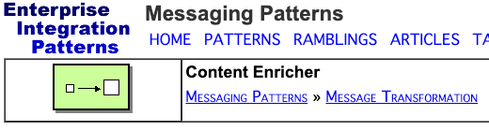
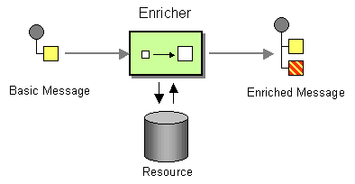
Architecture Patterns Have Diagrams
Good architecture patterns have clear diagrams that have common meaning
New patterns can be derived from similar patterns
Example EIP Pattern: Content Enrichment
https://www.enterpriseintegrationpatterns.com/patterns/messaging/DataEnricher.html
Notes:
Steve

Slide 10
Prompt Enrichment
By using similar terminology that architects are already familiar with, we can quickly build new patterns
Basic Prompt
Enriched Prompt
Notes:
Steve – Single pass. Better responses

Slide 11
Architecture Tradeoff Analysis
Business
Drivers
Quality
Attributes
User
Stories
Analysis
Architecture Plan
Architectural
Approaches
Architectural
Decisions
Tradeoffs
Impacts
Sensitivity
Points
Non-Risks
Distilled info
Risk Themes
Risks
This process defined by CMU's Software Engineering Institute
Notes:
Steve – options and recommendations

Slide 12
Example: Databases Architectures
Relational
Analytical (OLAP)
Key-Value
key
value
key
value
key
value
key
value
Column-Family
Graph
Document
There is no once-size-fits all. There are only tradeoffs.
Notes:
Dan

Slide 13
Architecture Tradeoffs in Generative AI
Finetune or Prompt Enrichment?
Small model or large model?
Small context window or large?
Faster response time or higher quality?
Vector database or graph database?
Public or private knowledge?
Security at the database or application level?
All public documents or role-based access control?
Notes:
Dan

Slide 14
Key GenAI Concepts
Neural networks
Large language models
Prompts
Tokens
Prompt context window
Prompt design and engineering
Embeddings
Concept Index (Vector database)
Comparison and Similarity
Classification
Multimodal
Notes:
Dan

Slide 15
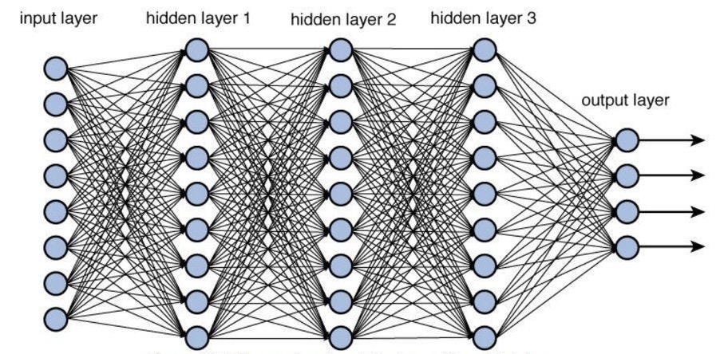
Deep Neural Network
Image source:
Notes:
Dan

Slide 16
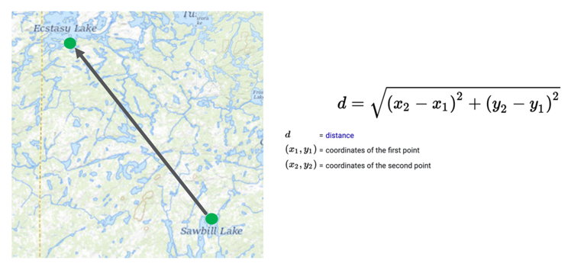
Comparing Items: The Geospatial Metaphor
Any two locations have a “distance” in space between them
We extend this to more than two dimensions
An embedding is expressed as a set of “coordinates” in a 200-dimensional space
Notes:
Dan

Slide 17
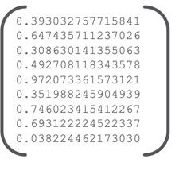
Text Embedding
Text Embedding
Text
How many family practice physicians are there in Minneapolis that are taking new Medicare patients?
128 decimal values
Notes:
Dan

Slide 18
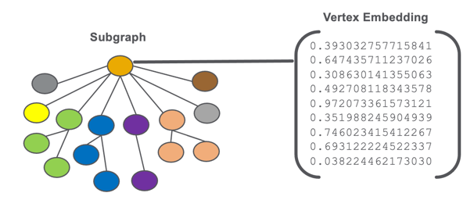
Graph Embedding
256 decimal values
A Representation of a Physician, Member, Customer etc.
Notes:
Dan

Slide 19
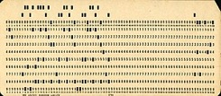
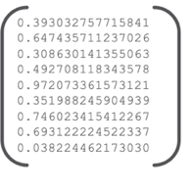
GenAI is about Comparison (not counting)
Old Way: Counts and Amounts
New Way: Comparison
COBOL Flat Files
Spreadsheets
RDBMS Tables
OLAP Cube
Embedding
Similarity
How do we store knowledge for fast counting?
Tables and OLAP Cubes
How do we store knowledge for comparison?
Graphs and Embeddings
Notes:
Dan

Slide 20
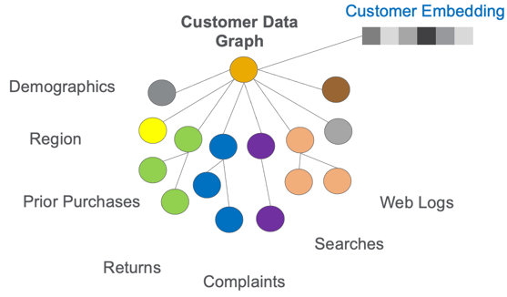
Customer Embeddings
Comparing customers depends on storing their properties and linking customer touchpoints
Building embeddings is the domain of graph machine learning
Notes:
Dan

Slide 21
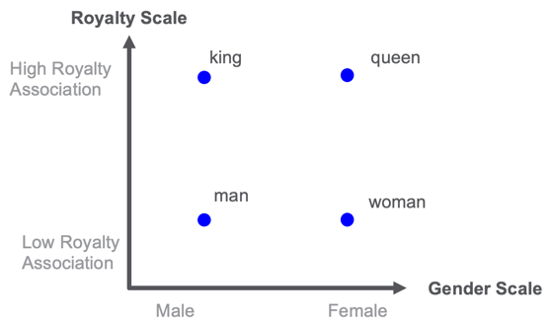
Distance Between Words
Manually rating 40K common English words is too expensive!
Notes:
Dan

Slide 22
Key Question: What Do You Never Want to Compare?
Customers
Products
Competitors
Competitors products
Product comments
Words
Sentences
Paragraphs
Documents
Images
Workflows
Code
Queries
APIs
Action items assigned during a meeting
Frequently asked questions
Applications on the desktop
Documents in a knowledge base
Spreadsheets
Reports
Graphics
PowerPoint slides
Virtual machine configurations
Errors in a log file
Answer: Our answer: none of the above!
Notes:
Dan

Slide 23
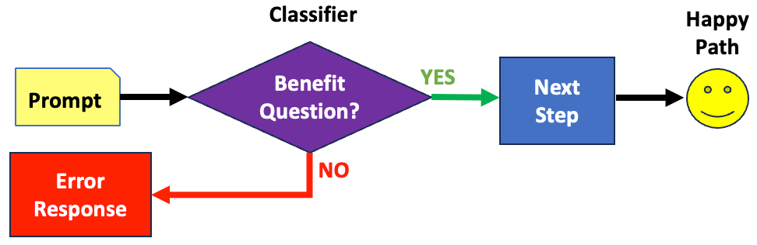
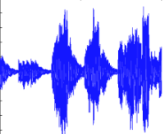

Multi-Modal Generative AI
Code
Text
Markdown
Deep Neural Network
Prompt
Architecture Diagrams!
Generative AI includes the creation of many content types including images, sound, music, videos, code, markdown, and even architecture diagrams
Notes:
Dan

Slide 24
Example: Gardening Question Chatbot
Standard Gardening Questions
Product and Mushroom Questions
How do I get rid of spurge from my lawn?
Do you think that this mushroom is OK to eat?
You can answer standard questions about gardening, trees, shrubs, and lawns, etc.
You cannot answer questions about commercial products or mushrooms

Slide 25
Example: Benefits Chatbot
Benefit Questions
Medical Advice Questions
Is acupuncture covered by my plan?
Do you think that acupuncture is effective?
You can only answer questions about what is covered in your health plan
You must refuse to answer questions about medical advice
Notes:
Steve

Slide 26
Sample Workflow
Classifier
Happy
Path
Benefit
Question?
Prompt
YES
Next
Step
Error
Response
NO
Architecture is about what boxes we have in our toolchest and how they are connected
Notes:
Dan

Slide 27

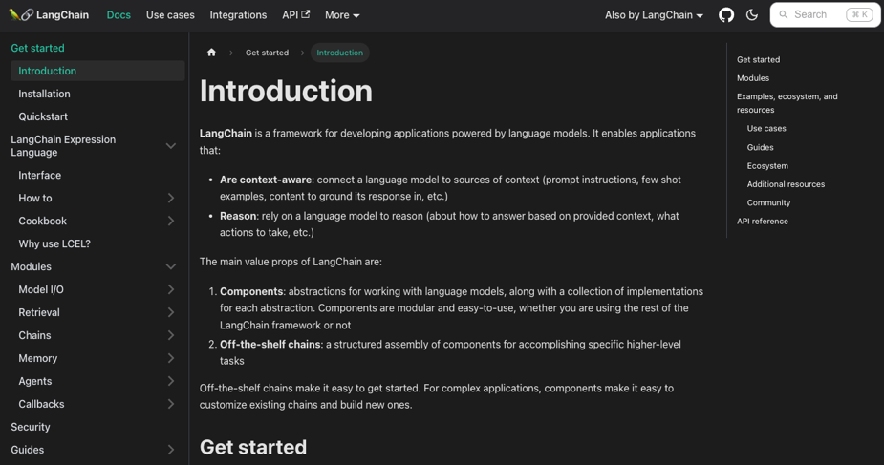
LangChain
Chains of Language Models
Allows developers to quickly configure workflows that integrate LLMs
Notes:
Dan

Slide 28
Workflows, LangChain and Prompt Enrichment
Prompt
Do We Have
Enough Info?
YES
Embedding
Classifier
Next
Step
NO
Knowledge
Graph
Enrich
LangChain is a software system for building workflows where the components are often large-langauge models
Notes:
Dan

Slide 29
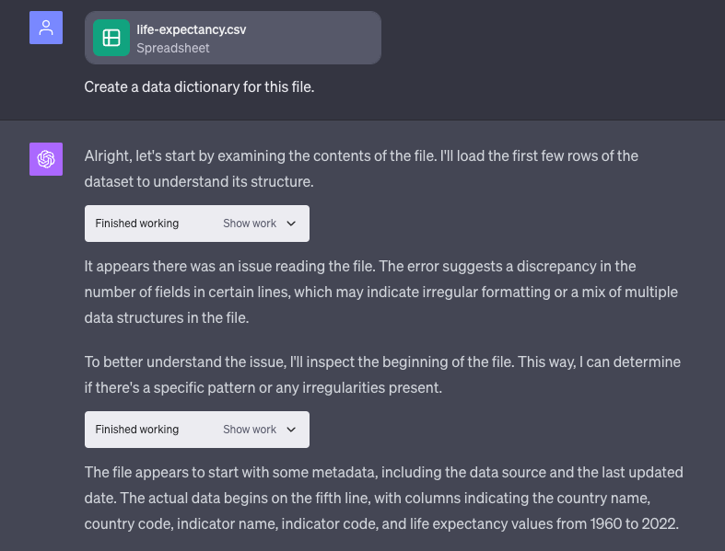
ChatGPT Advanced Data Analytics
Generate and Execute Python Code
Generate and Execute Python Code
Loops of:
Generate code
See results of the data profiling Python code
Pick the next most similar workflow (that may also have Python code)
https://dmccreary.medium.com/asking-ai-about-lowering-healthcare-costs-in-the-us-7224b4f958cc
Notes:
Dan

Slide 30
Hundreds of Cooperating Agents
Today
Next Year
Single prompt
Single Large-language model (LLM)
LLMs generate code
Executed code generates prompts
Example: ChatGPT Advanced Data Analytics
Hundreds of agents interacting inside your organization
Agents calling services and databases
LLMs are only limited by your company's ability to describe the APIs
LLM
API
User
LLM
Code
DB
User
3-Agents
System
Code
Notes:
Dan

Slide 31
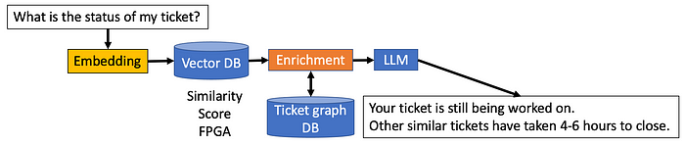
Helpdesk Chatbot
Similarity can tell you if other questions needed a query executed to get the right results
The system must understand context (who you are and your context)
Example:
Docker problems on a PC – average of over 2 hours to fix
Docker problems on the Mac – average less than 20 minutes to fix
Notes:
Dan

Slide 32
Towards a Loosely Coupled Architecture
Key
LLM Task
New GenAI App
English
Other GenAI Apps
Standard Infrastructure
Single Task
Multiple Tasks
GenAI Wrapper
REST APIs
Agent Safety Guardrails
English
Goal Decomposition
Task Ordering
GenAI Wrapper
Knowledge
Graph
Estimation
Logging
Scheduling
English
Document Cracking
Embedding
Verification
Collection
Notification
Goal: define loosely coupled resilient architecture where clearly defined interfaces allow components to be swapped in and out has technology changes and new contracts are negotiated.
Architecture
Notes:
Dan

Slide 33
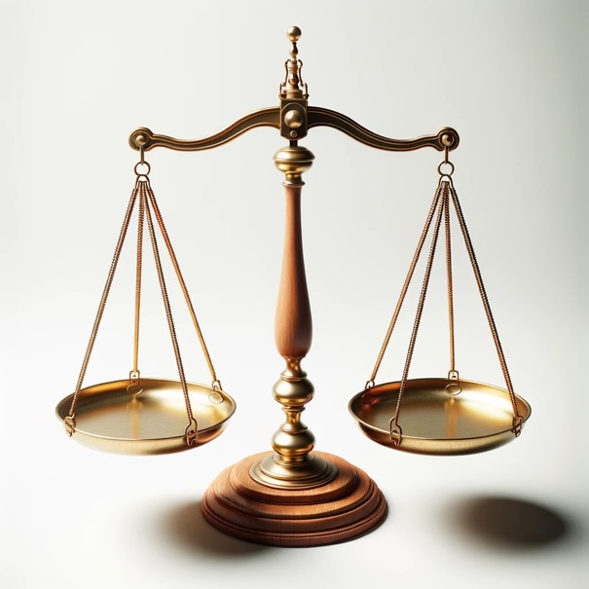
Finding The Simplest Architecture
Complexity has a cost
Can we get by with a simpler architecture?
COST
BENEFITS
The cost of building a model
The of benefits of using the model
Notes:
Prompt: Photo of a traditional balance scale made of polished wood and brass, set against a pristine white background. The scale is evenly balanced, with empty pans on either side.

Slide 34
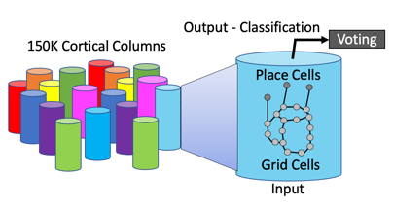
Comparing Knowledge Representations
Large-Language Model (Deep Neural Network)
Works well with current CPU and GPU hardware but not a model of the world around us
Knowledge Graph (Nodes and Edges with Properties)
Our best attempt at creating detailed models of the world around us with efficient traversal without JOINs
Reference Frames (used by the human brain)
The way that human intelligence is really represented in the neocortex
Notes:
Dan

Slide 35
GenAI Strategy References
The Generative Turn:
https://dmccreary.medium.com/the-generative-turn-for-tech-strategy-502390aafb76
The Jellyfish and the Flatworm
https://iianalytics.com/community/blog/the-jellyfish-and-the-flatworm-a-story-about-ai-strategy
Notes:
Dan

Slide 36
Questions
Thank You!
Site for this presentation: https://dmccreary.github.io/genai-arch-patterns
Dan’s LinkedIn: https://www.linkedin.com/in/danmccreary
Steve’s LinkedIn: https://www.linkedin.com/in/steven-peterson-7928995/
Dan’s Blog: http://medium.com/@dmccreary
Notes:
Steve

