Slide 1
The Business Value of Intelligent Agents
Steve Peterson
Dan McCreary
MACC November 2024

Slide 2
Description of Talk
Join Dan and Steve as they expand on last year’s Generative Patterns for AI, introducing new strategies for intelligent agents. Discover how agents can efficiently answer questions from documents and data sources, backed by real-world case studies showcasing cost savings. Learn actionable steps to implement pilot projects leveraging RAG and GraphRAG.

Slide 3
Disclaimer
This content represents our personal views & approaches.
The content does not represent the viewpoint of any of our current or previous employers. Steve Peterson
Dan McCreary

Slide 4


Our Presenters
Steve Peterson
Dan McCreary
Steve Peterson is the Chief Architect at Aon Reinsurance.
Steve brings over three decades of experience in spearheading enterprise architecture initiatives. His impressive career includes pivotal roles at renowned organizations such as IBM, Be The Match, UnitedHealthcare (UHC) & Optum, and AT&T. During his tenure at UHC, Steve showcased his visionary leadership by developing strategic roadmaps that prioritized innovations in integration, chatbots, and Natural Language Processing.
Dan McCreary is a retired Solution Architect who focused on AI and generative AI architectural patterns.
In the past, he worked at Bell Labs with the creators of the UNIX operating system, with Steve Jobs at NeXT Computer, and founded his own consulting firm with over 75 employees. His background included topics such as scale-out enterprise knowledge graphs, high-performance computing, and NoSQL databases. He is the co-author of the book “Making Sense of NoSQL” and is a frequent blogger on AI strategy.

Slide 5

The AI Skeptic
AI is much like quantum computing, blockchain and AR/VR. We are promised huge impact and yet we see no business benefits.
AI Is Hype
Notes:
Dan

Slide 6
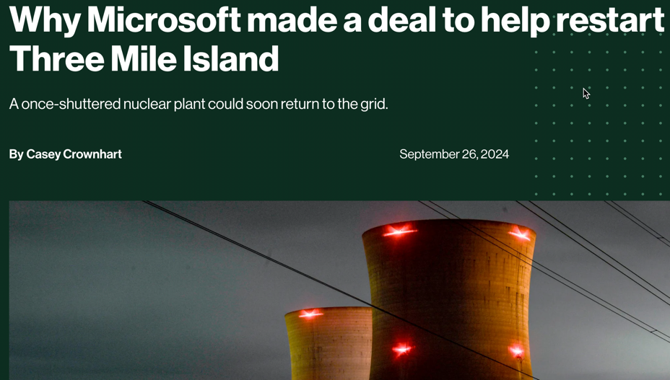
Worldwide AI Investment Is Approaching $1 Trillion
2023 - $154B
2024 - $200B (estimate)
2025 - $250B (estimate)
Compound annual growth rate (CAGR) of 27%
Microsoft signs 20-year deal to restart Three Mile Island
https://chatgpt.com/share/6726301e-f290-8001-b2a0-5faadbb53792
Notes:
Steve

Slide 7
Our Prediction
Intelligent Agents will have ten times more impact on Minnesota organizations than any of these other emerging technologies
Blockchain
AR/VR
Quantum computing
Crypto
Nuclear Fusion
Solar power
Most executives at Minnesota organizations are not prepared for advances in agentic AI
Notes:
Steve

Slide 8
Outline of Today’s Talk
What are Intelligent Agents?
How are Intelligent Agents Different from where we are e.g. ChatGPT?
Data Sources used:
Large Language Models (LLM)
Vector RAG – Role and Value
GraphRAG – key emerging technology
Business Value – calculation of cost and benefit for AI projects
Challenges of Calculating Current Business Value from Emerging Technologies – remember quantum and blockchain
Trend Analysis – how fast are agent technologies improving?
Impact on enterprise architecture
Three key recommendations
Notes:
Steve

Slide 9
What Are Intelligent Agents?
According to Andrew Ng, Agents have Four Key Architectural Differences
Autonomy and Decision-Making: Intelligent agents can operate independently, making decisions to achieve goals, unlike LLMs, which respond only to prompts.
Iterative Workflows: Intelligent agents refine their outputs through repeated cycles, while LLMs do not improve iteratively without external integration.
Tool Use and Environmental Interaction: Intelligent agents interact with external tools and environments, whereas LLMs lack this capability.
Modular Design and Multi-Agent Collaboration: Intelligent agents can work in multi-agent systems, solving complex problems together, unlike LLMs, which work in isolation.
Notes:
Steve compare this to a single prompt which does pass of a prompt through a LLM

Slide 10
Hundreds of Cooperating Agents
Single Pass
ChatGPT o1-preview
Single prompt
Single Large-language model (LLM)
LLMs generate code
Executed code generates prompts
Example: ChatGPT Advanced Data Analytics
Hundreds of agents interacting inside your organization
Agents calling services and databases
LLMs are only limited by your company's ability to describe the APIs
LLM
API
LLM
User
User
3-Agents
System
Code
DB
Code
Notes:
Dan – comparing different workflows of prior vs. ChatGPT o1 Preview

Slide 11
How are Intelligent Agents Different?
Autonomy: LLMs respond only when prompted, whereas intelligent agents proactively pursue goals e.g. they can go find the data
Memory: LLMs typically don’t have memory across sessions without external tools; agents can have memory and adapt iteratively.
Tool Usage: LLMs need integration with external tools to perform actions, while intelligent agents have embedded mechanisms for interacting with the environment and adapt to changes
Collaboration: Agents work together modularly to solve problems; LLMs work individually.
Notes:
Steve – independence and not just a response to a prompt

Slide 12
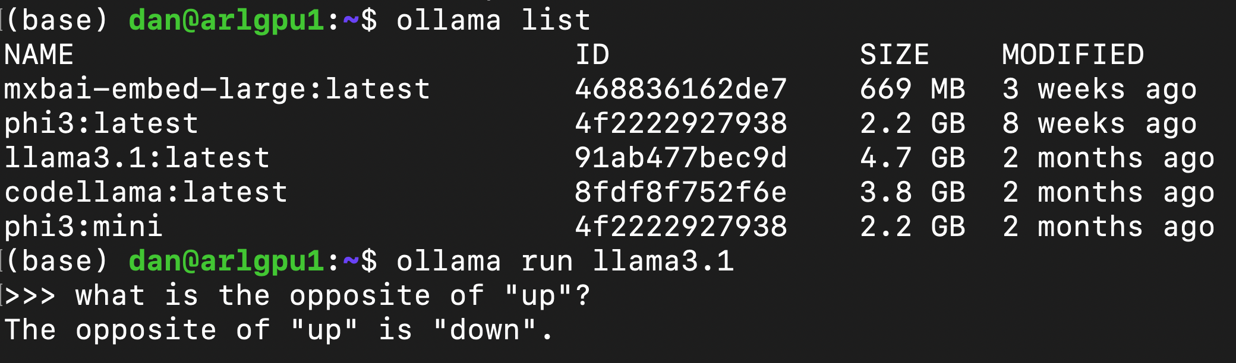
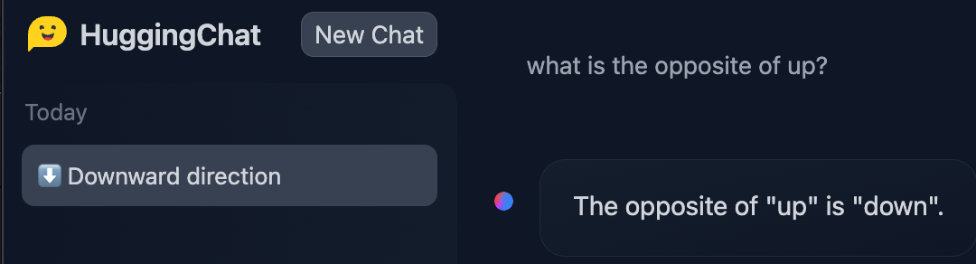
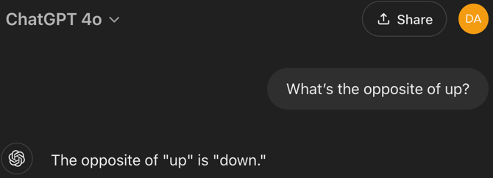
GenAI Systems Estimate Problem Complexity
Simple problems can use very small models (Ollama on a local GPU)
Notes:
Dan – reference this as using simple models for low-cost questions

Slide 13
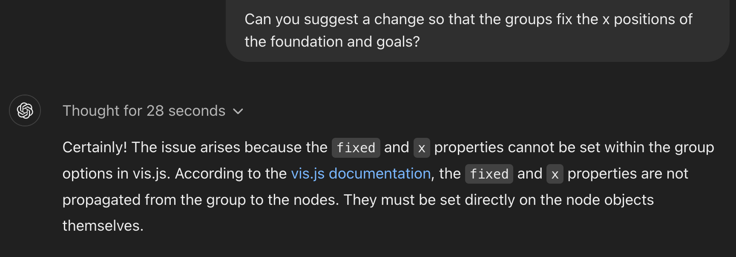
Example: ChatGPT o1-preview
Estimate the complexity of problems
Assigns the right resources to each problem
Use “Chain of Thought Reasoning”
Response take between 1 second and 100 seconds
Notes:
Dan

Slide 14
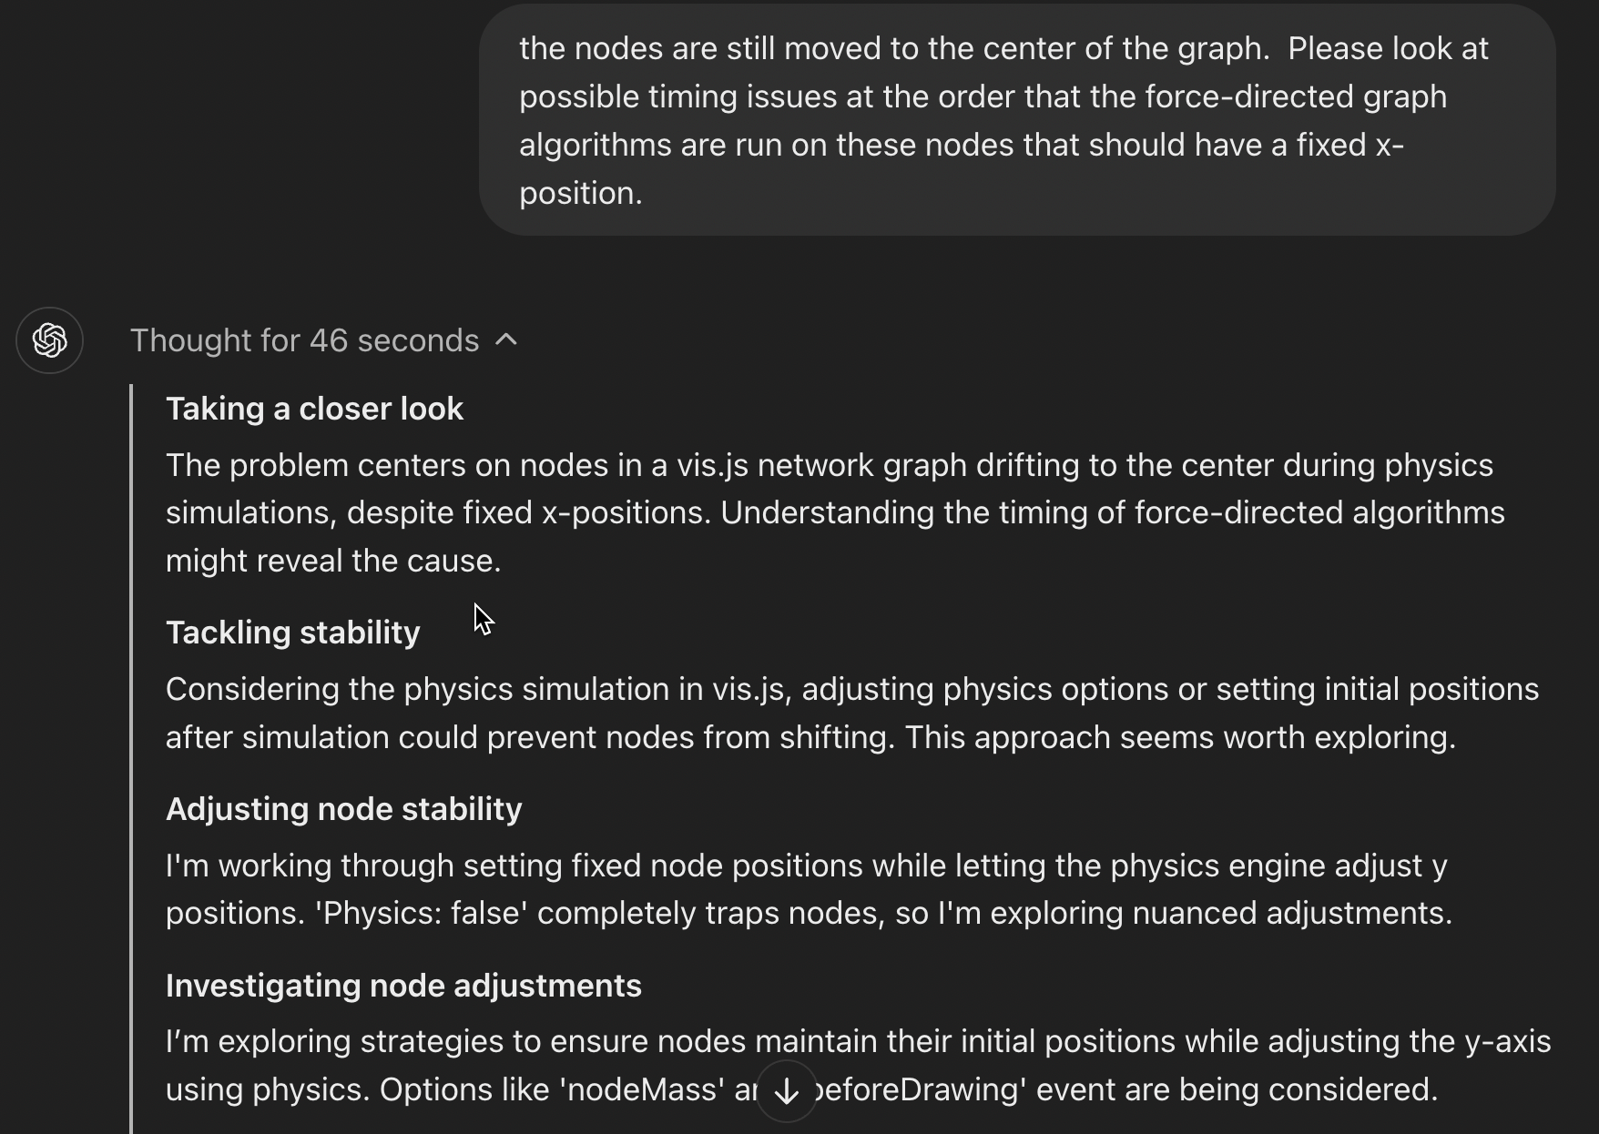
ChatGPT o1-preview
Dropdown
Notes:
Dan

Slide 15
Agentic Architecture Enhancing Integration and Performance
Seamless Integration:
Autonomous Agents: Agents independently interact with LLMs and vector & graph databases.
Dynamic Decision-Making: Agents choose the optimal data source based on query complexity.
Improved Performance:
Scalability: Easily incorporate new data sources or agents.
Adaptability: Agents learn and refine retrieval strategies over time.
Collaborative Problem-Solving:
Multi-Agent Systems: Agents share insights and work together to handle complex queries.
Iterative Processing: Agents can loop through retrieval and generation steps to improve responses.
Business Impact:
Efficiency Gains: Faster response times and reduced operational costs.
Better Insights: Deeper understanding of data leads to improved decision-making.
Competitive Advantage: Enhanced capabilities that differentiate your services.
Notes:
Steve: Integrating RAG in Graph with Vector Databases is an advanced technique for improving language models and answering complex questions with unstructured data. This is done by combining the relational context of graph databases with the semantic similarity of vector databases. This technique enables organizations to more efficiently find answers to difficult questions, and can help in a variety of industries such as healthcare, finance, and more.

Slide 16
Data: Beyond LLMs, GraphRAG and Vector Databases
Understanding RAG in Graph:
Retrieval-Augmented Generation (RAG): Enhances language models by retrieving relevant external data during the generation process.
Graph Databases: Store data as nodes and edges, capturing complex relationships and hierarchies.
Role of Vector Databases:
Vector Embeddings: Numerical representations of text or data capturing semantic meaning.
Vector Databases: Enable efficient similarity searches based on these embeddings.
How They Work Together:
Combined Retrieval: Use vector databases for semantic similarity and graph databases for relational context.
Enhanced Contextualization: Provides both the "what" (vector similarity) and the "how" (graph relationships).
Notes:
Steve: Integrating RAG in Graph with Vector Databases is an advanced technique for improving language models and answering complex questions with unstructured data. This is done by combining the relational context of graph databases with the semantic similarity of vector databases. This technique enables organizations to more efficiently find answers to difficult questions, and can help in a variety of industries such as healthcare, finance, and more.

Slide 17
The Complementary Nature of LLMs and EKGs
Large Language Models
Statistical
Models of language
Designed to predict the next token
Likely to hallucinate
Contains Knowledge of the Outside World
Enterprise Knowledge Graphs
Deterministic
Models of your customer and products
Designed for knowledge traversal
Precise graph queries
Contains Knowledge of your Internal Organization
LLMs
EKGs
Notes:
Dan

Slide 18
Intelligent Agent Benefits
Seamless Integration:
Autonomous Agents: Agents independently interact with LLMs and vector & graph databases.
Dynamic Decision-Making: Agents choose the optimal data source based on query complexity.
Improved Performance:
Scalability: Easily incorporate new data sources or agents.
Adaptability: Agents learn and refine retrieval strategies over time.
Collaborative Problem-Solving:
Multi-Agent Systems: Agents share insights and work together to handle complex queries.
Iterative Processing: Agents can loop through retrieval and generation steps to improve responses.
Business Impact:
Efficiency Gains: Faster response times and reduced operational costs.
Better Insights: Deeper understanding of data leads to improved decision-making.
Competitive Advantage: Enhanced capabilities that differentiate your services.
Notes:
Steve: Integrating RAG in Graph with Vector Databases is an advanced technique for improving language models and answering complex questions with unstructured data. This is done by combining the relational context of graph databases with the semantic similarity of vector databases. This technique enables organizations to more efficiently find answers to difficult questions, and can help in a variety of industries such as healthcare, finance, and more.

Slide 19

Estimating Today’s Value of Future Business Agent
How do we, as architects, help our financial team create a net present value of an investment in a future that is not clear?
Notes:
Dan – focus on working with the Finance team

Slide 20
Challenges of Calculating Value of AI Agents
Data Quality and Availability: Ensuring access to high-quality, relevant, and up-to-date data is essential for accurate valuation, but organizations often face data silos, incomplete records, or unstructured data that complicates assessments.
Complexity of Integration and Deployment Costs: Estimating the full cost of implementing and maintaining intelligent agents, including system integration, training, and change management, is challenging due to hidden costs and the need for specialized expertise.
Uncertainty in ROI and Long-term Value: Predicting the potential impact of intelligent agents on productivity and revenue involves a high degree of uncertainty, as benefits may vary over time and are influenced by evolving technology and market dynamics.
Notes:
Dan

Slide 21
Trend Analysis
Rapid Progress: Improvements in multi-agent collaboration, autonomy, and decision-making are occurring rapidly due to advancements in AI research.
1
Moore's Law for AI: Similar exponential improvements in processing power and software efficiency are accelerating agent capabilities.
2
Tooling: Integration with tools like reinforcement learning and real-time data processing is making agents smarter and more adaptable.
3
Notes:
Steve

Slide 22
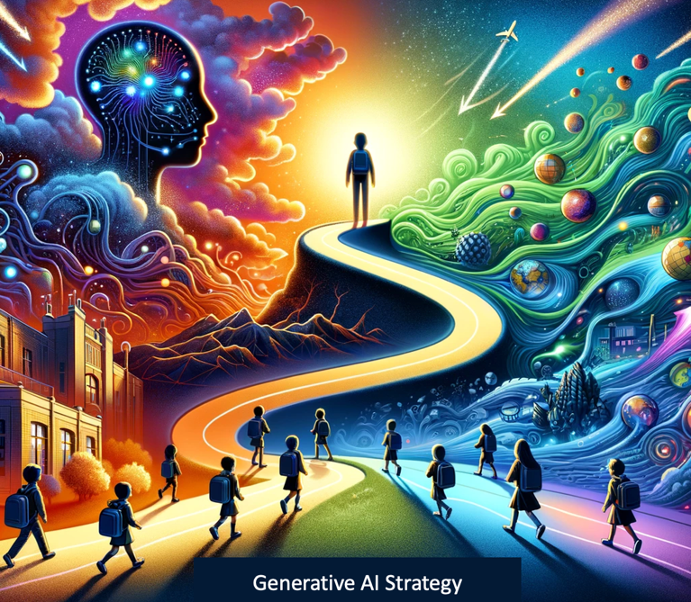
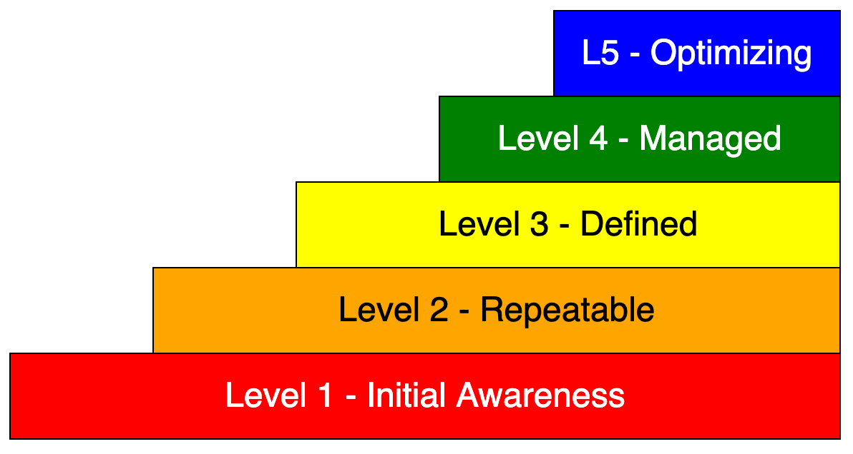
Parts of Your AI Agent Strategy
https://dmccreary.medium.com/using-generative-ai-to-create-a-generative-ai-strategy-db71f53ae6a5
Notes:
Dan

Slide 23
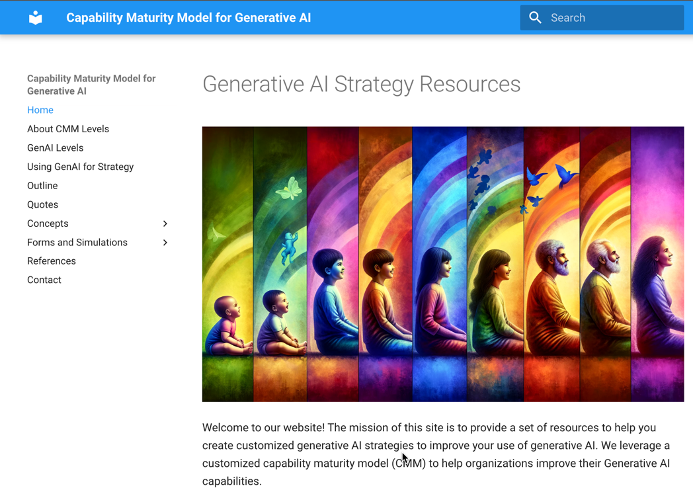
CMM for Gen AI Strategy
https://dmccreary.github.io/cmm-for-genai/
Notes:
Dan

Slide 24
Saffo Quote
Never Mistake a Clear View for a Short Distance
— Paul Saffo
Notes:
Steve

Slide 25
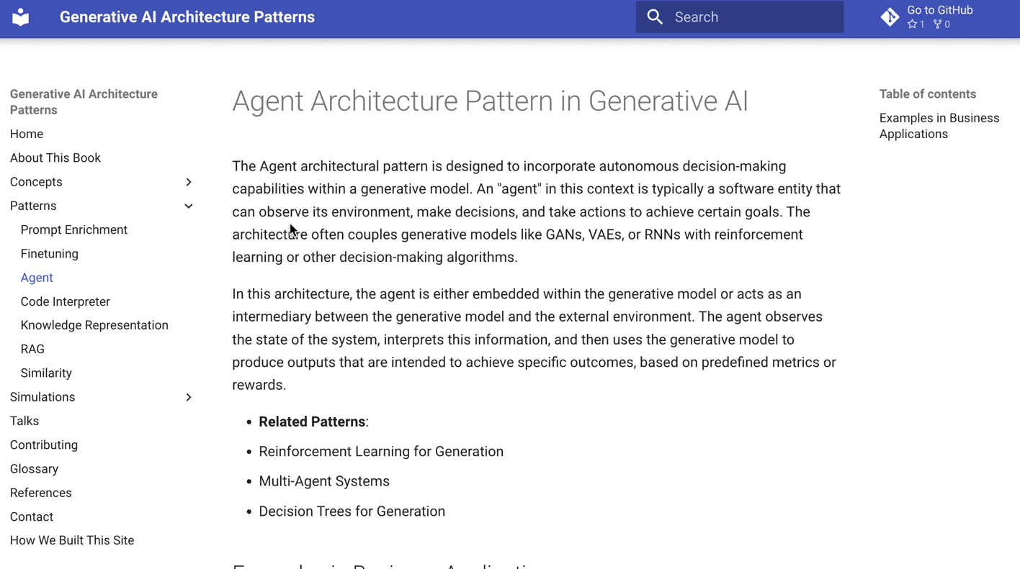
Generative AI Architecture Patterns: Agents
https://dmccreary.github.io/genai-arch-patterns/
Notes:
Dan

Slide 26
References
Presentation Website:
https://dmccreary.github.io/genai-arch-patterns/
CMM for GenAI Tools
https://dmccreary.github.io/cmm-for-genai/
Blogs
https://dmccreary.medium.com/the-generative-turn-for-tech-strategy-502390aafb76
https://dmccreary.medium.com/using-generative-ai-to-create-a-generative-ai-strategy-db71f53ae6a5

Slide 27
Case Studies
Nine case studies of how AI agents can save money
Notes:
Steve

Slide 28
Use Case 1: Personalized Patient Care and Treatment Recommendations
Data Involved:
Structured Data: Electronic Health Records (EHRs), lab results, medication histories.
Semi-Structured Data: Medical device data (e.g., heart rate monitors), patient surveys.
Unstructured Data: Doctor's notes, medical imaging reports, research articles.
Graph Database Use:
Patient Relationship Mapping:
Map relationships between patients, treatments, medications, and outcomes.
Understand comorbidities and their impact on treatment efficacy.
Knowledge Graphs:
Incorporate medical ontologies and relationships between diseases, symptoms, and treatments.
Vector Database Use:
Semantic Search:
Store embeddings of medical texts and patient records for efficient retrieval.
LLM Integration:
Natural Language Processing:
Use LLMs to extract relevant information from doctor's notes and medical reports.
Summarize patient histories and highlight critical findings.
Research Analysis:
LLMs analyze and summarize the latest medical research articles to assist in treatment decisions.
Agentic Architecture Role:
Clinical Decision Support Agents:
Agents assist clinicians by providing evidence-based treatment recommendations.
Continuously learn from new data to refine suggestions.
Data Integration Agents:
Handle data ingestion from various sources and ensure data quality.
Outcome:
Improved Patient Outcomes:
Personalized treatment plans based on comprehensive data.
Efficiency Gains:
Reduced time in data gathering and analysis, allowing clinicians to focus on patient care.
Notes:
Steve

Slide 29
Use Case 2: Drug Discovery and Clinical Trials Management
Data Involved:
Structured Data: Electronic Health Records (EHRs), lab results, medication histories.
Semi-Structured Data: Medical device data (e.g., heart rate monitors), patient surveys.
Unstructured Data: Doctor's notes, medical imaging reports, research articles.
Graph Database Use:
Patient Relationship Mapping:
Map relationships between patients, treatments, medications, and outcomes.
Understand comorbidities and their impact on treatment efficacy.
Knowledge Graphs:
Incorporate medical ontologies and relationships between diseases, symptoms, and treatments.
Vector Database Use:
Semantic Search:
Store embeddings of medical texts and patient records for efficient retrieval.
LLM Integration:
Natural Language Processing:
Use LLMs to extract relevant information from doctor's notes and medical reports.
Summarize patient histories and highlight critical findings.
Research Analysis:
LLMs analyze and summarize the latest medical research articles to assist in treatment decisions.
Agentic Architecture Role:
Research Agents:
Agents use LLMs to autonomously scan new publications and update the knowledge base.
Generate hypotheses for new drug candidates.
Trial Monitoring Agents:
Use LLMs to analyze patient feedback and adverse event reports.
Accelerated Drug Discovery:
Faster identification of promising compounds and treatments.
Risk Reduction:
Early detection of potential issues in clinical trials.
Notes:
Steve

Slide 30
Use Case 3: Finance - Anti-Money Laundering (AML) and Fraud Detection
Data Involved:
Structured Data: Transaction records, customer profiles, account details.
Semi-Structured Data: Communication logs, compliance reports.
Unstructured Data: Emails, call transcripts, social media data.
Graph Database Use:
Network Analysis:
Map relationships between accounts, transactions, and entities.
Detect complex money flow patterns indicative of laundering.
Beneficial Ownership Structures:
Understand hidden relationships in corporate structures.
Vector Database Use:
Natural Language Processing:
Analyze unstructured communications for suspicious content.
Anomaly Detection:
Use embeddings to identify outlier transactions.
Agentic Architecture Role:
Monitoring Agents:
Continuously monitor transactions and flag suspicious activities.
Compliance Agents:
Assist in generating reports and ensuring regulatory compliance.
Outcome:
Regulatory Compliance:
Meet AML regulations effectively.
Financial Security:
Prevent financial losses due to fraud.
Notes:
Steve

Slide 31
Use Case 4: Personalized Financial Advisory
Data Involved:
Structured Data: Client portfolios, market data, financial products.
Semi-Structured Data: Investment reports, client interactions.
Unstructured Data: News articles, social media sentiment, analyst reports.
Graph Database Use:
Relationship Mapping:
Map relationships between clients, financial products, and market trends.
Interest Graphs:
Understand client preferences and behaviors.
Vector Database Use:
Sentiment Analysis:
Analyze news and social media to gauge market sentiment.
Content Recommendations:
Provide clients with personalized insights and articles.
Agentic Architecture Role:
Advisory Agents:
Generate personalized investment advice based on comprehensive data.
Market Monitoring Agents:
Monitor market conditions and alert clients or advisors to significant changes.
Outcome:
Enhanced Client Experience:
Personalized, timely advice increases client satisfaction.
Increased Revenue:
Better client retention and potential for upselling.
Notes:
Steve

Slide 32
Use Case 5: Retail – Supply Chain Optimization
Data Involved:
Structured Data: Inventory levels, sales data, supplier information.
Semi-Structured Data: Shipment tracking logs, vendor reports.
Unstructured Data: Market trends, weather forecasts, social media trends.
Graph Database Use:
Supply Chain Mapping:
Map relationships between suppliers, distribution centers, stores, and customers.
Dependency Analysis:
Understand how disruptions in one part of the chain affect others.
Vector Database Use:
Demand Forecasting:
Analyze unstructured data to predict changes in consumer demand.
Risk Analysis:
Monitor news and social media for events that could impact the supply chain.
Agentic Architecture Role:
Logistics Agents:
Optimize routing, scheduling, and inventory management.
Risk Management Agents:
Proactively identify potential disruptions and suggest mitigation strategies.
Outcome:
Cost Savings:
Reduced inventory costs and improved efficiency.
Resilience:
Ability to adapt quickly to disruptions.
Notes:
Steve

Slide 33
Use Case 6: Personalized Marketing and Customer Engagement
Data Involved:
Structured Data: Purchase history, customer profiles, loyalty programs.
Semi-Structured Data: Web analytics data, email campaign metrics.
Unstructured Data: Product reviews, customer feedback, social media interactions.
Graph Database Use:
Customer Relationship Mapping:
Understand connections between customers, products, and preferences.
Influencer Networks:
Identify influential customers and their networks.
Vector Database Use:
Sentiment Analysis:
Analyze reviews and feedback to understand customer sentiments.
Content Personalization:
Tailor marketing content based on customer interests.
Agentic Architecture Role:
Marketing Agents:
Automate personalized marketing campaigns.
Engagement Agents:
Interact with customers through chatbots, providing personalized assistance.
Increased Sales:
Higher conversion rates due to targeted marketing.
Improved Customer Loyalty:
Enhanced customer satisfaction and repeat business.
Notes:
Steve

Slide 34
Use Case 7: Manufacturing Predictive Maintenance
Data Involved:
Structured Data: Equipment specifications, maintenance schedules.
Semi-Structured Data: Sensor data logs, operational parameters.
Unstructured Data: Technician notes, incident reports.
Graph Database Use:
Equipment Relationship Mapping:
Map relationships between machinery, components, and failure modes.
Process Flow Analysis:
Understand how equipment performance affects production lines.
Vector Database Use:
Anomaly Detection:
Analyze sensor data embeddings to predict equipment failures.
Text Analysis:
Extract insights from technician notes to identify recurring issues.
Agentic Architecture Role:
Monitoring Agents:
Continuously analyze data to predict maintenance needs.
Scheduling Agents:
Optimize maintenance schedules to minimize downtime.
Reduced Downtime:
Preventative actions avoid unexpected equipment failures.
Cost Savings:
Lower maintenance costs and improved efficiency.
Notes:
Steve

Slide 35
Use Case 8: Quality Control and Defect Detection
Data Involved:
Structured Data: Production metrics, defect rates.
Semi-Structured Data: Quality inspection reports.
Unstructured Data: Images of products, operator comments.
Graph Database Use:
Process Mapping:
Map the manufacturing process stages and their interdependencies.
Defect Correlation:
Understand how defects relate to specific processes or components.
Vector Database Use:
Image Analysis:
Use embeddings to detect defects in product images.
Natural Language Processing:
Analyze operator comments for common issues.
Agentic Architecture Role:
Inspection Agents:
Automate quality checks using image recognition.
Feedback Agents:
Provide real-time feedback to operators for immediate corrections.
Outcome:
Improved Quality:
Higher product quality through early defect detection.
Efficiency Gains:
Faster inspection processes and reduced waste.
Notes:
Steve

Slide 36
Use Case 8: Quality Control and Defect Detection
Data Involved:
Structured Data: Production metrics, defect rates.
Semi-Structured Data: Quality inspection reports.
Unstructured Data: Images of products, operator comments.
Graph Database Use:
Process Mapping:
Map the manufacturing process stages and their interdependencies.
Defect Correlation:
Understand how defects relate to specific processes or components.
Vector Database Use:
Image Analysis:
Use embeddings to detect defects in product images.
Natural Language Processing:
Analyze operator comments for common issues.
Agentic Architecture Role:
Inspection Agents:
Automate quality checks using image recognition.
Feedback Agents:
Provide real-time feedback to operators for immediate corrections.
Outcome:
Improved Quality:
Higher product quality through early defect detection.
Efficiency Gains:
Faster inspection processes and reduced waste.
Notes:
Steve

Slide 37
Use Case 9: Energy – Smart Grid
Data Involved:
Structured Data: Energy production and consumption data, grid infrastructure details.
Semi-Structured Data: Sensor readings from smart meters, weather data.
Unstructured Data: Maintenance logs, regulatory documents.
Graph Database Use:
Network Modeling:
Map the electrical grid, including power plants, substations, and consumers.
Load Analysis:
Understand how energy flows and where bottlenecks occur.
Vector Database Use:
Demand Forecasting:
Analyze historical data and external factors to predict energy demand.
Text Analysis:
Process maintenance logs to schedule preventative maintenance.
Agentic Architecture Role:
Inspection Agents:
Automate quality checks using image recognition.
Feedback Agents:
Provide real-time feedback to operators for immediate corrections.
Outcome:
Improved Quality:
Higher product quality through early defect detection.
Efficiency Gains:
Faster inspection processes and reduced waste.
Notes:
Steve

Slide 38
Thank You!

