Slide 1
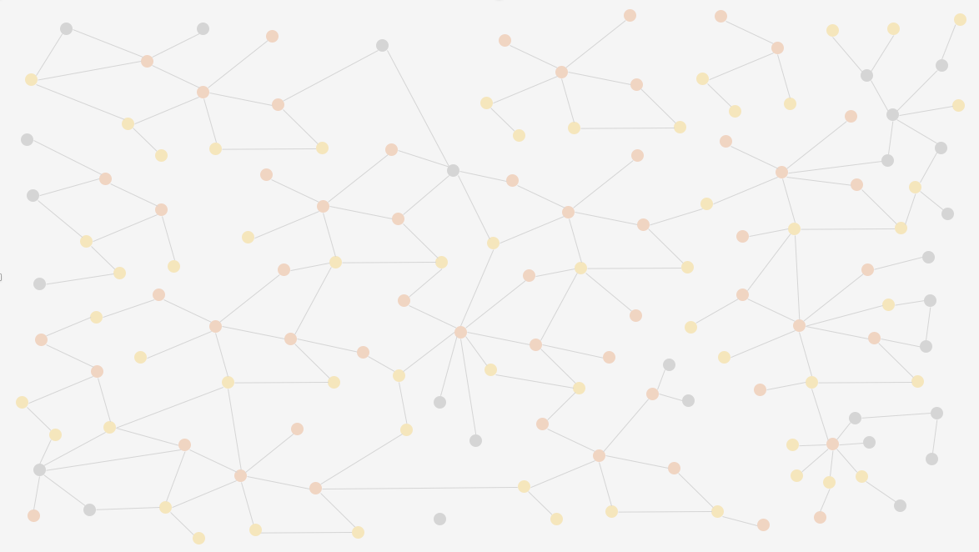
Graph & Systems Thinking Workshop
Using Systems Thinking to Guide Enterprise Knowledge Graph Adoption
Dan McCreary
Dan McCreary

Slide 2
Class Structure
4 hours wall-clock time – 4 50-minute sessions with 10-minute breaks between sessions
Part 1: Introduction
50 minutes overview of graph systems thinking
EKG assumptions, causal loop diagrams
Part 2: Try It
35 minutes, 15 minutes - analysis
Draw causal loop diagrams for things that might impact your EKG evolution
Part 3: Refine Connected Emergence
How does connecting new data sources trigger insight?
Exercise: Predict new insights
Part 4: Working Session
Break up into groups
35 minutes: Focus on key problems that you are interested in
Final 15 minutes: share results
Lecture
Intro
Break
Lab
Try It
Analysis
Break
Lecture
Refine
Lab
Analysis
Break
Lab
Explore
Analysis

Slide 3
Agenda
Enterprise
Knowledge
Graphs
Systems
Thinking
How to use systems thinking to guide the adoption of Enterprise Knowledge Graphs (EKGs)

Slide 4
Assumptions
Enterprise Knowledge Graphs (EKGs) are going to become a central force in organizational dynamics
They are becoming the Central Nervous System (CNS) of organizations
We need tools to manage the adoption and growth of EKGs
Systems Thinking is an appropriate tool to help us guide EKG Growth

Slide 5
EKGs: Today vs Future
Today
Future
Many graph database don’t scale well over 100s of servers
Distributed graph database licenses are prohibitively expensive ($1M/TB)
Only the largest companies can afford them
No specialized graph chips
No built-in machine learning
Most software vendors will have scalable graph solutions
Open source distributed graphs will be common
Even small-medium companies will have robust EKGs
Specialized graph hardware
Out-of-the box machine learning

Slide 6
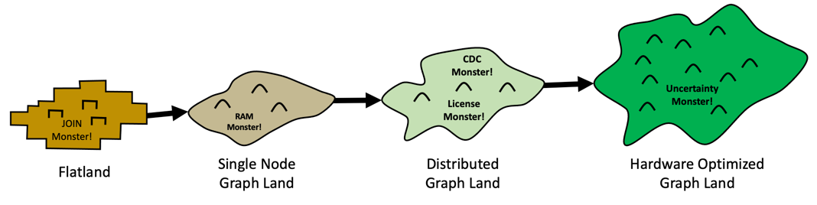
Four Stages of EKG Adoption
Flatland
Single node graph
Distributed graph
HOG Heaven
From Flatland to HOG Heaven
https://towardsdatascience.com/from-flatland-to-hog-heaven-the-four-lands-of-ekg-adoption-945571c09b67
Notes:
https://towardsdatascience.com/from-flatland-to-hog-heaven-the-four-lands-of-ekg-adoption-945571c09b67

Slide 7

HOG Heaven
Hardware optimized graph solutions
100B vertices
Vertex-level role-based access control
Complete views of customers in under 100 milliseconds
Embeddings for every vertex to enable fast similarity at scale
Photo by Bruno van der Kraan on Unsplash

Slide 8

Key Question
How do we choose what entities in our organization should be in our EKG?
Answer: Use Systems Thinking!

Slide 9
Edge of Chaos
Consider two regions of your data model:
1) The part of the world that you have modeled with precision. We call this region the EKG region
2) The part of the world that you have not modeled yet. We call this the “region of chaos”
The border between the EKG and the region of chaos we will call “The Edge of Chaos”
Concepts
Already Modeled in the
Enterprise Knowledge Graph
?
EDGE OF CHAOS
?
?
?
Unmodeled Concepts
?
Notes:
Consider two regions of your data model:
The part of the world that you have modeled with precision. We call this region the EKG region.
The part of the world that you have not modeled yet. We call this the “region of chaos”
The border between the EKG and the region of chaos we will call “The Edge of Chaos”

Slide 10
Example: Provider Recommendation
When our senior members call into our call centers to find a healthcare provider in their area, many of them don’t drive. They only want providers that are on bus routes. However, our current system does not store this information.

Slide 11
Example: Geospacial Models
Country
What should you add?
Regions?
Zip code
State
EDGE OF CHAOS
Metropolitan Areas?
Address
City
Watersheds?
What you have modeled
Roads?
Bus Routes?

Slide 12
Causal Loop Diagram
NPS = Net Promoter Score – how happy are our customers
Fast Right Answers
Increases
More Funding to Calculate Bus Routes
Increases
Member NPS
Less Funding to Calculate Bus Routes
Decreases
Decreases
Slow Wrong Answers
Assumption: Higher NPS promotes higher market share

Slide 13
Predictive Feedback Cycle
More Revenue
Users Purchase More Products
Increases
Good Recommendations
Recommend Product
Poor Recommendations
Decreases
Users Purchase Fewer Products
Less Revenue

Slide 14
The AI Flywheel
Creates
Data
Use to build
Feedback
Machine Learning Model
Prediction
Use to make
Can gather
More data creates more precise machine learning models

Slide 15
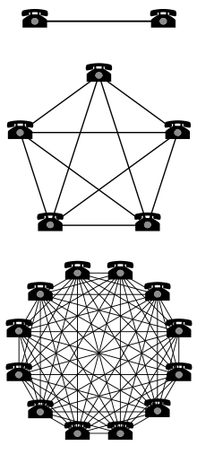
Metcalf’s Law
The value of a telecommunications network is proportional to the square of the number of connected users of the system (n²)
Value
Number of Devices
https://en.wikipedia.org/wiki/Metcalfe%27s_law

Slide 16
Network Effects (Metcalfs’s Law)
Increases Use
Lower Cost Per
Device
More Devices
Manufactured
Higher Adoption
Higher Adoption
Networking
Standard
Decreased Use
Lower Adoption
Use Alternate Standards
Users Can’t Communicate
High Cost Per Device
The value of any device on a network standard grows exponentially as the number of connections increase

Slide 17
Customer Support Chatbot
Chat Log
Use to build intent detection model
Creates
Feedback
Machine Learning Model
Chatbot
Answer
Attempt to answer question
Did that answer
your question?
More feedback is used to build better intent detection models

Slide 18
Data Model Precision and Cost Sharing
Increases Use
Lower Cost Per
Business Unit
EKG Shared by Multiple Business Units
More Insights
High
Data Model
Precision
Decreased Use
Low
Few Insights
Users Fork Their Own Data Marts
High Cost for Each Business Unit
Precise data models allow multiple business units to share EKG infrastructure costs

Slide 19
Data Model Precision and Cost Sharing
Higher Sharing of EKG
Precise Data Models
Cost Savings
High Quality
More
Data Model
Training
Less
Low Quality
Higher Costs
Poor Data Models
Constant Rework
We just modeled this like our RDBMS
Precise data models allow multiple business units to share EKG infrastructure costs

Slide 20
Systems Thinking Terminology
Unintended consequences
Local optimization
Optimization to early

