Slide 1

Graph Systems Thinking Workshop
Using Systems Thinking to Guide Enterprise Knowledge Graph Adoption
Knowledge Graph Conference – April 2022
1pm to 5pm EST
Dan McCreary

Slide 2
Workshop Goal
Enterprise
Knowledge
Graphs
Systems
Thinking
How to use Systems Thinking to guide the adoption of Enterprise Knowledge Graphs (EKGs)

Slide 3
Workshop Description
Graph databases are characterized by their ability to model relationships between entities. Graph models allow for relationship traversals up to 3-5 orders of magnitude faster than traditional relational models.
This performance advantage allows graphs to include more data and different types of data than were possible in the past. This workshop will introduce the fundamental concepts around Enterprise Knowledge Graphs (EKGs) and Systems Thinking and how they fit together. We then will walk the group through a series of exercises to demonstrate how the two concepts are related with examples.

Slide 4

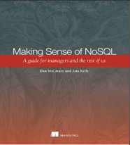
Hello, my name is
Dan
Distinguished Engineer in AI and Graph Technologies at Optum’s Advanced Technology Collaborative
Co-founder of "NoSQL Now!" conference (now part of Dataversity)
Author of "Making Sense of NoSQL" (w. Ann Kelly)
Background in solution architecture, metadata management, NLP, semantics, text analytics and knowledge representation for AI
Personal Mission: Use storytelling to unleash the power of connected data
Disclaimer: All opinions are my own and may not reflect the views of my employer
dan.mccreary@gmail.com
Notes:
My background is a solution architect. I have spent most of the last 20 years understanding how to objectively match business problems to the appropriate technologies. My focus has been on the fast-evolving area of NoSQL databases. I have also had a strong interest in AI, semantics, natural language process and search.

Slide 5
Graph is a “NoSQL” Data Architecture
Relational
Analytical (OLAP)
Key-Value
key
value
key
value
key
value
key
value
Column-Family
Graph
Document
See Chapter 1: https://www.manning.com/books/making-sense-of-nosql
Notes:
OK, now lets take a step back and take a more structure look at where these tools fit into our business processes at Optum.
There are six main database architecture patterns we use when we think of a business problem.
Relational or row-stores
Analytical or OLAP
Key-Value stores – one of the simplest but most extensible data architectures
Column-family stores
Graph stores
and Document stores
Graph is just one of these six. Graph stores are often most closely related to document stores. Both Graph and document stores have the ability for new data to be added to structures without needing to remodel the data. We call these systems schema-free or schema agnostic. They are a key driver for highly agile systems.
Your systems may often draw on two or more of these systems. Databases that support multiple data models are called multi-model databases. They prevent us from having to store the same data over in multiple systems for transactions, search and analytics. Multi-modal systems that integrate graph technologies are also an emerging trend.

Slide 6
Class Structure
4 hours wall-clock time – 4 50-minute sessions with 10-minute breaks between sessions
Part 1: Introduction
50 minutes overview of graph systems thinking
EKG assumptions, causal loop diagrams
Part 2: Try It
35 minutes, 15 minutes - analysis
Draw causal loop diagrams for things that might impact your EKG evolution
Part 3: Refine Connected Emergence
How does connecting new data sources trigger insight?
Exercise: Predict new insights
Part 4: Working Session
Interactive discussions – questions and answers
35 minutes: Focus on key problems that you are interested in
Final 15 minutes: share results
Lecture
Intro
Break
Lab
Try It
Analysis
Break
Lecture
Refine
Lab
Analysis
Break
Lab
Explore
Analysis

Slide 7




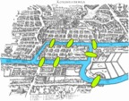
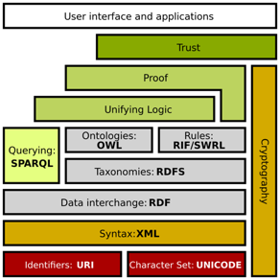
Key Developments in Graph as KR
Google’s
Knowledge
Graph
“Things Not
Strings”
May 2012
Euler Solves
7 Bridges of Königsberg
1736
Sir Tim’s
Vision RDF
2001
Labeled
Property
Graph
Neo4j 1.0
2010
On
Intelligence
2005
W3C SPARQL
2008
LPG
in AI
2018
AlexNet
Sept 2012
Graphs Rise
Semantic Web Stack

Slide 8
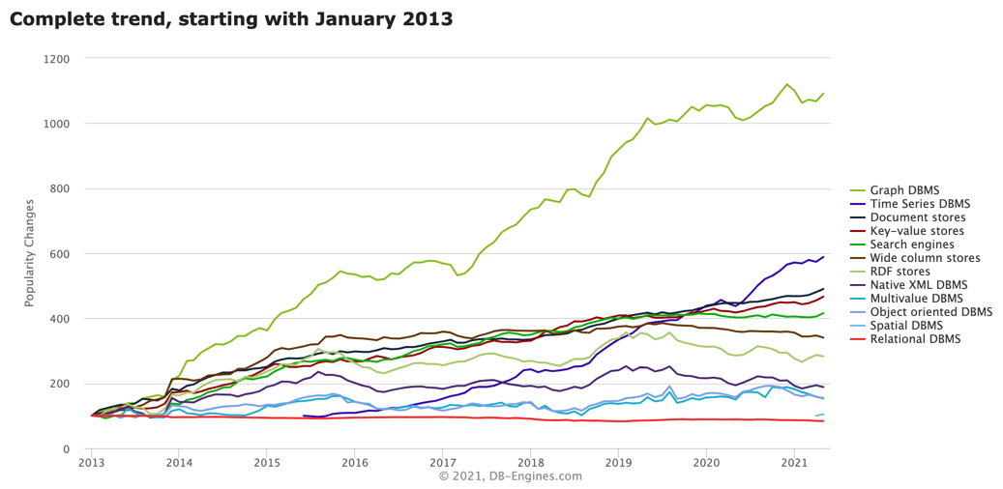
Graph Databases are Hot!
Graph Databases
Notes:
https://db-engines.com/en/ranking_categories

Slide 9
EKG Architects Questions
What other data should we include in our graph?
What benefits could we gain if we began to think of our organization as a more holistic and integrated system?
How do the diverse datasets interact to give us deeper insights into how to optimize our operations?

Slide 10
Objectives for the Workshop
Define the characteristics of an Enterprise Knowledge Graph (EKG)
Allow participants to understand how EKG data modeling processes determine what is stored in an enterprise knowledge graph
Learn the fundamentals of Systems Thinking and how large graph models help us with Systems Thinking
See the role of time in data models (temporal modeling)
How to align the EKG data model with enterprise strategy (lower costs, increase revenue, increase agility)
Learn how to predict the value of insights as you connect more systems together

Slide 11
Outline for the Workshop
What is an Enterprise Knowledge Graph?
What is Systems Thinking?
What are predictive graph models?
What are feedback loops?
What are externalities?
How do we look for unintended consequences?
How do we decide what new data to model?
How do large, diverse connected datasets change the way we think?
What new insights can we discover?
How do we decide what datasets can provide the most value to our system?

Slide 12
Workshop Philosophy
1/3 lecture – light introduction
1/3 trying out systems thinking on your challenges
1/3 shared analysis of what worked/what did not work
There are no right answers, only trade offs

Slide 13
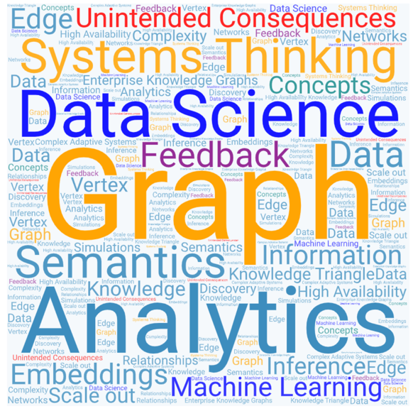
Terminology
https://dmccreary.github.io/graph-systems-thinking/glossary/

Slide 14
Assumptions
Enterprise Knowledge Graphs (EKGs) are going to become a central force in organizational dynamics
They are becoming the Central Nervous System (CNS) of organizations
We need tools to manage the adoption and growth of EKGs
Systems Thinking is an appropriate tool to help us guide EKG Growth

Slide 15
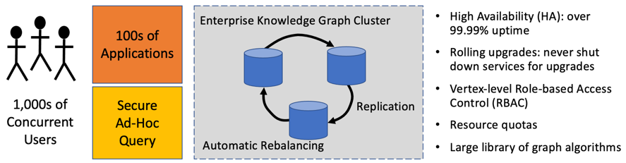
Definition of an Enterprise Knowledge Graph
An Enterprise Knowledge Graph (EKG) is a type of graph database designed to scale-out to meet large organizations' demanding requirements to store diverse forms of connected knowledge.

Slide 16







Seven Measure of Scale-out Graphs
Scale-out data size
Scale-out compute
Scale-out security
Scale-out manageability
Scale-out data quality
Scale-out algorithms
Scale-out query
Notes:
Scale-out data size — adding more RAM, SSD, and spinning disk should not interrupt services
Scale-out compute — adding additional CPUs should be possible without service interruption
Scale-out security — adding more projects with more roles and more users should not impact system performance
Scale-out manageability — monitoring the continual performance of 100s of applications executing thousands of graph queries is a complex process.
Scale-out data quality —EKG software must make it easy to perform data validation as it enters the EKG and as it evolves within the EKG as new relationships are inferred
Scale-out algorithms — EKGs need to run an extensive library of standard graph algorithms and a new generation of machine-learning algorithms that create graph embedding
Scale-out query — EKGs need query software that allows developers to express distributed queries in high-level query languages

Slide 17
Seven Measure of Scale-out Graphs
Scale-out data size — adding more RAM, SSD, and spinning disk should not interrupt services
Scale-out compute — adding additional CPUs should be possible without service interruption
Scale-out security — adding more projects with more roles and more users should not impact system performance
Scale-out manageability — monitoring the continual performance of 100s of applications executing thousands of graph queries is a complex process.
Scale-out data quality —EKG software must make it easy to perform data validation as it enters the EKG and as it evolves within the EKG as new relationships are inferred
Scale-out algorithms — EKGs need to run an extensive library of standard graph algorithms and a new generation of machine-learning algorithms that create graph embedding
Scale-out query — EKGs need query software that allows developers to express distributed queries in high-level query languages
https://dmccreary.medium.com/a-definition-of-enterprise-in-ekgs-561283d37deb

Slide 18
EKGs vs Departmental Graphs
EKGs deal with all the information in an organization and how to lower total costs and increase the agility of an organization
Departmental Graph deal with the concerns of a single department
Both are valid types of projects, but they take a different view of what the “System” is!
Remember to define what each group means by “System”
Does your “system” include your organizations impact to society and pollution on planet Earth?
Company
Dept A
Dept B

Slide 19
EKGs: Today vs Future
Today
Future
Many graph database don’t scale well over 100s of servers
Distributed graph database licenses are prohibitively expensive ($1M/TB)
Only the largest companies can afford them
No specialized graph chips
No built-in machine learning
Most software vendors will have scale-out graph solutions
Open-source distributed graphs will be common
Even small-medium companies will have robust EKGs
Specialized graph hardware
Out-of-the box machine learning

Slide 20
General CPU Hardware vs. Graph Hardware
Intel Xeon CPU
1503 Defined x86 Instructions
Complex Instruction Set Computer (CISC)
50 Instructions
Needed
Reduced Instruction Set Computer (RISC)
Fewer Instructions -> More Cores
Most graph traversal algorithms only need simple pointer hopping
How efficient are CPU and GPUs at running graph algorithms?
No need for floating point
No need for matrix multiplication

Slide 21
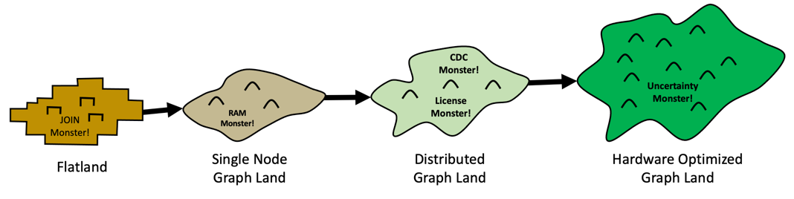
Four Stages of EKG Adoption
Flatland
Single node graph
Distributed graph
HOG Heaven
From Flatland to HOG Heaven
https://towardsdatascience.com/from-flatland-to-hog-heaven-the-four-lands-of-ekg-adoption-945571c09b67
Notes:
https://towardsdatascience.com/from-flatland-to-hog-heaven-the-four-lands-of-ekg-adoption-945571c09b67

Slide 22

HOG Heaven
Hardware optimized graph solutions
100B vertices
Vertex-level role-based access control
Complete views of customers in under 100 milliseconds
Embeddings for every vertex to enable fast similarity at scale
Photo by Bruno van der Kraan on Unsplash

Slide 23

Key Question
How do we choose what entities in our organization should be in our EKG?
Answer: Use Systems Thinking!

Slide 24
Edge of Chaos
Consider two regions of your data model:
1) The part of the world that you have modeled with precision. We call this region the EKG region
2) The part of the world that you have not modeled yet. We call this the “region of chaos”
The border between the EKG and the region of chaos we will call “The Edge of Chaos”
Concepts
Already Modeled in the
Enterprise Knowledge Graph
?
EDGE OF CHAOS
?
?
?
Unmodeled Concepts
?
Notes:
Consider two regions of your data model:
The part of the world that you have modeled with precision. We call this region the EKG region.
The part of the world that you have not modeled yet. We call this the “region of chaos”
The border between the EKG and the region of chaos we will call “The Edge of Chaos”

Slide 25
Example: Provider Recommendation
When our senior members call into our call centers to find a healthcare provider in their area, many of them don’t drive. They only want providers that are on bus routes. However, our current system does not store this information.

Slide 26
Example: Geospatial Models
Country
What should you add?
Regions?
Zip code
State
EDGE OF CHAOS
Metropolitan Areas?
Address
City
Watersheds?
What you have modeled
Roads?
Bus Routes?

Slide 27
Exercise
How do you currently decide what items to put in your EKG?

Slide 28
What is a System?
A collection of components that interact together to produce some sort of behavior of the whole
Systems can have subsystems

Slide 29
















Wonderful Resources for Learning Systems Thinking
Don’t be intimidated!
Systems Thinking really is about a dozen core concepts
Most people can learn the basic principals of Systems Thinking in a few days

Slide 30




Tragedy of The Commons
Farmer Brown
Farmer Smith
Farmer Cooper
The Commons
Farmer Jones
Farmer Baker
Farmer Anderson

Slide 31
Tragedy of The Commons
A situation in economic science when individual users, who have open access to a resource unhampered by shared social structures or formal rules that govern access and use, act independently according to their own self-interest and, contrary to the common good of all users, cause depletion of the resource through their uncoordinated action.
The more everyone uses a resource, the less valuable it becomes.
https://en.wikipedia.org/wiki/Tragedy_of_the_commons

Slide 32
EKGs are Also Shared Resources
Marketing
Product Development
Sales
“The Enterprise
Knowledge Graph”
Customer Support
Information
Technology
Research

Slide 33
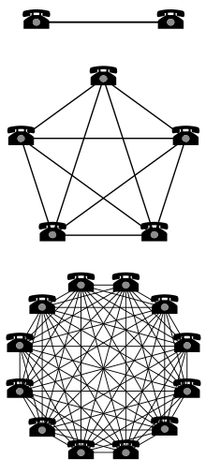
Metcalf’s Law
The value of a telecommunications network is proportional to the square of the number of connected users of the system (n²)
Value
The more everyone uses a standard, the more valuable it becomes.
Number of Devices
https://en.wikipedia.org/wiki/Metcalfe%27s_law

Slide 34
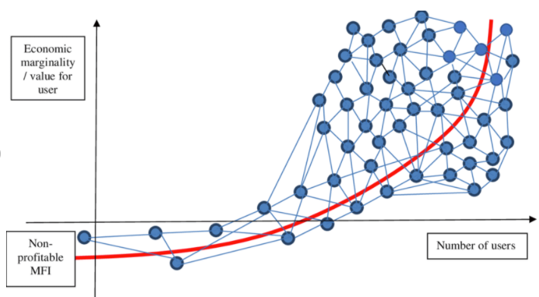
Visualizing Metcalf Law
The valuation of social networks is not just the users but the number of connections
Notes:
https://www.researchgate.net/publication/333017873_THE_VALUATION_OF_INTERNET_COMPANIES_AND_SOCIAL_NETWORKS

Slide 35
Project Cost vs Connections
As more data is added to an enterprise knowledge graph there are fewer new data sources to load.
Average
Analytical
Project
Cost
0%
50%
100%
Percent of Data Already in the Graph

Slide 36
Conway’s Law
Any organization that designs a system will produce a design whose structure is a copy of the organization's communication structure.
Dept A
Lib A
Dept B
Dept C
Lib B
Lib C
Dept D
Dept E
Lib D
Lib E
Corollary: The structure of our enterprise knowledge graph will tend to reflect our our org chart, not what is ideal for serving our customers!

Slide 37
Query Response vs. Time of Day
Average
Query Response Time in
Seconds
(M-F)
10
Lunch
5
2
Time of Day
Midnight
8 am
Noon
5pm
Many users fighting for a shared resource with limited capability
The more you use it the lower the value to others

Slide 38
Systems Thinking Definition
Systems Thinking is a holistic approach to analysis that focuses on the way that a system's constituent parts interrelate and how systems work over time and within the context of larger systems.
A Definition of Systems Thinking: A Systems Approach
Ross D. Arnold and Jon P. Wade
https://www.sciencedirect.com/science/article/pii/S1877050915002860

Slide 39
Project Silos vs Systems Thinking
Isolated Silo View
Systems Thinking View
Project
Project
Project
Project
Project
Project
Project
Project
Project
Project
Each project is an independent silo of effort
The success of any project will not impact the success of other projects
Project order is not relevant and project value is static in time
Project costs and benefits are easy to represent in a simple spreadsheet
The spreadsheet may not reflect the complexities of the real world
Projects are dependent on another project success
The success of foundational projects may have a dramatic impact on other projects (x10 faster)
Project order is relevant and deferring customer benefit is needed until foundational projects are complete
Requires a deep understanding of how resources created by one project can be leveraged by other projects
Reflects the tacit knowledge gained over years of working in research projects and observing different teams' ability to build reusable artifacts

Slide 40
Centralized vs Decentralized Control
Central Control
Decentralized Control
Business
Unit
Business
Unit
Centralized
IT Decision
Business
Unit
Business
Unit
IT decisions are made by individual business units
Acquired companies frequently have their own IT infrastructure that is incompatible with other acquired organizations
IT decisions are made in a centralized IT organization
Example: Amazon – centralized dictates on sharing data

Slide 41
Exercise
How do you determine what projects to start?
How would Systems Thinking change project priorities?

Slide 42
Connected Data Strategy
Connected Data Strategy: An Enterprise Data Strategy pattern that brings focus to the business value of connecting disparate silos of data.
How much value?
At what cost?
$
$$$$
Lower Value
Higher Value

Slide 43
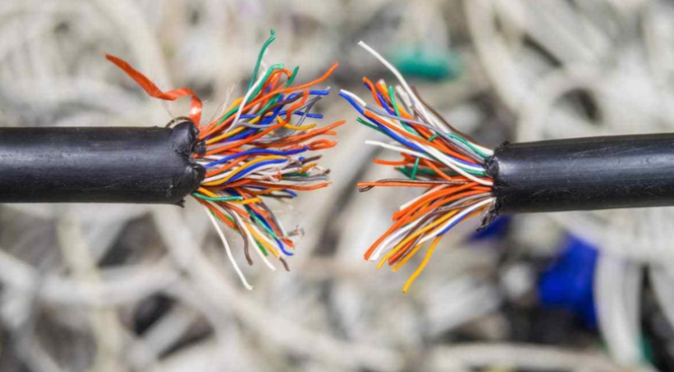
My Favorite Kendall Clark Quote
Unconnected Data is a Liability
- Kendall Clark
https://www.stardog.com/blog/unconnected-data-is-a-liability

Slide 44
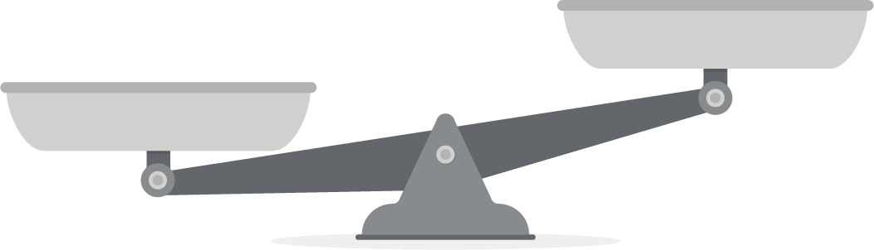
Goal: Objective Weighing of Pros and Cons
Graph Cost
New Insights
Kafka Streaming Cost
Easy to measure
Hard to measure
CDC Cost
Data Science
Productivity
Member Journey
Cons
Pros
We are starting to learn the benefits of connected data: Customer 360
It takes time and effort to create high-quality connected data
Can we objectively measure each of the pros and cons?
What is the value of “new insights?”
How is our decision making driven by what is easy to measure?

Slide 45
Causal Loop Diagram
NPS = Net Promoter Score – how happy are our customers
Fast Right Answers
Increases
More Funding to Calculate Bus Routes
Increases
Member NPS
Less Funding to Calculate Bus Routes
Decreases
Decreases
Slow Wrong Answers
Assumption: Higher NPS promotes higher market share

Slide 46
Predictive Feedback Cycle
More Revenue
Users Purchase More Products
Increases
Good Recommendations
Recommend Product
Poor Recommendations
Decreases
Users Purchase Fewer Products
Less Revenue

Slide 47
The AI Flywheel
Creates
Data
Use to build
Feedback
Machine Learning Model
Prediction
Use to make
Can gather
More data creates more precise machine learning models

Slide 48
Network Effects (Metcalfs’s Law)
Increases Use
Lower Cost Per
Device
More Devices
Manufactured
Higher Adoption
Higher Adoption
Networking
Standard
Decreased Use
Lower Adoption
Use Alternate Standards
Users Can’t Communicate
High Cost Per Device
The value of any device on a network standard grows exponentially as the number of connections increase

Slide 49
Customer Support Chatbot
Chat Log
Use to build intent detection model
Creates
Feedback
Machine Learning Model
Chatbot
Answer
Attempt to answer question
Did that answer
your question?
More feedback is used to build better intent detection models

Slide 50
Data Model Precision and Cost Sharing
Increases Use
Lower Cost Per
Business Unit
EKG Shared by Multiple Business Units
More Insights
High
Data Model
Precision
Decreased Use
Low
Few Insights
Users Fork Their Own Data Marts
High Cost for Each Business Unit
Precise data models allow multiple business units to share EKG infrastructure costs

Slide 51
Data Model Precision and Cost Sharing
Higher Sharing of EKG
Precise Data Models
Cost Savings
High Quality
More
Data Model
Training
Less
Low Quality
Higher Costs
Poor Data Models
Constant Rework
We just modeled this like our RDBMS
Precise data models allow multiple business units to share EKG infrastructure costs

Slide 52
Org Chart vs Influence Diagram
Promoters
CEO
Neutral
CIO
Detractors
VP1
VP1
Architect
Director
Developer
Developer

Slide 53
Systems Thinking Terminology
Archetypes
Balancing Loop
Digital Twin
Dynamics
Feedback
Influence Diagram
Unintended consequences
Local optimization
Emergence
Flow
Leverage Points
Limiting Factor
Nonlinear Relationships
Resilience
Reinforcing Loop
Self Organization
Sustainability
Unintended consequences

Slide 54


From Data Scientist to Knowledge Scientist
Knowledge
Graph
Fast Path with Feedback
Insights
70% of
your time
Information
Slow Path
Data
Data Engineering

Slide 55
Customer-Centric EKG Strategy
Demographics
Purchases
Search
Customer
Returns
Page Views
Reviews
Put your customer at the center of your EKG

Slide 56
Modeling Precision
All models are wrong. Some models are useful. - George Box
Graph data models are better at modeling the real world
Models that are correct are easily shared across business units

Slide 57
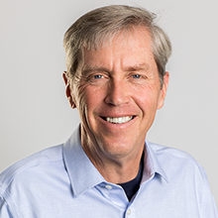
Jeff Hawkins Quote
Representation is the hardest part of AI.
- Jeff Hawkins
Intelligence involves creating models of the world in our mind and predicting how these models evolve over time.

Slide 58

A Thousand Brains Theory
Understand the role of modeling the outside world
Understand how reference frames are used to store knowledge
Understand the role of special knowledge representation

Slide 59
Advanced Systems Theory
Dynamical Systems
SUBSET_OF
Complex Adaptive System
RELATED_TO
Systems Thinking
Critical
Thinking
RELATED_TO
Fields of Study

Slide 60
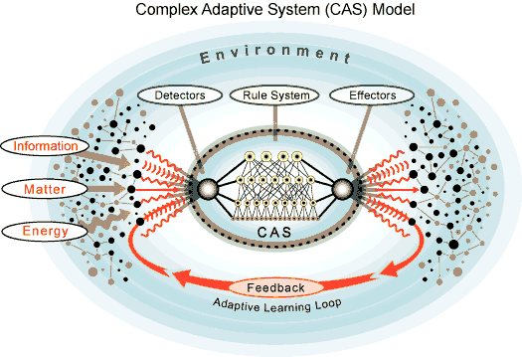
Complex Adaptive System As Rules
Customers
Products
Competitors
Inspired by http://www.calresco.org/lucas/cas.htm

Slide 61

Graphs
Relational Databases
Graph Databases
The Art of Clean Up: Life Made Neat and Tidy by Ursus Wehrli

Slide 62



Thank You!
Generates
Dan.McCreary@gmail.com
Course
Feedback
https://www.linkedin.com/in/danmccreary
https://dmccreary.medium.com/
Improves
@dmccreary

