Slide 1

University of Minnesota Senior Design Lecture AI, Agents and Intelligent Textbooks Overcoming Fear and Embracing Change
Dan McCreary
April 5th, 2025

Slide 2
Today’s Agenda
The Accelerating Pace of Change of AI
Understanding Minnesota’s FUD factors
The “deer in the headlights” syndrome
Recent events in agentic IDEs
The impact to software and hardware acceleration
Example: The $20 DIY spectrum analyzer
The Five Levels of Intelligent Textbooks
Tip and Tricks for using chatbots and agentic IDE
Decomposition, context and testing
Dan’s Prediction: LLM, Agents and Enterprise Knowledge Graphs (EKGs)
Q&A – 10 minutes

Slide 3
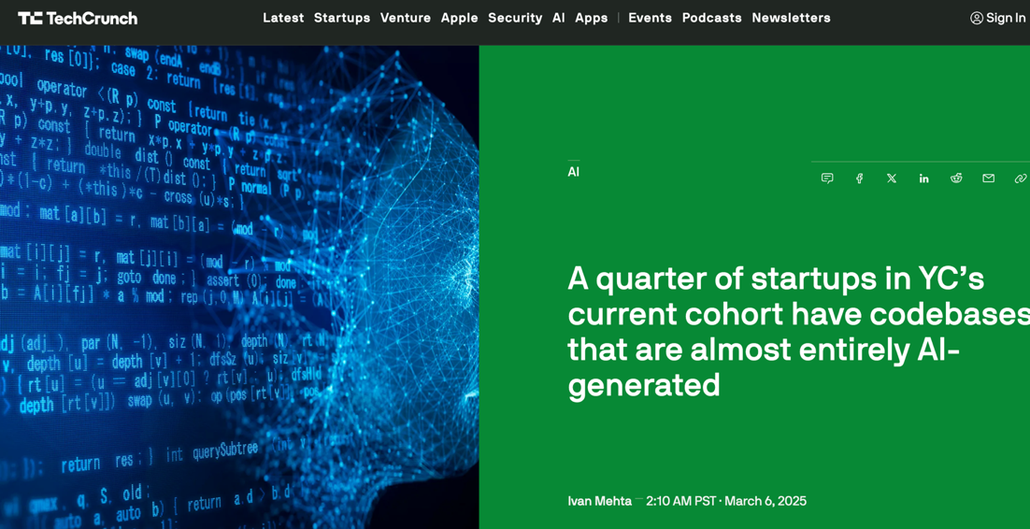
Recent Headline in TechCrunch

Slide 4
2025 Y-Combinator Statistic
In the 2025 Bay Area Y-Combinator “Sharktank” for venture-capital funding, in ¼ of the companies, over 95% of their code was written by generative AI
25%
Over 95% Written by AI
Total Startups
Percent of Code Written by AI

Slide 5
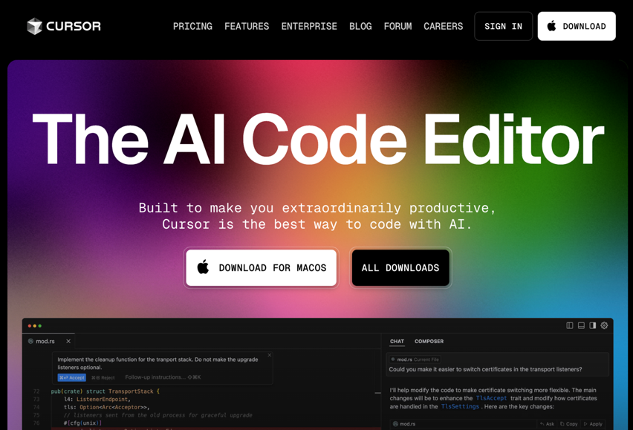
Leading Agentic AI IDE: Cursor
Not Google
Not Amazon
Not Microsoft
Not OpenAI
Mostly powered by Anthropic Claude

Slide 6
Review of Systems Thinking Causal Loop Diagrams
B
R
Balancing Loops
Example: Thermostat
Reinforcing Loops
Example: Nuclear Reaction

Slide 7
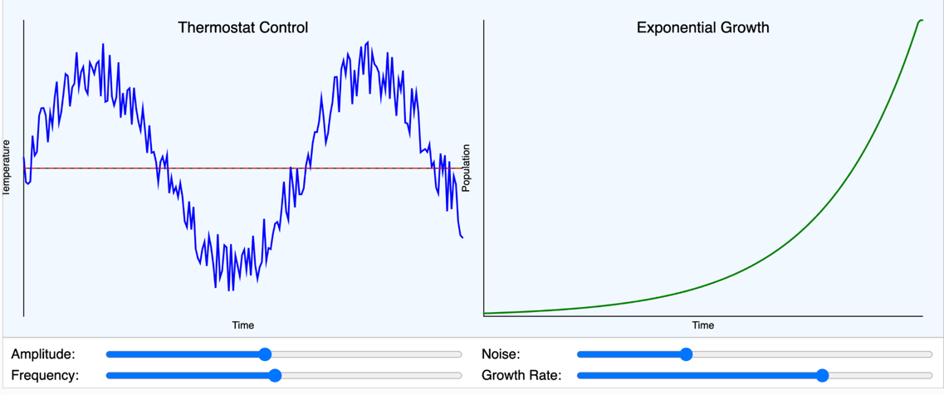
Balanced vs. Reinforcing
B
R

Slide 8
AI Agent Positive Feedback Loop
AI Agent
R
Used to Create

Slide 9
Agent MCP Positive Feedback Loop
MCP
Model
Context
Protocols
Used to Create
AI Agent
R
Increase Capabilities
R
Used to Create

Slide 10
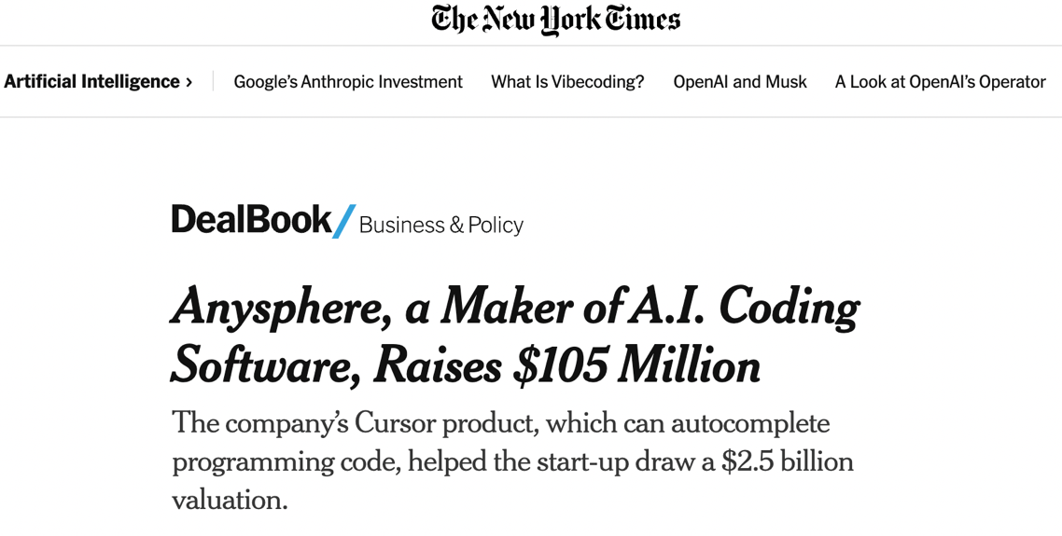
1/14/2005
https://www.nytimes.com/2025/01/14/business/dealbook/anysphere-cursor-25-billion-valuation.html

Slide 11
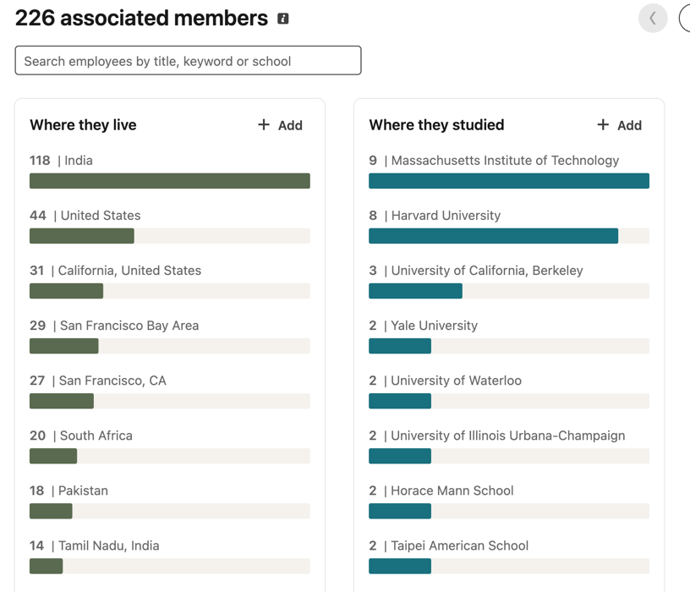
Anysphere has 226 employees

Slide 12
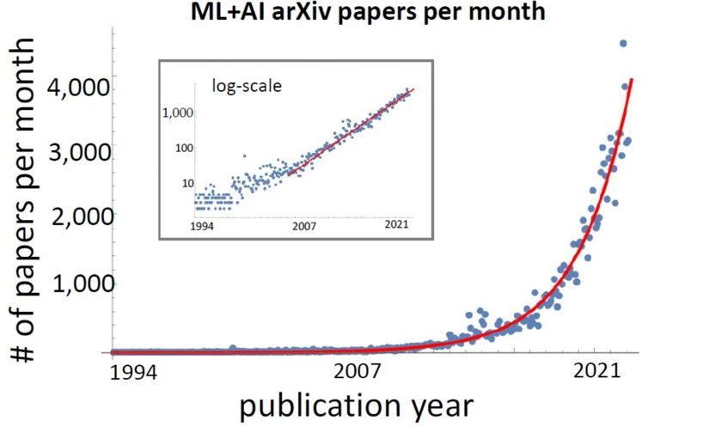
Rate of Change is Getting Faster
Doubling every 24 months
https://www.reddit.com/r/singularity/comments/xwdzr5/the_number_of_ai_papers_on_arxiv_per_month_grows/

Slide 13
Key Events in Agentic AI
1956 to this week
Semantic Web article in Scientific American (2001)
AlexNet (2014)
OpenAI Release ChatGPT (2022)
Meta open sources Llama LLM (2023)
DeepSeek R1 (2023)
Y-Combinator survey shows that ¼ of companies use AI to generate over 95% of their code (2024)
“Vibe Coding”
Cursor
Codium LightSpeed
Manus

Slide 14
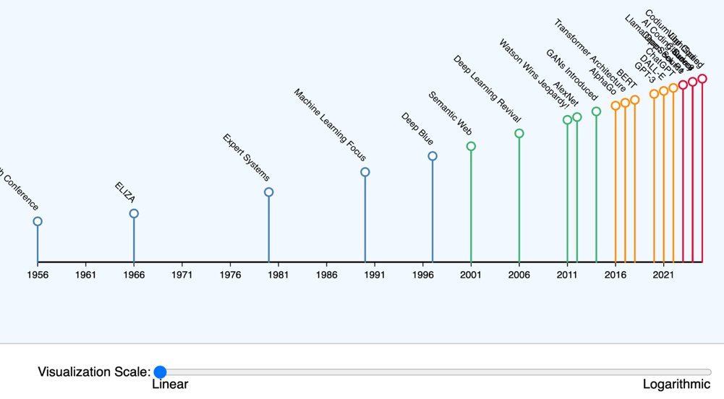
Accelerating Pace of AI Innovation
https://dmccreary.github.io/intelligent-textbooks/sims/ai-pace-accelerating/

Slide 15

A Young Lady's Illustrated Primer A fully adaptive intelligent learning device Storytelling customized to each child’s needs From Neal Stephenson’s 1995 Cyberpunk Novel “Diamond Age”

Slide 16
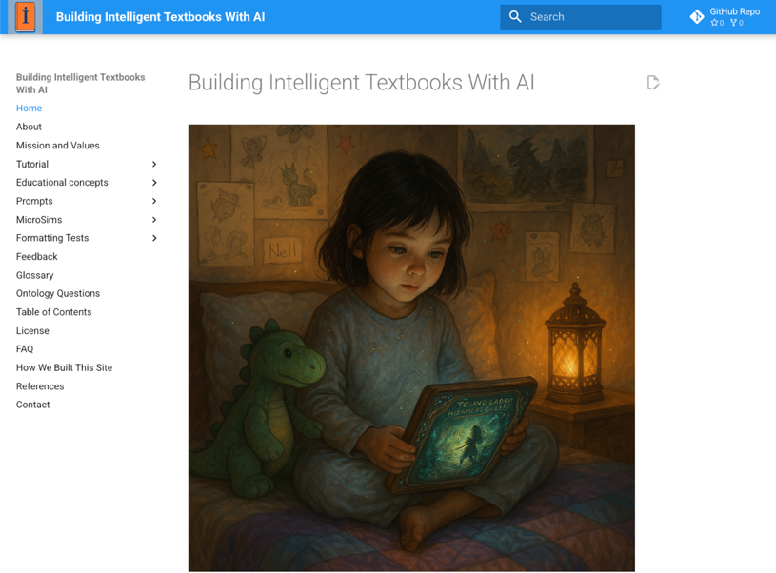
https://dmccreary.github.io/intelligent-textbooks/

Slide 17
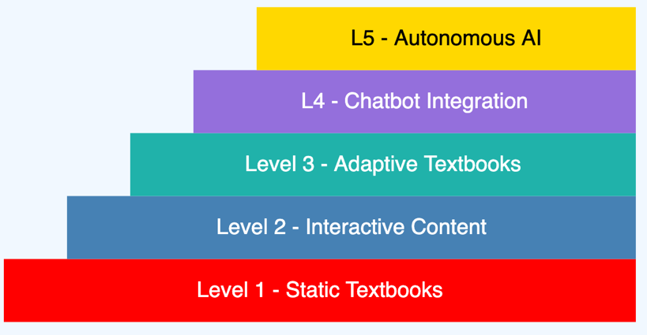
Five Levels of Intelligent Textbooks
https://dmccreary.github.io/intelligent-textbooks/sims/book-levels/

Slide 18
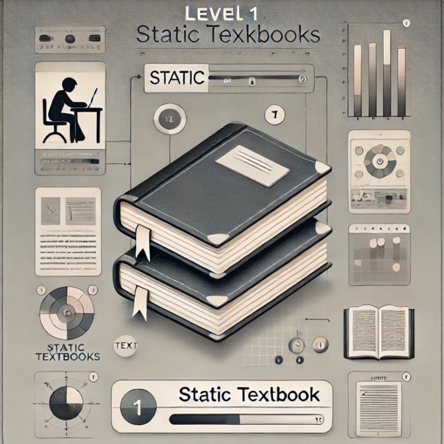
Level 1
Static textbook
Table of contents
Glossary of terms
Index
Static charts and figures
No interactivity

Slide 19
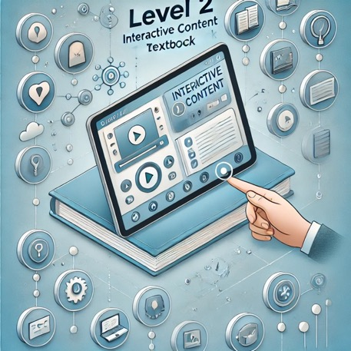
Level 2 – Interactive content
Online interactive
Links
Interactive charts
Simulations (MicroSims)
Animations
Level 2.9 took a lot of work before generative AI
Learning graphs
Simple chatbots for question answering
No personalization

Slide 20
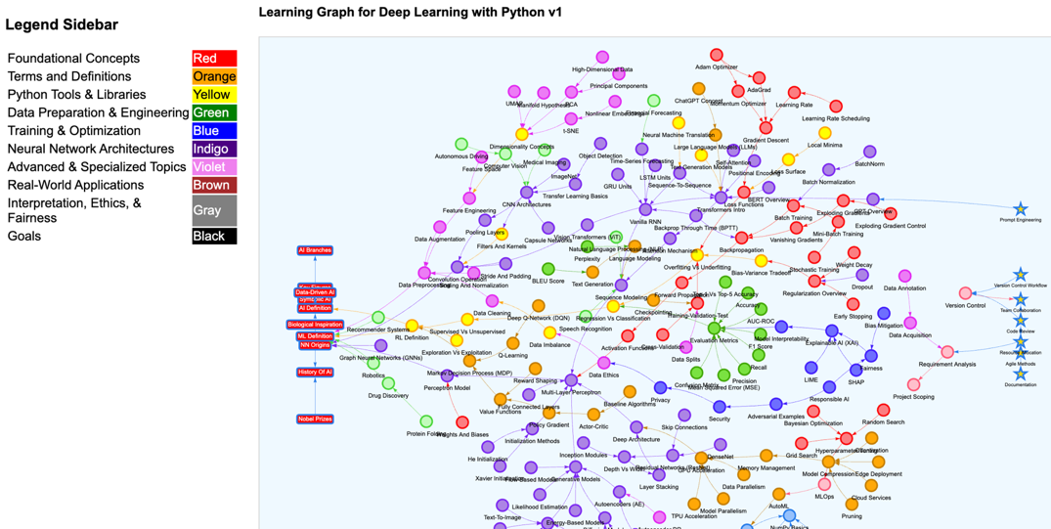
Learning Graph
https://dmccreary.github.io/deep-learning-course/sims/learning-graph/view-graph.html

Slide 21
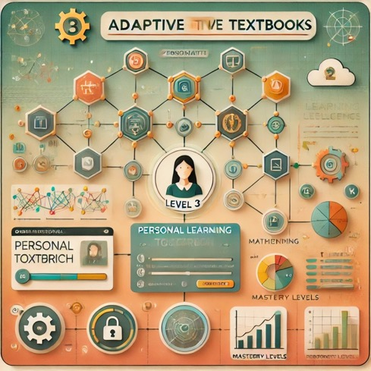
Level 3: Personalized Adaptive Textbooks
Personal Learning Paths: Customized content sequences based on prerequisite knowledge
Context Aware Chatbots: They know your learning goals and what you have already mastered
Concept Dependency Graphs: Visual maps showing how concepts connect
Personal Learning Graphs: Tracking individual mastery of concepts
Simple Algorithms for Recommendations: Content adapts based on quiz results or user input
Privacy Considerations: Begins to collect personal data, emphasizing data protection
Regulatory: Must comply with GDPR guidelines about student privacy

Slide 22
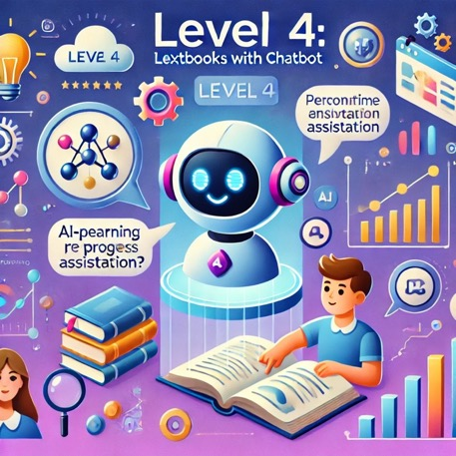
Level 4 – Chatbot
Sophisticated content generation
Personalized content
Conversational textbook
Answer’s still grounded by knowledge graphs that have been peer reviewed for quality

Slide 23
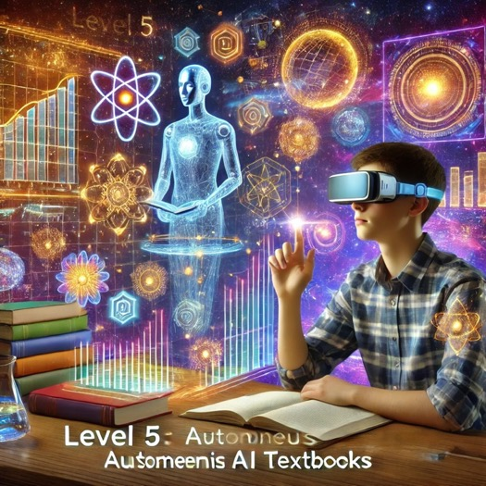
Level 5
“The Primer” as in Neal Stephenson’s book
Fully personalized
Generates complex simulations and immersive VR experiences on demmand

Slide 24

Being at the Right Place at the Right Time
2008 paper on agents used RDF in the browser
Ran as a Firefox plugin and helped you shop
Based on simple rules

Slide 25
Agents: 0 to $2.5B in 18 Years
Dan published first agent paper in 2008
Started using GPT-3 in 2021 to generate lesson plans for teachers
Prompts were very long and contained many examples
As LLMs got bigger, prompts got smaller
LLMs began to be easier to use and generated consistent Markdown
In 2022, we began to use GPT to write code - 10 lines at most
Nov 30, 2022 - ChatGPT introduced by OpenAI
In July 2023, Val Lockhart coined the term "MicroSim."
2023 Cursor IDE launched
January 2025 Anysphere Cursor valued at $2.5 billion
¼ of Y-Combinator startups had over 95% of their code written by AI
Most new agents and MCPs are being written by agents

Slide 26
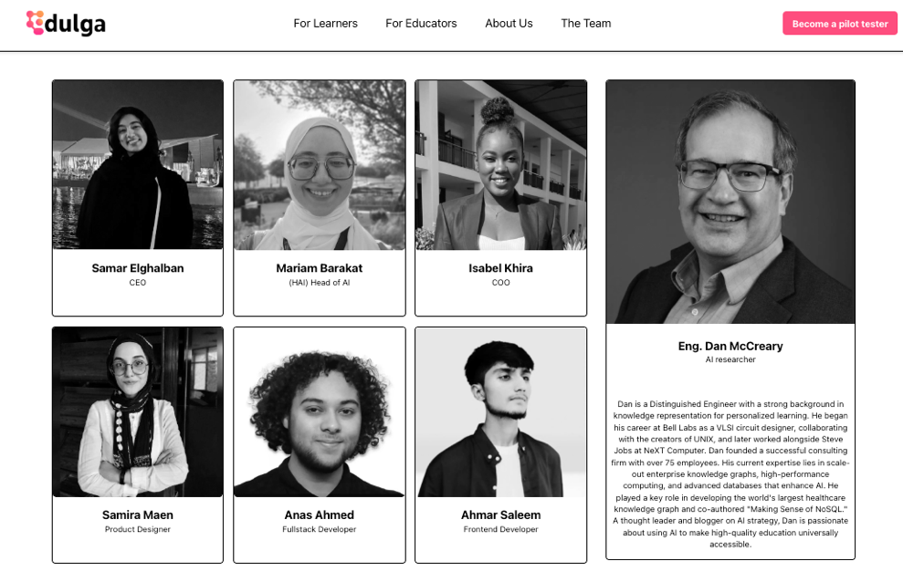
https://www.edulga.ai/team

Slide 27
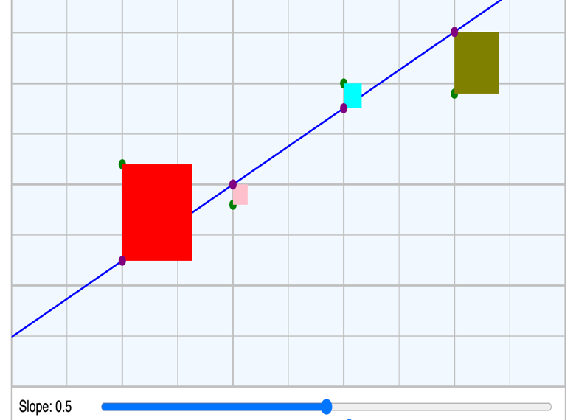
Least Squares
https://dmccreary.github.io/microsims/sims/least-squares/

Slide 28
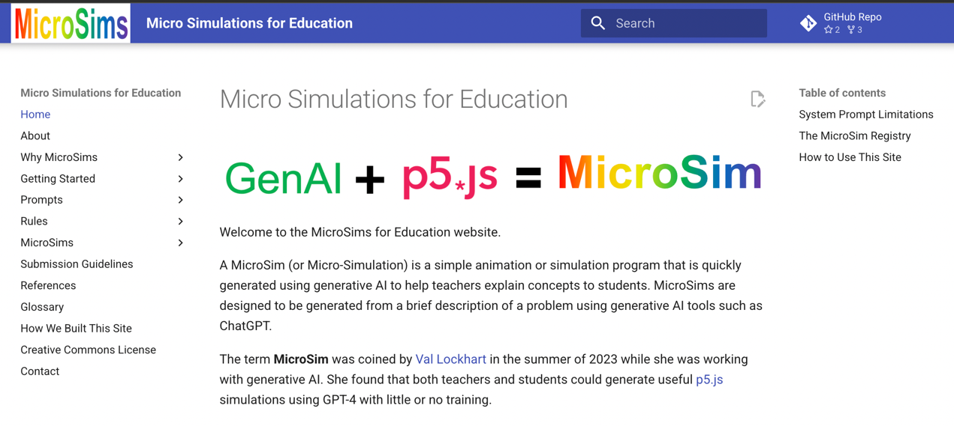
https://dmccreary.github.io/microsims/

Slide 29
Knowledge Representation
“The key to artificial intelligence has always been the representation.”
Jeff Hawkins

Slide 30
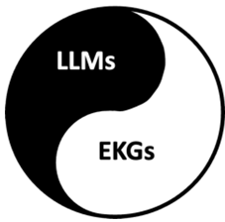
The Complementary Nature of LLMs and EKGs
Large Language Models
Statistical
Models of language
Designed to predict the next token
Likely to hallucinate
Contains Knowledge of the Outside World
Enterprise Knowledge Graphs
Deterministic
Models of your customer
Designed for holistic knowledge traversal
Precise graph queries
Contains Knowledge of your Internal Organization

Slide 31
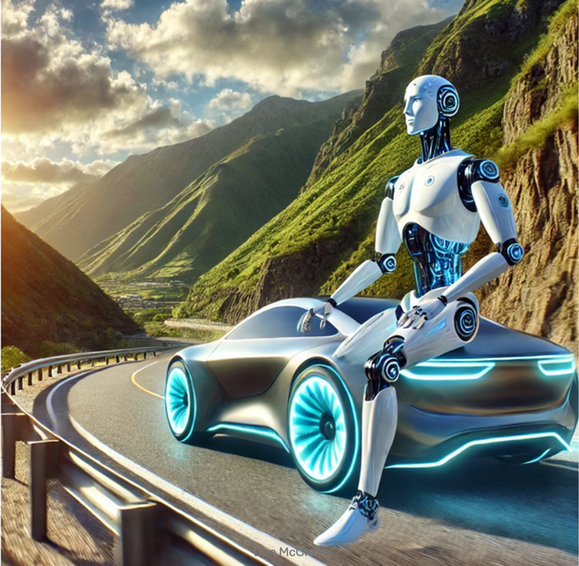
Agent Guardrails

Slide 32
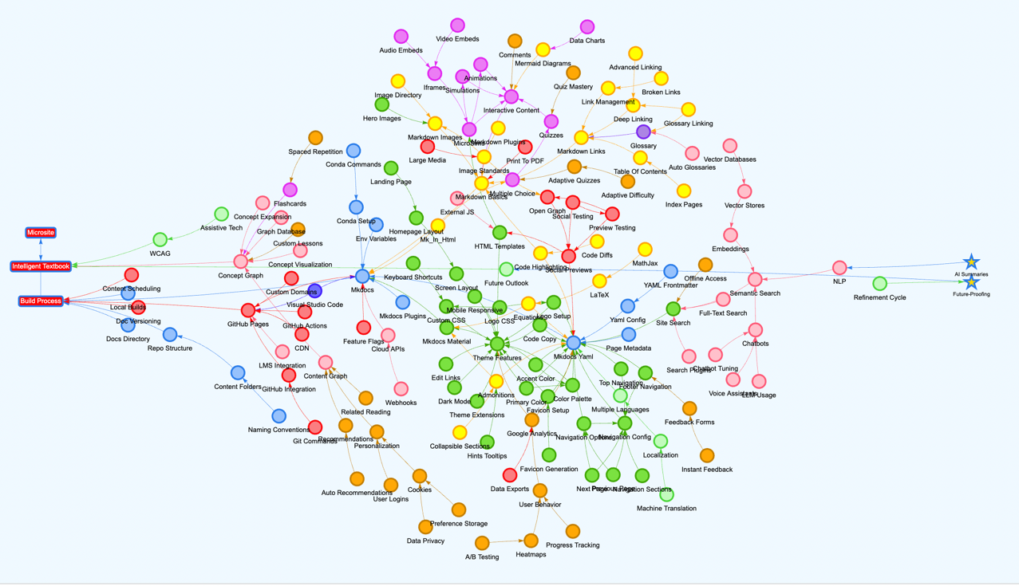
Learning Graph for Intelligent Textbooks
https://dmccreary.github.io/intelligent-textbooks/sims/learning-graph/graph-viewer.html

Slide 33
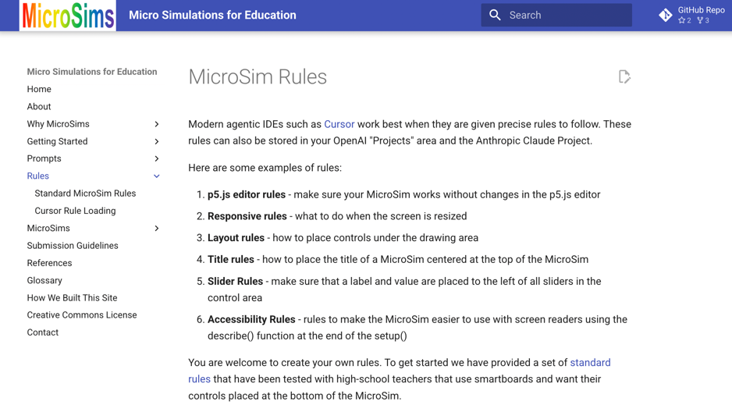
IDE Agent Generation Rules
https://dmccreary.github.io/microsims/rules/

Slide 34
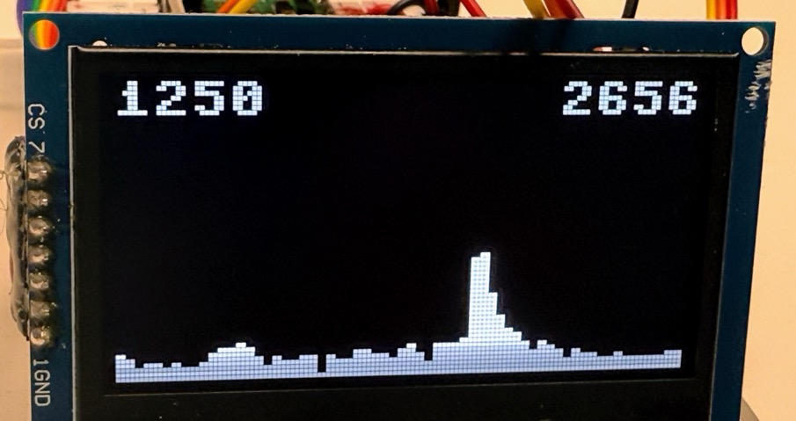
$20 Spectrum Analyzer
https://dmccreary.github.io/spectrum-analyzer/

Slide 35
Sample Intelligent Textbooks
Agents Course: https://dmccreary.github.io/agents-course/
Deep Learning Course: https://dmccreary.github.io/deep-learning-course/
Intelligent Textbooks: https://dmccreary.github.io/intelligent-textbooks/
MicroSims: https://dmccreary.github.io/microsims/
Learning Graphs: https://dmccreary.github.io/learning-graphs/
MicroPython: https://dmccreary.github.io/learning-micropython/
Clocks and Watches: https://dmccreary.github.io/clocks-and-watches/
Graph Algorithms: https://dmccreary.github.io/graph-algorithms/
Signal Processing: https://dmccreary.github.io/signal-processing/
Circuits: https://dmccreary.github.io/circuits/
Systems Thinking: https://dmccreary.github.io/graph-systems-thinking/
Personal Finance with AI: https://dmccreary.github.io/personal-finance/
Maroon text developed with the help of the University of Minnesota

Slide 36
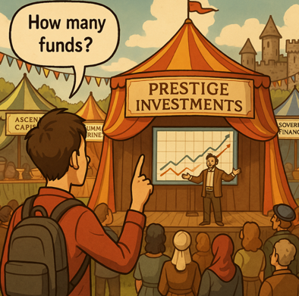
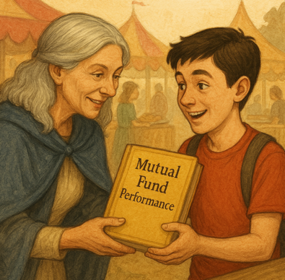
ChatGPT o1 Image Generation WOW!
Consistent character embeddings through a story
https://dmccreary.github.io/personal-finance/stories/selection-bias/

Slide 37
Direction vs. Distance
Never Mistake a Clear View for a Short Distance
- Paul Saffo
AI will democratize education worldwide
An MIT-quality education for every child in the world
Intelligent textbooks will be easier to build every month
Colleges will be rated on their average textbook level
(most of them are at zero today)
There are many challenges with MicroSim/Book integration into legacy LMSs built on old relational databases that don’t understand similarity

Slide 38
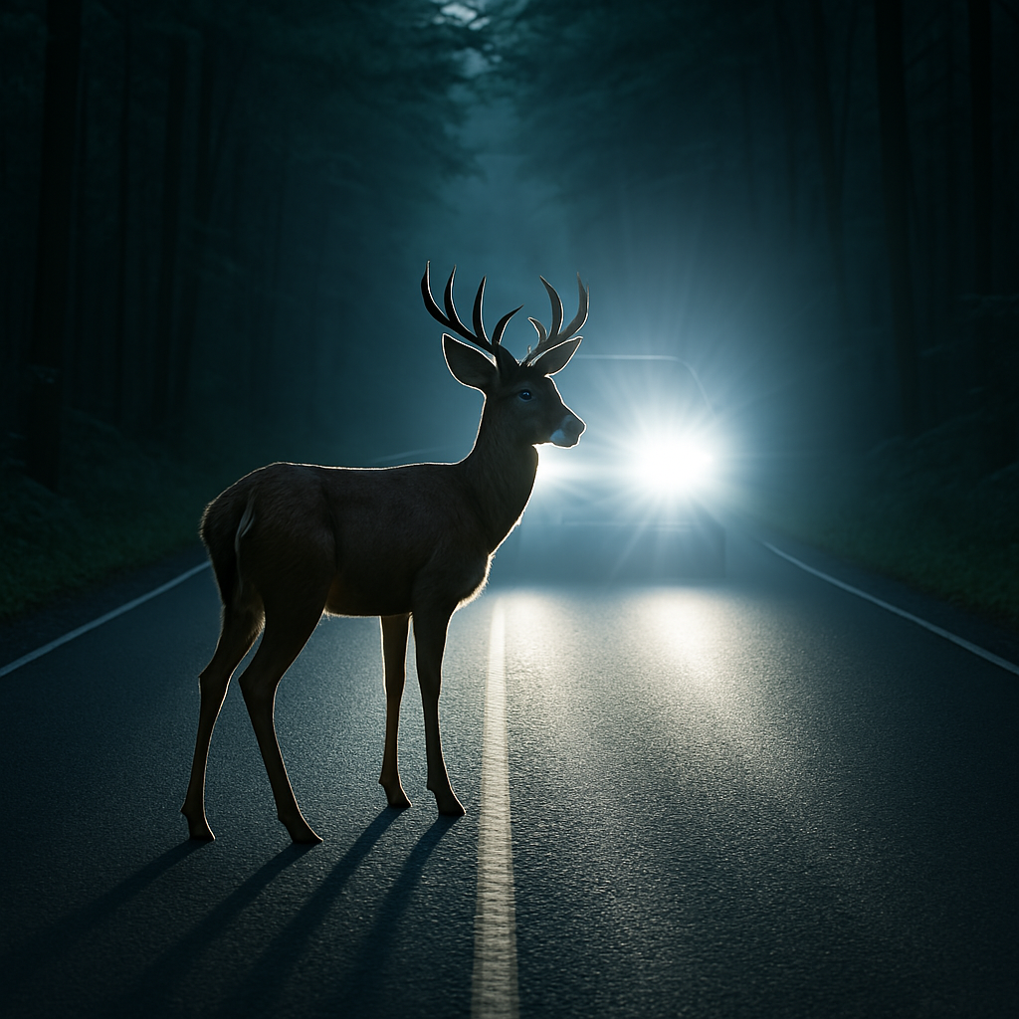
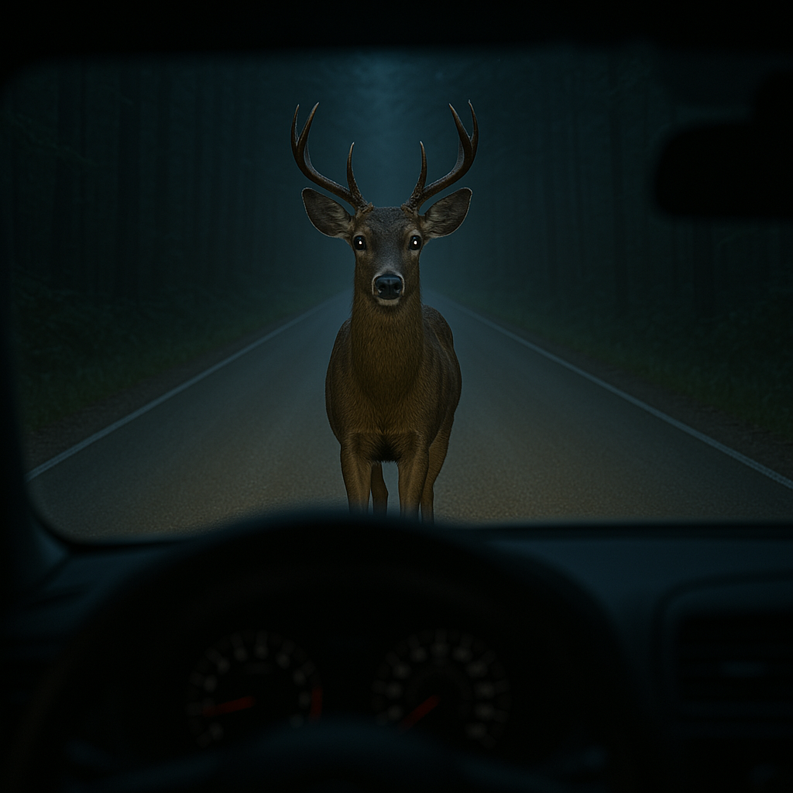
What Will We Do?

Slide 39

Call to Action
Use Generative AI to automate the boring stuff
Download the Cursor IDE or the Codium Windsurf IDE and build a MicroSim using our MicroSim rules
Watch some tutorial videos on agentic IDEs
”Just Do It!”

Slide 40

Questions
Please connect with me on LinkedIn:
https://www.linkedin.com/in/danmccreary/

