Slide 1

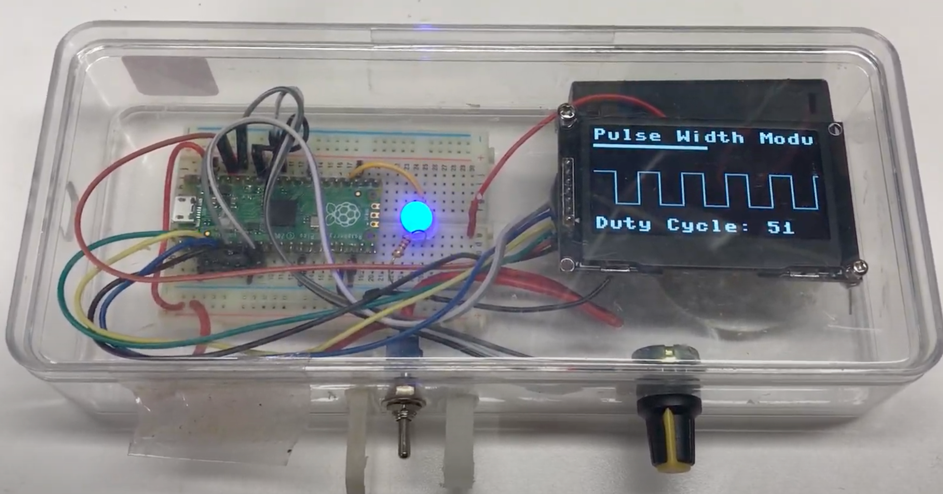

Prepare2Inspire STEM Project Kit Urban Research and Outreach-Engagement Center
Pulse Width Modulation Kit
Operation:
Turn the knob to change the pulse width of the signal
See the width of the pulse change in the display
Note that the brightness of the LED changes
Note that you can change the duty cycle ranges from 0 %to 100%
Challenges:
Can you turn the knob so that the duty cycle is 25%?
When is the width of the pulse the same as the spacing between the pulses
Parts:
Raspberry Pi Pico ($4.00)
Breadboard ($1.75)
Potentiometer (20K ohm) ($0.50)
LED (0.05)
128x64 OLED display ($13.00)
Total Cost: $20
https://dmccreary.github.io/learning-micropython/kits/pwm/

