Slide 1
STEM Robot GenAI Strategy
Dan McCreary
May18, 2024

Slide 2
Objective
Create a holistic strategy to generate high-quality content for the STEM robot using generative AI tools such as ChatGPT and Llama 3
Document the information flows of content used to enrich prompts
Create tools to automate the generation of hyper-customized content

Slide 3
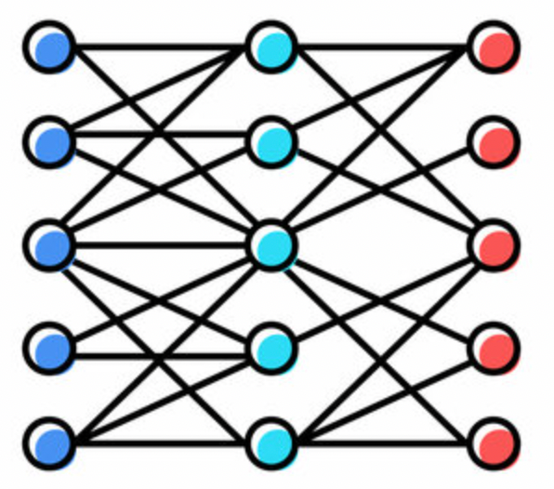
The Key Inputs
Task
The overall Goals of the STEM Robot website – teach computational thinking in a fun way and description of the course
Information about the robot – hardware capabilities for the base robot and extensions
Python configuration file – what GPIO ports are used for each function
Templates – small example programs that help GenAI get started on the right track
Goals
Robot Hardware
LLM
(ChatGPT)
Python
Config
Templates
New Content

Slide 4
Generating Personas
STEM Robot Kit Personas
Student
Teacher
Volunteer/Mentor
Curriculum Developer
School Administrators
Technical Support
Parent/Guardian
Persona
Prompt
LLM
(ChatGPT)
Goals
Robot Hardware
Persona Prompt: For the following robot, generate a list of personas that might be involved in using this robot in a classroom to teach computational thinking. Return the personas in a markdown list.

