Slide 1
MicroSim Figures

Slide 2


Banner
MicroSim

Slide 3

Favicon
MicroSim

Slide 4

MicroSim Social Media Card Template
Recommended Resolution: 1200x637

Slide 5
Social Media Image
MicroSims for Education

Slide 6


Slide 7
Social Media Image
MicroSims for
Education

Slide 8
Social Media Image
MicroSims for
Education

Slide 9
I am a local image.
Local Image

Slide 10

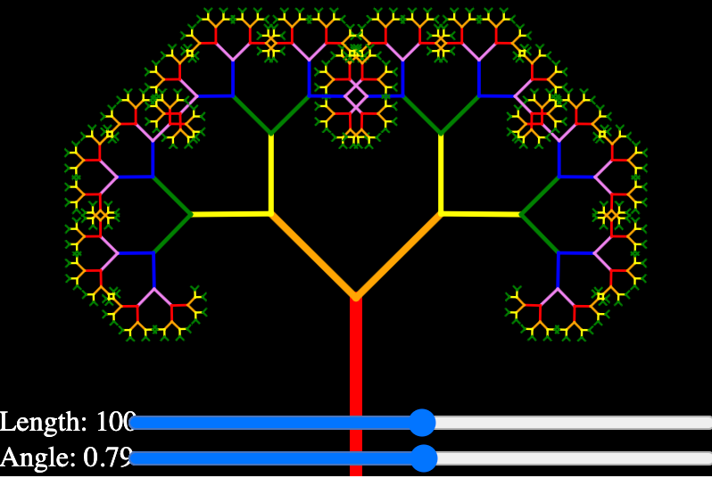

Slide 11

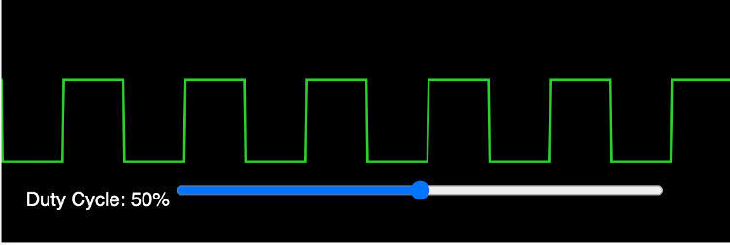
Pulse Width Modulation

