Slide 1
MicroSim Figures

Slide 2

New Banner
MicroSim
GenAI

Slide 3

Old Banner
MicroSim

Slide 4

Favicon
MicroSim

Slide 5

MicroSim Social Media Card Template
Recommended Resolution: 1200x637

Slide 6
Social Media Image
MicroSims for Education

Slide 7


Slide 8
Social Media Image
MicroSims for
Education

Slide 9
Social Media Image
MicroSims for
Education

Slide 10
I am a local image.
Local Image

Slide 11

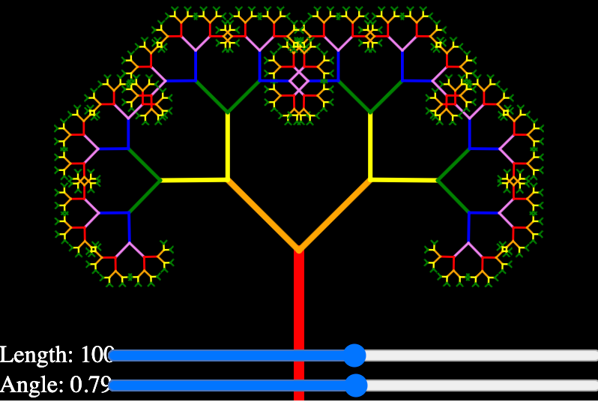

Slide 12

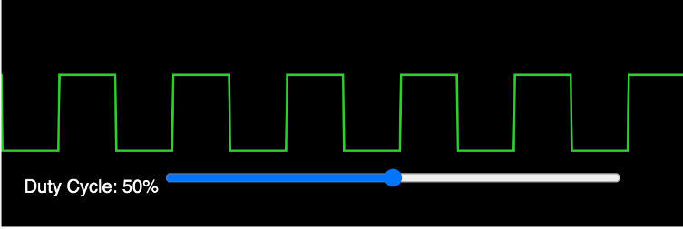
Pulse Width Modulation

