Slide 1
Using MicroSim Skills
Dan McCreary

Slide 2
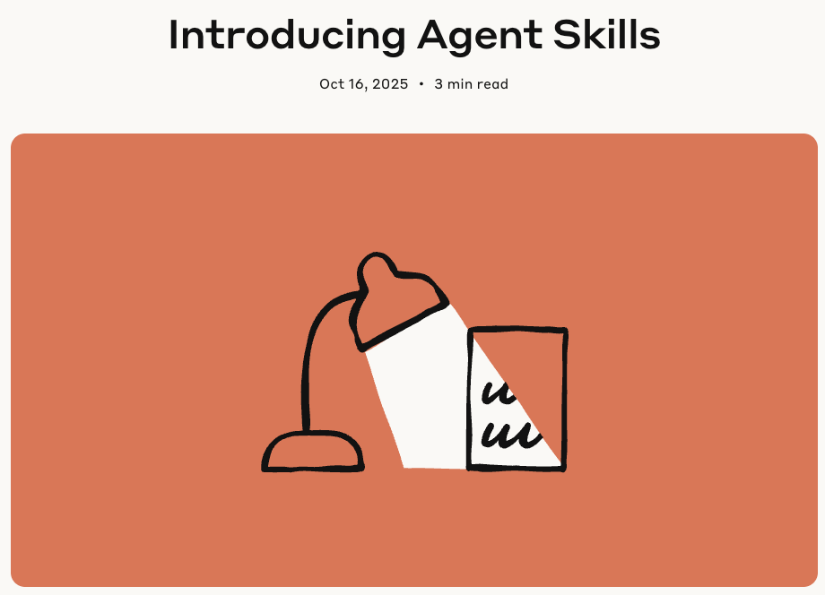
What is a Claude Skill?
A highly detailed set of rules for executing specific tasks
Standardized by Anthropic in October 2025
Stored in a zip file that can be quickly added to your Anthropic settings
Easy to setup and use within Claude using both the webpage or the Terminal using Claude Code
Availabe with the Pro ($20/month) plan

Slide 3
How Skills Work
A task is typically a unit of work.
Tasks are matched to skills
Task
Skill
Workflow
Task
Skill
Plan
Workflows
contain many tasks
Task
Skill
Use planning mode to generate workflows
Task
Skill
While working on tasks, Claude scans available skills to find relevant matches. When one matches, it loads only the minimal information and files needed—keeping Claude fast while accessing specialized expertise.

Slide 4
Steps to Use
Download the MicroSim Skill file
Upload the skill file to your Anthropic Setting Capabilities
Add “Using the MicroSim skill” to your prompt

Slide 5
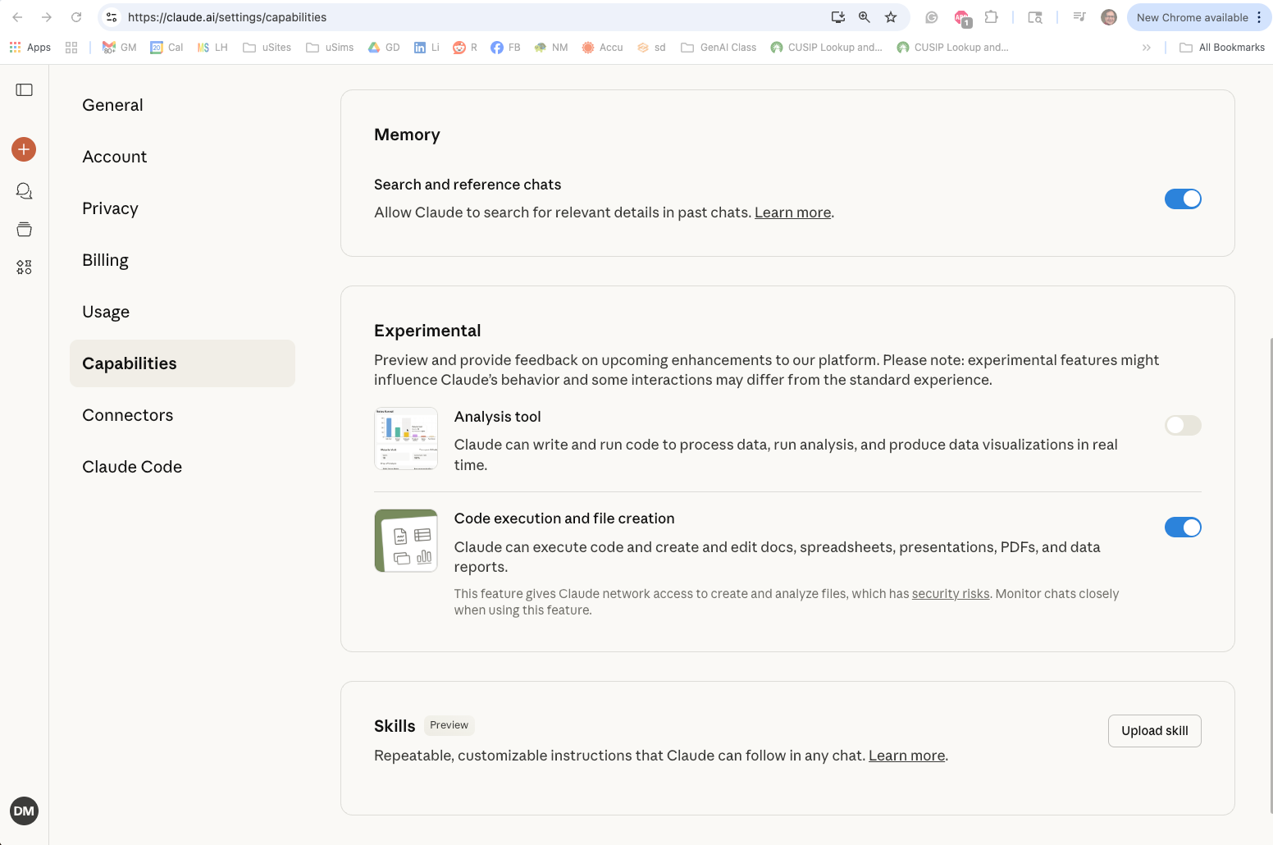
Go to your Claude Setting Capabilities Menu
Go to: http://claude.ai/settings/capabilities
CLICK HERE
In the Skills area, click the “Upload skill” button

Slide 6
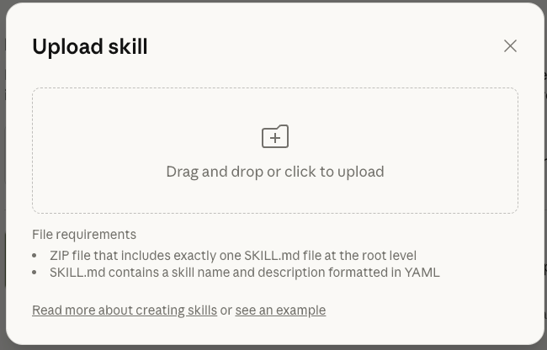
Drag and Drop the MicroSim Skill zip file

Slide 7
