Slide 1
MicroSim Figures

Slide 2
Sample MicroSim with Annotations

Slide 3

New Banner
MicroSim
GenAI

Slide 4

Old Banner
MicroSim

Slide 5

Favicon
MicroSim

Slide 6

MicroSim Social Media Card Template
Recommended Resolution: 1200x637

Slide 7
Social Media Image
MicroSims for Education

Slide 8


Slide 9
Social Media Image
MicroSims for
Education

Slide 10
Social Media Image
MicroSims for
Education

Slide 11
I am a local image.
Local Image

Slide 12

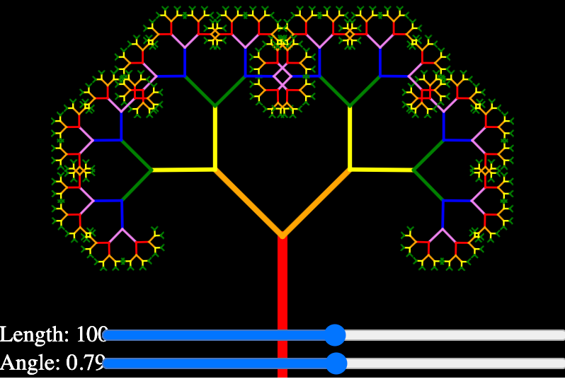

Slide 13

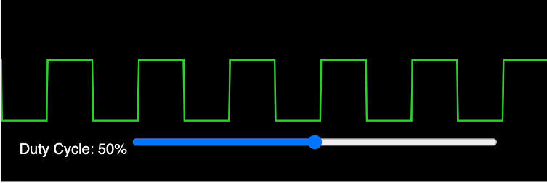
Pulse Width Modulation

