Slide 1
Using MicroSim Skills
Dan McCreary

Slide 2
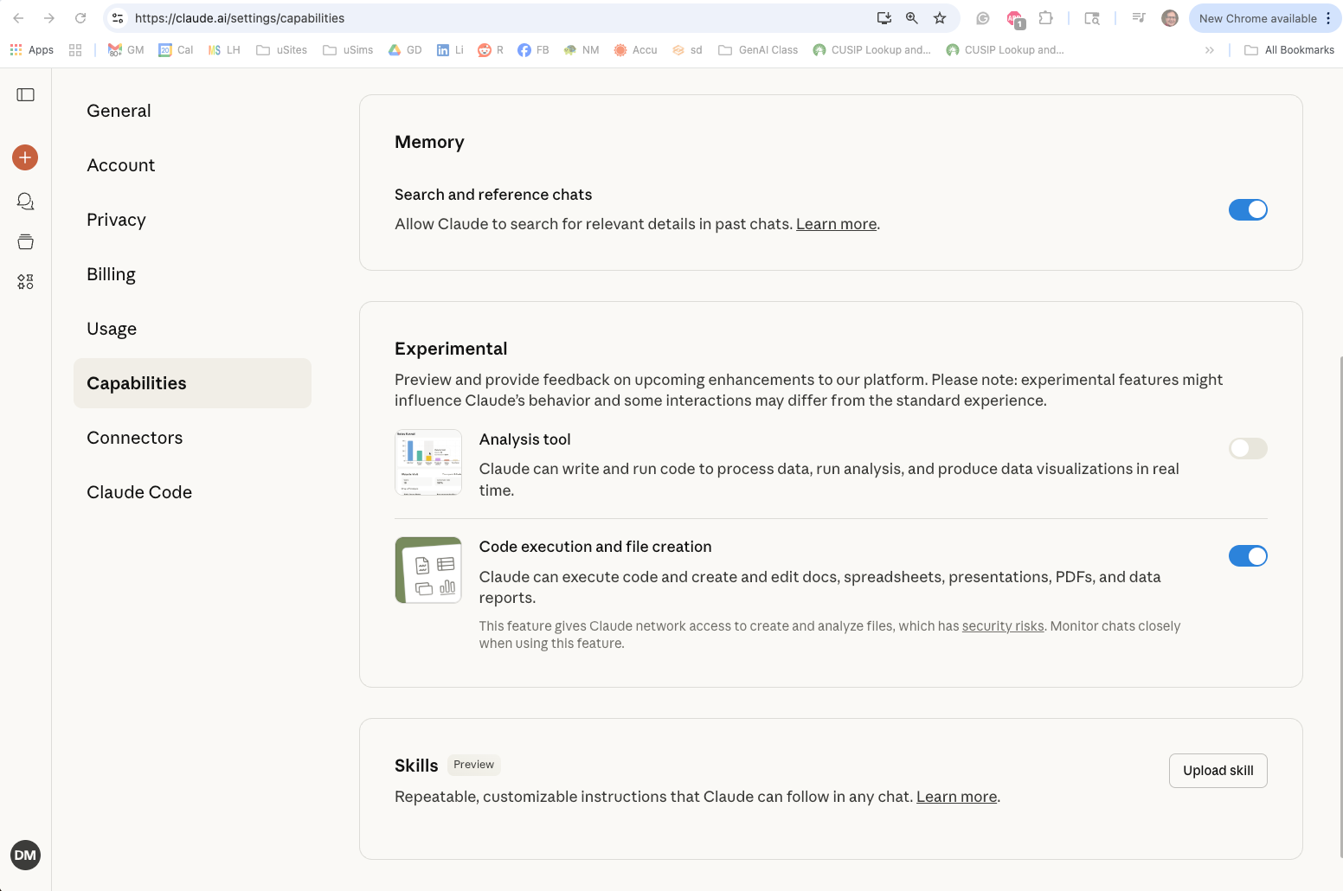
Go to your Claude Setting Capabilities Menu
http://claude.ai/settings/capabilities
CLICK HERE
In the Skills area, click the “Upload skill” button

