Slide 1
MicroSim Figures

Slide 2
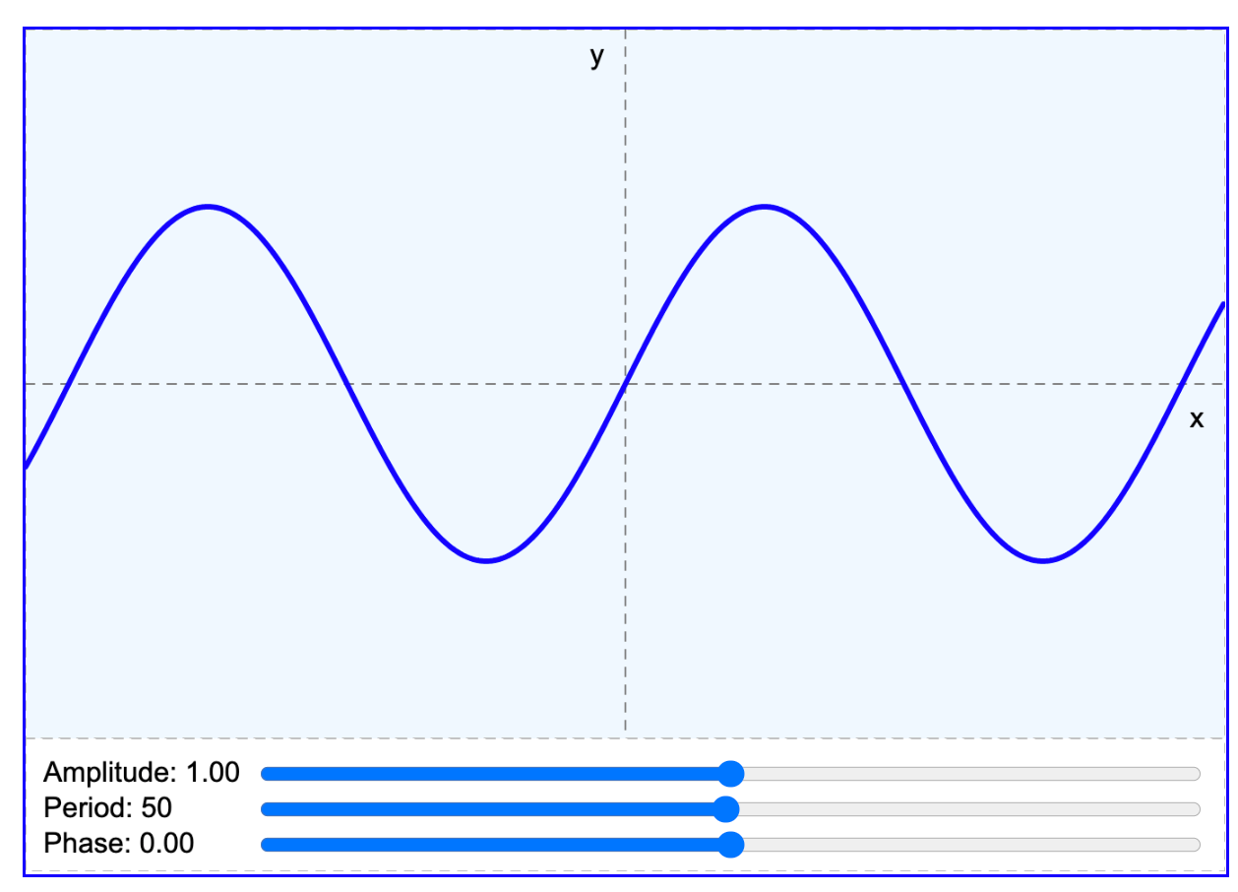
Sample MicroSim with Annotations (figure 2 in paper)
Blue border and light blue background indicate an interactive graphic
Fixed Height
Top drawing region does not contain interactive controls
Lower control region contains interactive simulation controls
Responsive
Width
Horizontal sliders resize when container changes

Slide 3
MicroSim Architecture
xAPI
Learner
Record
Store
MicroSim
JavaScript Libraries (p5.js, vis.js etc.)
HTML 5/ECMAScript/Canvas
Web Browser (Chrome, FireFox)
Drawing Libraries (WebGL, WebGPU)

Slide 4

New Banner
MicroSim
GenAI

Slide 5

Old Banner
MicroSim

Slide 6

Favicon
MicroSim

Slide 7

MicroSim Social Media Card Template
Recommended Resolution: 1200x637

Slide 8
Social Media Image
MicroSims for Education

Slide 9


Slide 10
Social Media Image
MicroSims for
Education

Slide 11
Social Media Image
MicroSims for
Education

Slide 12
I am a local image.
Local Image

Slide 13

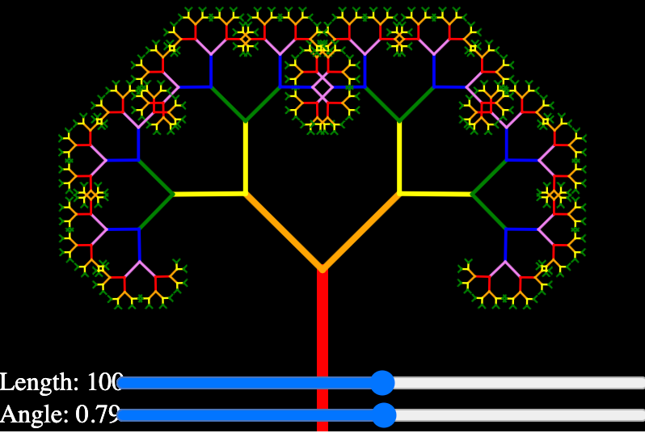

Slide 14

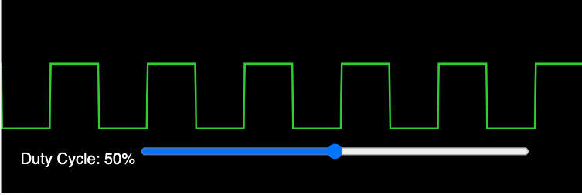
Pulse Width Modulation

