Slide 1
Bathtub Simulation

Slide 2
Bathtub Drain Simulation
Source
Chart of Water Height vs. Time
Water Height
Water
Height
Drain
Time
Start/Stop
Reset
Source Flow Rate:
Drain Flow Rate:

Slide 3
Text
Create a simulation of a bathtub with a source and drain
On the left is an image of the bathtub with the water height shown
On the right is a chart that displays water height vs. time
Add sliders for the source and drain flow rates
Make the source initial value be 0 liters/minute
Make the drain be 1 liter per minute
Add buttons to start/stop and reset the simulation

Slide 4
Pressure at the Bottom of the Tank
Prompt:
Assume we have water in a cylinder tank container of height H and diameter W. Write a formula that expresses the pressure at the bottom of the cylinder as a function of the depth of the water D.
The pressure at the bottom of a cylindrical tank containing water depends on the depth of the water, rather than the height of the tank or its diameter. This pressure can be calculated using the formula:
�=�×�×�P=ρ×g×D
Where:
�P is the pressure at the bottom of the tank.
�ρ is the density of the water (approximately 1000 kg/m31000kg/m3 for fresh water at room temperature).
�g is the acceleration due to gravity (approximately 9.81 m/s29.81m/s2 on the surface of the Earth).
�D is the depth of the water in the tank.
So, the pressure increases linearly with the depth of the water. The height of the tank and its diameter don't directly influence the pressure at the bottom, as long as the depth �D of the water is considered.

Slide 5
Python Code
Create a Python program that will plot the rate of flow that water will drain out of the tank over time. Assume we have a 10 liter tank and there is a hole at the bottom of the tank that is 2 cm in diameter. Make whatever assumptions that are resasonable.
To create a Python program that simulates and plots the rate of flow of water draining from a tank, we need to consider several aspects:
Tank Properties: A 10-liter tank (10 liters = 0.01 cubic meters).
Hole Properties: A hole with a 2 cm diameter at the bottom of the tank.
Water Properties: We'll assume the density of water to be approximately 1000 kg/m³.
Flow Calculation: We can use Torricelli's Law for the velocity of the fluid leaving the tank: �=2�ℎv=2gh​, where �g is the acceleration due to gravity (9.81 m/s²) and ℎh is the height of the water above the hole.
Flow Rate: The flow rate �Q can be calculated as �=��Q=Av, where �A is the area of the hole and �v is the velocity of the water. The area �A can be calculated using the formula for the area of a circle: �=��2A=πr2.
Time Evolution: We'll simulate how the height of the water decreases over time. This requires updating the height ℎh as the water drains and recalculating the flow rate.
Assumptions: We'll assume the tank maintains a constant cross-sectional area and ignore factors like air resistance and viscosity for simplicity.
Let's write the program and plot the results:

Slide 6
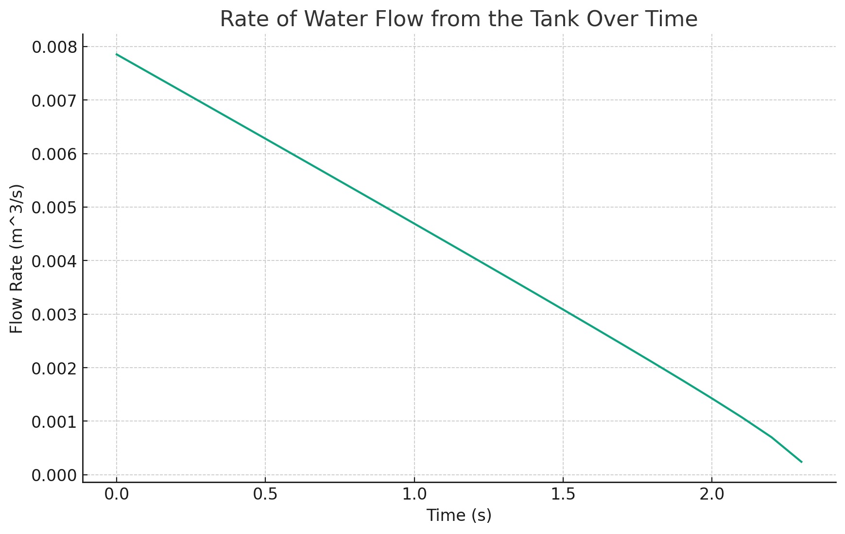
Rate of Flow vs. Time

Slide 7
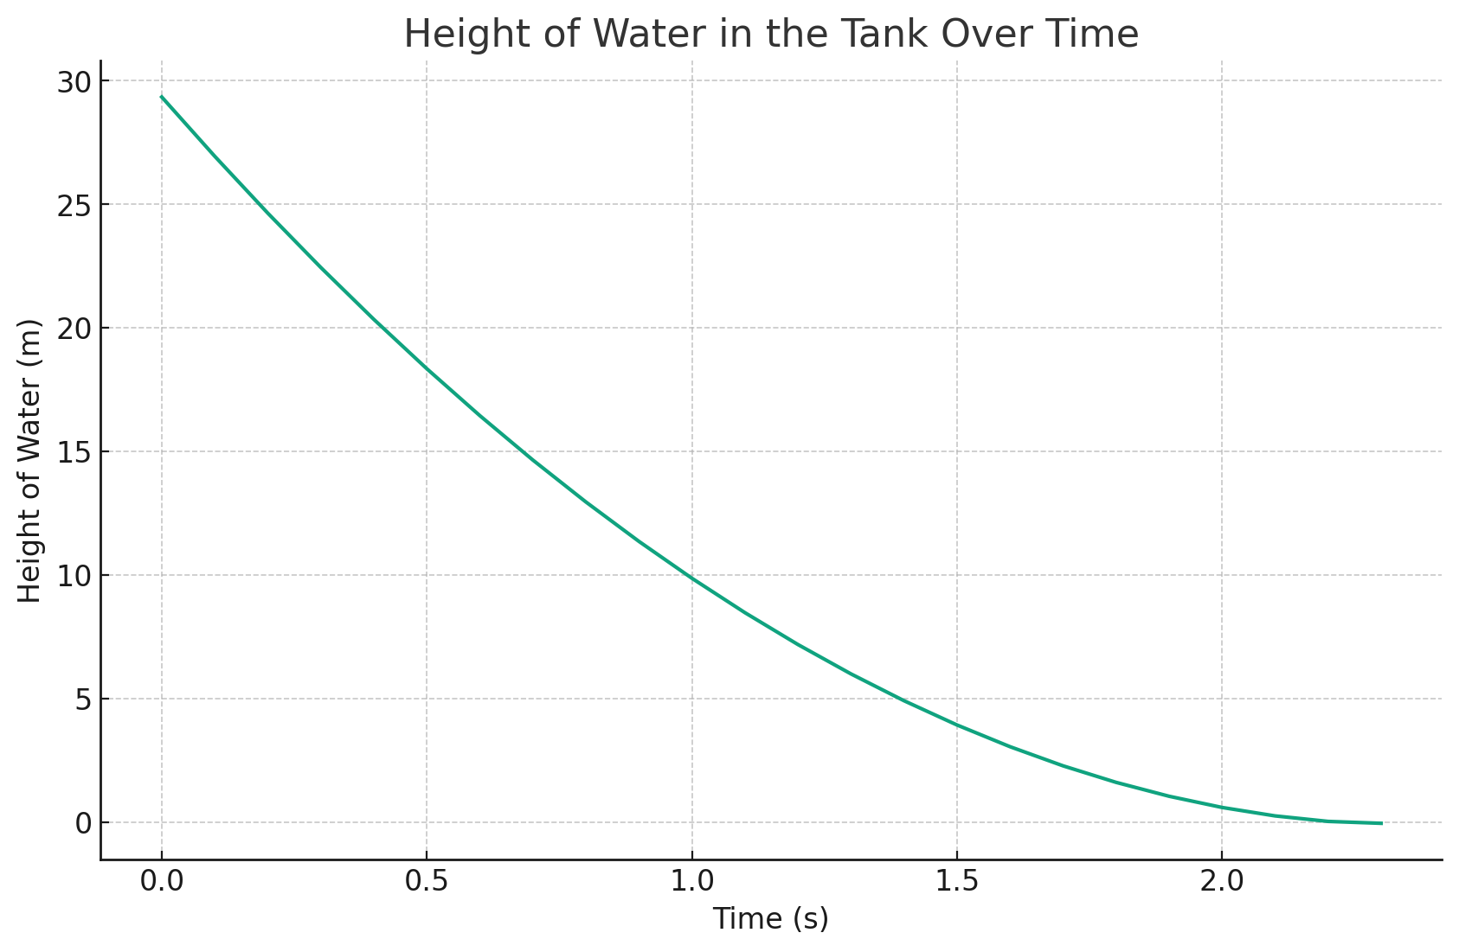
Height of Water Over Time

Slide 8
Python Code
# Re-running the simulation to track the height of the water over time
# Reset initial conditions
height = initial_height
height_over_time = []
# Re-simulate
for t in np.arange(0, max_time, time_step):
if height <= 0:
break
velocity = np.sqrt(2 * g * height)
current_flow_rate = hole_area * velocity
height -= current_flow_rate * time_step / (np.pi * hole_radius**2)
height_over_time.append(height)
# Plotting the results
plt.figure(figsize=(10, 6))
plt.plot(time, height_over_time)
plt.title("Height of Water in the Tank Over Time")
plt.xlabel("Time (s)")
plt.ylabel("Height of Water (m)")
plt.grid(True)
plt.show()

