Slide 1
Using MicroSim Skills with Anthropic Claude
Dan McCreary
October 23, 2025

Slide 2
Overview
What is a Claude Skill?
Loading the MicroSim-p5 skill into Claude’s Capabilites
Using the Skill to generate a p5.js file
Testing the p5.js MicroSim with the p5.js editor
Generating a full MicroSim package
Installing the package in your intelligent book
Testing the MicroSim package in your textbook
Adding a Social Media Preview Image

Slide 3

What is a Claude Skill?
A highly detailed set of rules for executing specific tasks
Standardized by Anthropic in October 2025
Stored in a zip file that can be quickly added to your Anthropic settings
Easy to setup and use within Claude using both the webpage or the Terminal using Claude Code
Available with the Pro ($20/month) plan and other more expensive plans
https://www.anthropic.com/news/skills

Slide 4
How Skills Work with Agents
A task is typically a unit of work.
Tasks are matched to skills
Task
Skill
Workflow
Task
Skill
Plan
Workflows
contain many tasks
Task
Skill
Use planning mode to generate workflows
Task
Skill
While working on tasks, Claude scans available skills to find relevant matches. When one matches, it loads only the minimal information and files needed—keeping Claude fast while accessing specialized expertise.

Slide 5
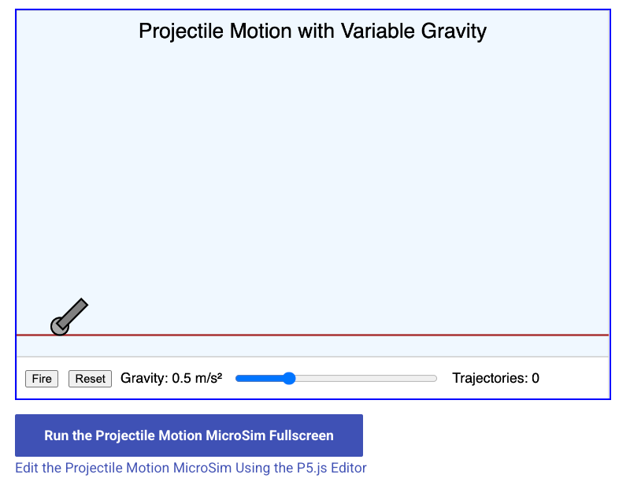
Sample MicroSim Created by Skill
Simple Prompt
Using the MicroSim-p5 skill, create a new MicroSim that demonstrates the effect of gravity on projectile motions
https://dmccreary.github.io/microsims/sims/projectile-motion-gravity/

Slide 6
What the MicroSim Creates
A 427-line width-responsive p5.js application
A 121-line index.md file that includes a user guide and lesson plan
A 12-line main html driver file
A 427-line metadata.json file for search optimization

Slide 7
Sample Steps to Use the p5 MicroSim in Claude
Download the MicroSim Skill file to your local hard drive
Upload the skill file to your Anthropic Setting Capabilities
Add “Using the MicroSim-p5 skill..,” to your prompt:
Example: Using the MicroSim-ps skill create a new MicroSim that will show the effect of gravity on projectile motion. Have a slider change the gravity.
Download the zip file that Claude creates
Open the zip file and test the JavaScript using the p5.js editor
If you are happy with the result, place the files in your sims folder of your textbook.
Note: Claude Code can also use these skills and automatically install the MicroSim in your book.

Slide 8
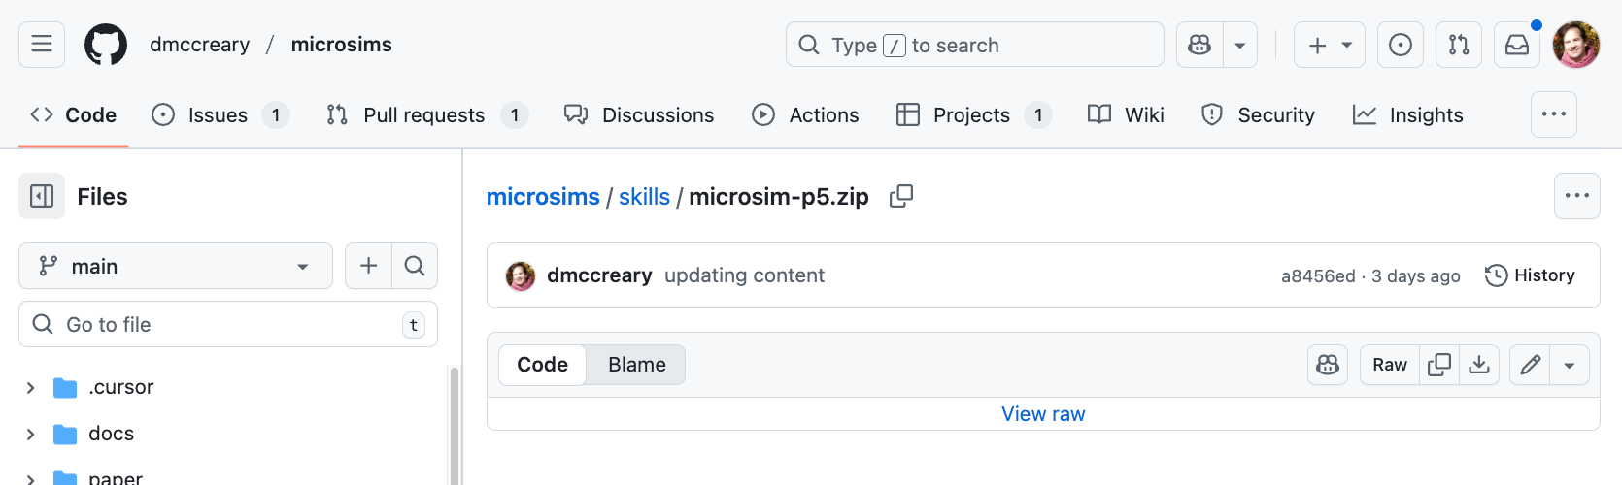
Step 1: Download the Skill to Your Local System
Go to:
https://github.com/dmccreary/microsims/blob/main/skills/microsim-p5.zip

Slide 9
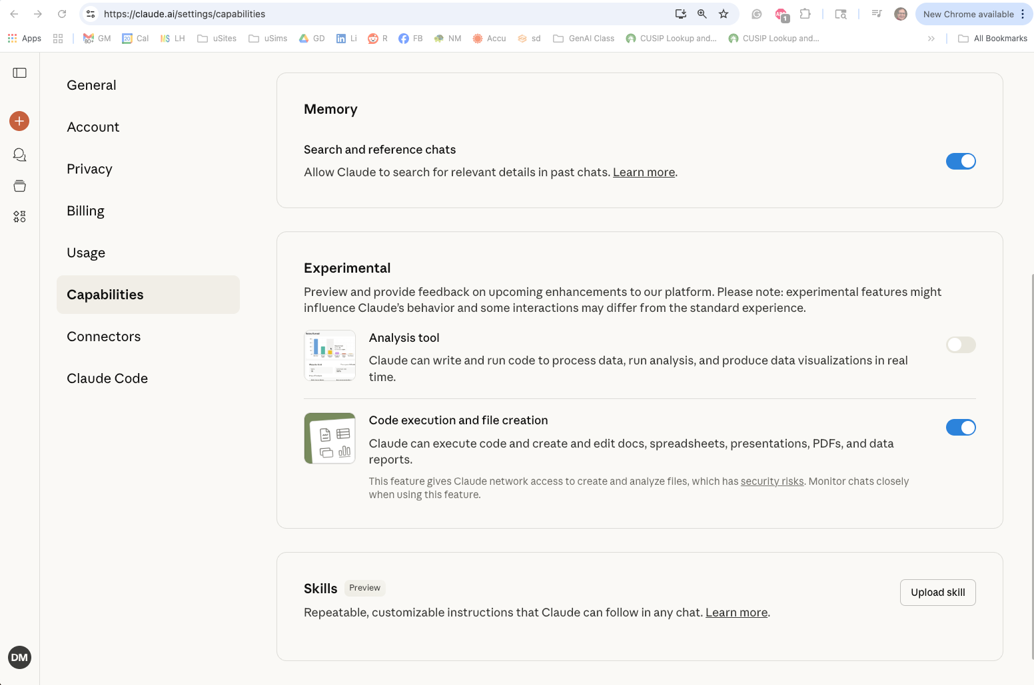
Go to your Claude Setting Capabilities Menu
Go to: http://claude.ai/settings/capabilities
CLICK HERE
In the Skills area, click the “Upload skill” button

Slide 10
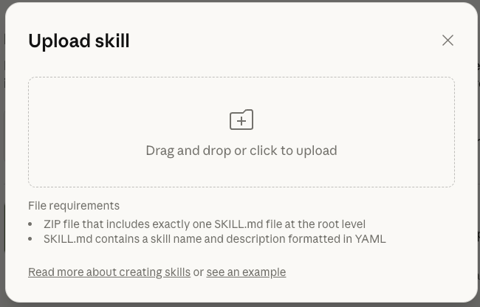

Drag and Drop the MicroSim Skill zip file
Drag Zip File

Slide 11

Confirmation Message

Slide 12
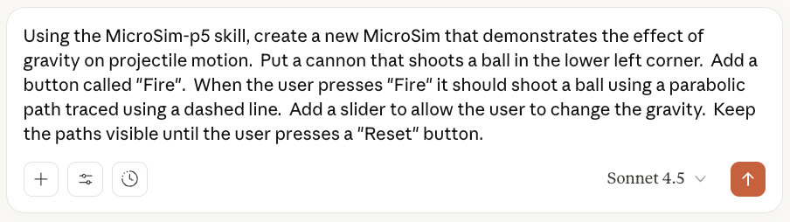
Sample Prompt that Uses the MicroSim-p5 Skill
Note, I forgot to state the name. I should have added the following The new Microsim will be called “projectile-motion-gravity”

Slide 13
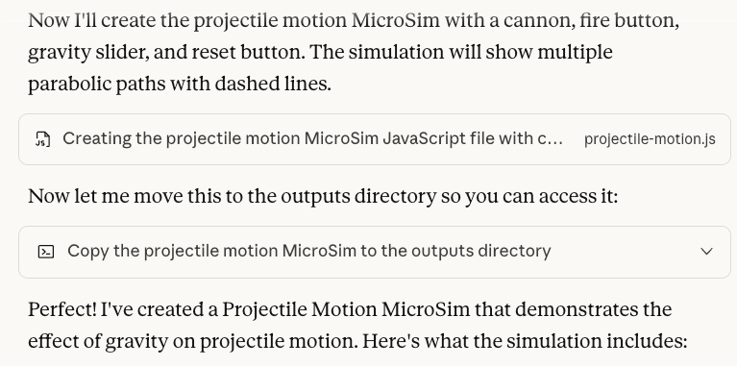
Sample Output

Slide 14
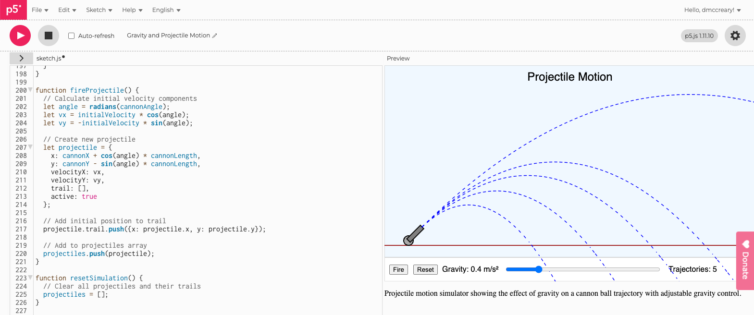
Testing MicroSim with the p5.js editor
https://editor.p5js.org/dmccreary/sketches/-aDDLBBD8

Slide 15
Note on Control Placement
LLMs are not good at the exact placement of some controls
Claude did make mistakes placing the button and slider controls in the controls area of the MicroSim
I went in and manually had to move the x-position of the slider in the control region
I will be adding specific rules to the skill to prevent this error in the next version

Slide 16
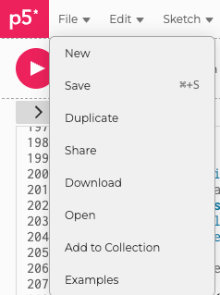
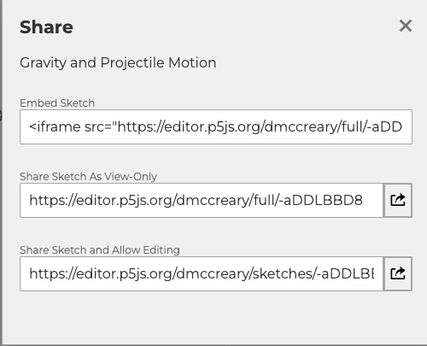
Share Your MicroSim Directly from the p5.js
Click File / Share

Slide 17
The Following Steps Are For Integrating Into a Textbook
Intelligent textbooks put MicroSims “inline” into chapters of online books
They use a specific folder and file structure that facilitates sharing
The MicroSim skill is able to generate additional files
Sample main.html
Sample index.md that contains user guide and lesson plans
Sample metadata.json to facilitate search in MicroSim search engines
The main JavaScript file can then be modified and versioned

Slide 18
Integrating any MicroSim into a Web Page is Easy!
<iframe
src="https://dmccreary.github.io/microsims/sims/projectile-motion-gravity/main.html"
height="452px"
scrolling="no">
</iframe>
This line of HTML can be added without jeopardizing the security of your site
The simulation runs in a secure “sandbox”
You do not need to make other changes to your website
You can also use CSS to style the border of the iframe

Slide 19

Generate the MicroSim Package zip file
This will force the MicroSim to not just generate the JavaScript, but all the supporting files in a MicroSim package

Slide 20
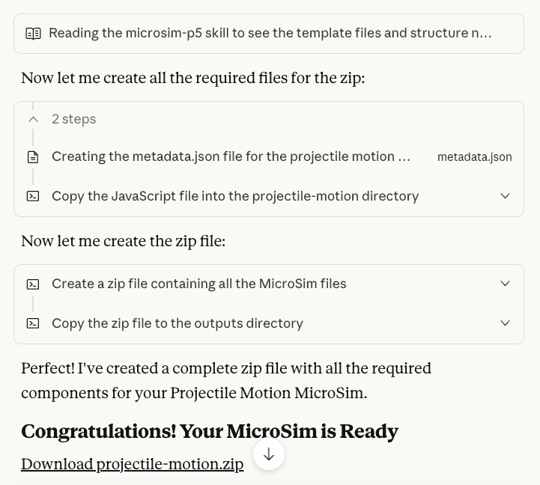
Sample Dialog
CLICK HERE

Slide 21
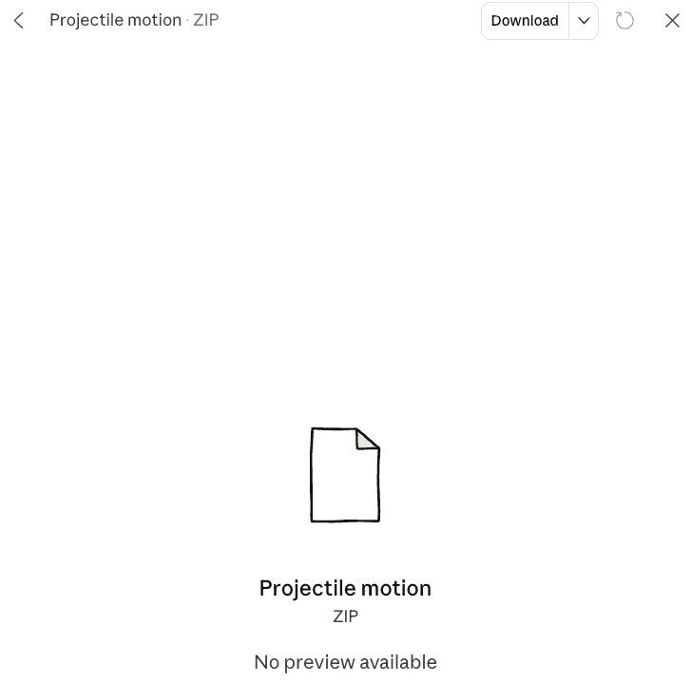

Click the Download
CLICK HERE

Slide 22
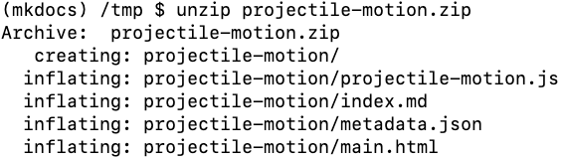
Unzip the MicroSim Package
Move and or rename:
$ cd /tmp
$ mv projectile-motion $BOOK/docs/sims/projectile-motion-gravity
Note: remove the zip file when you are done. The zip file should not be checked into your textbook site.

Slide 23
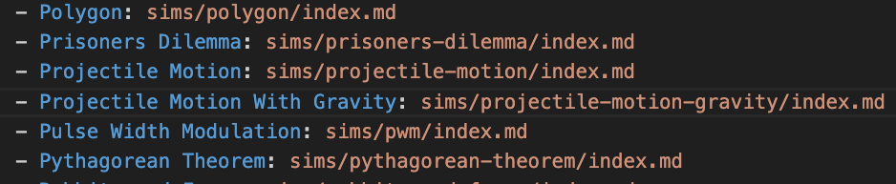
Add to Navigation in mkdocs.yml
New Line Here
Add to the nav: sims area indented with the other sims
- Projectile Motion With Gravity: sims/projectile-motion-gravity/index.md

Slide 24
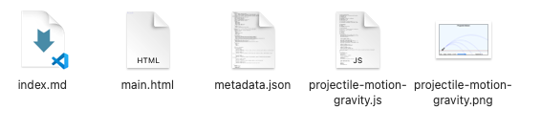
Optional: Social Media Preview
You can also take a screen image and use this for a social media preview. This image will show when you copy the link to the MicroSim into a chat, messenger, Slack, Discord, Zoom or reference the MicroSim on Facebook, Twitter, LinkedIn.
A future version of the skill might render the MicroSim and capture a screen image. However, for now this is a manual step
To enable this feature, you must take a screen image of the MicroSim and place it in the MicroSim folder with the same name as the folder:
Contents of my /docs/sims/projectile-motion-gravity folder:
New File

Slide 25
Sample Metadata in HTML body
<meta property="og:image" content="https://dmccreary.github.io/microsims/sims/projectile-motion-gravity/projectile-motion-gravity.png">

Slide 26
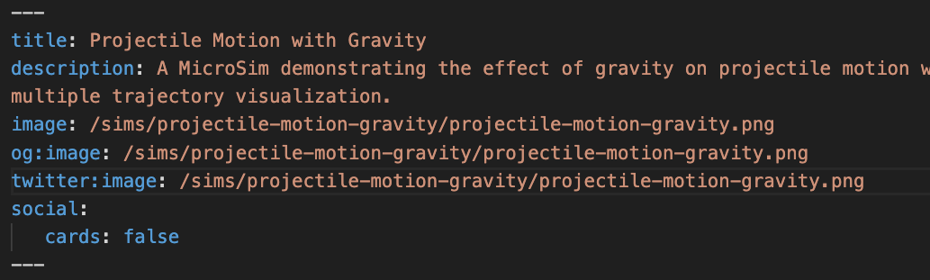
Sample Metadata in the index.md
Note that the path names are all relative to the /docs directory. You do not need to put in the full path.

Slide 27

Test the Social Media Preview
There are many free web sites that will test to see if the right metadata tags are placed correctly in the HTML header.
Example: https://socialsharepreview.com/
Paste the URL of your MicroSim Here

Slide 28
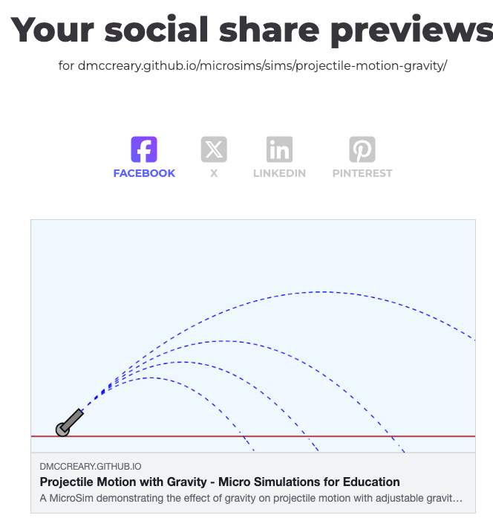
Positive Result!
For further details you can search for Open Graph standards for title, description and images

Slide 29
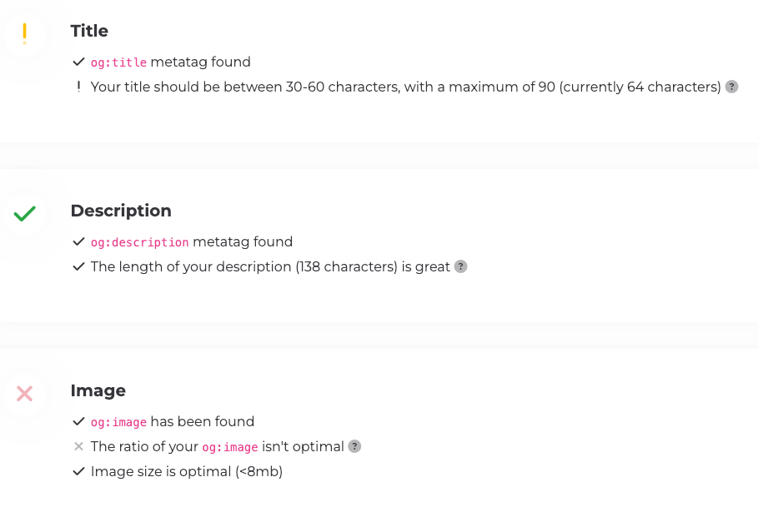
OG Tags Advise
Our title and description are fine
The ideal ratio for the social preview image is 1.91:1 width to height ratio which we failed to pass

Slide 30
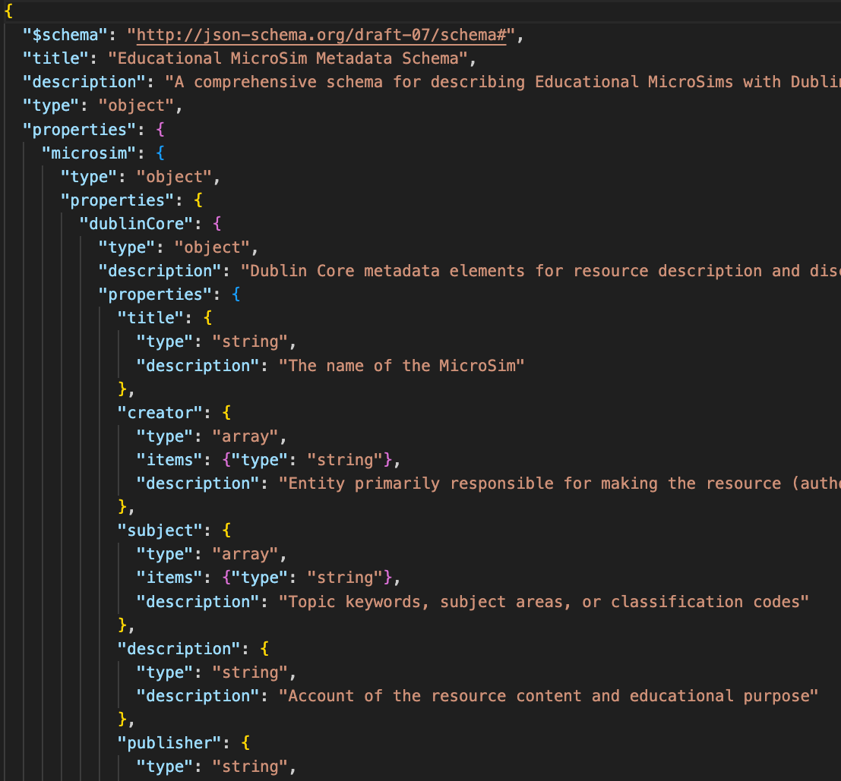
Claude Generates Massive Metadata!
Given a robust JSON Schema, Claude will generate fantastic highly detailed metadata that can be used to analyze and extend a MicroSim
The schema is an exhaustive list of fields that Claude will happily fill in for each MicroSim
Metadata is critical for building faceted search tools for MicroSims
https://github.com/dmccreary/microsims/blob/main/src/microsim-schema/microsim-schema.json

Slide 31
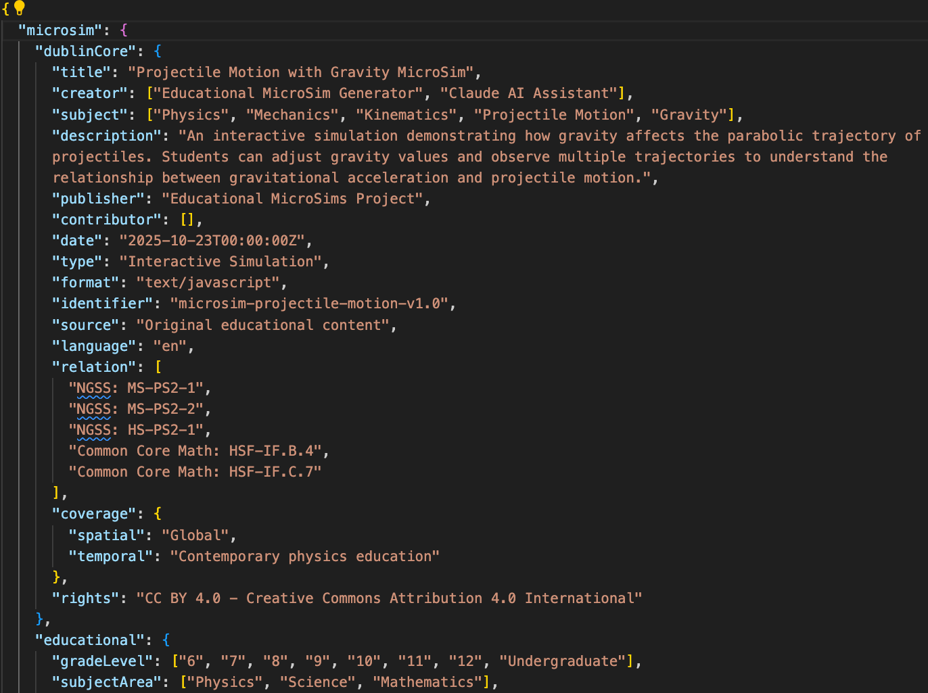
Sample Metadata File (metadata.json)

Slide 32
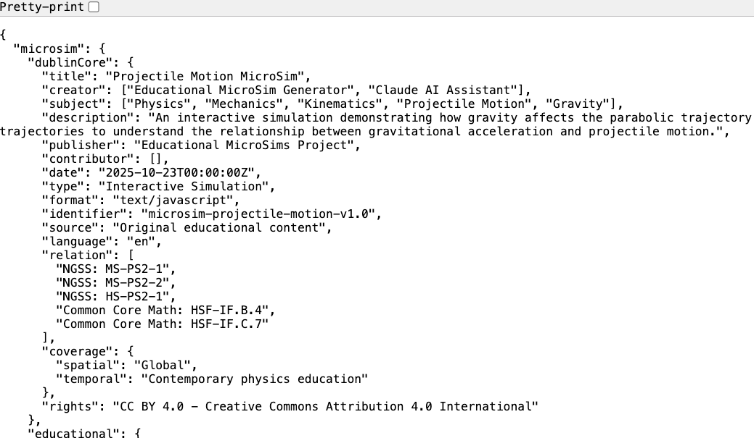
How To View
Add the string “/metadata.json” to the end of the path https://dmccreary.github.io/microsims/sims/projectile-motion-gravity/metadata.json

Slide 33
What is in the metadata.json file
Dublin core (title, creator, subject, description, publisher, date, etc.)
Things used to describe any book or paper resource in a library catalog
Education standards (NGSS, "Common Core Math: HSF-IF.B.4”)
License: CC BY 4.0 - Creative Commons Attribution 4.0 International
Grade Levels (6th to 12th grades)
Subjects: Physics, Science, Mathematics
Topics:
Projectile Motion
Gravity
Parabolic Trajectories
Kinematics
Newton's Laws
Acceleration

Slide 34
What is in the metadata.json (continued)
Learning Objectives
Understand that gravity affects the vertical motion of projectiles,
Apply concepts of parabolic motion to predict trajectory shapes,
Analyze how changes in gravity affect projectile range and height,
Evaluate the relationship between gravitational acceleration and trajectory characteristics,
Compare projectile motion under different gravitational conditions

Slide 35
What is in the metadata.json (continued)
Prerequisites
Duration (estimated times, typical, min, max)
Difficulty
Curriculum Standards (framework, id, description)
Technical:
JavaScript library and version
Responsive design
Browser compatibility analysis
Accessibility

Slide 36
Metadata (Continued)
List of UI Controls
Buttons
Sliders (ranges)
Visual Elements
Diagram
Animation
Text
Simulation Types
Physics, Equations, Algorithms
Model Assumptions
(no friction, no wind etc.)
Other possible variations for advanced simulations
Initial velocity
Launch angle
Projectile type
Scenarios
Earth, Moon, Mars, Space
Analytics for AI Textbooks
Events (start, stop, adjust, reset)
Metrics (engagement time, number of range adjustments)

Slide 37
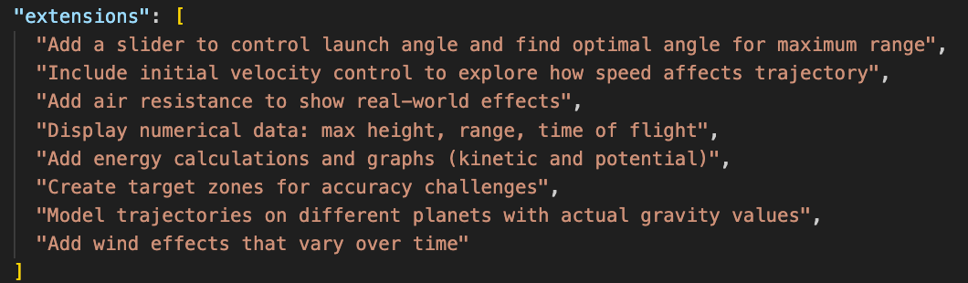
Metadata (continued)
Recommended Usage
Demos, exploration, guided practice, group activity, indivisual study
Instructional Strategies
Assessment Questions
Type, level
Extensions
What UI components could be added?

Slide 38
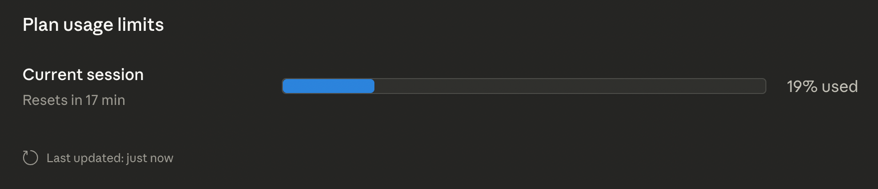
Claude Usage Impact
Generating a full MicroSim and all the metadata is a complex process and can use a significant portion of your Pro token allotment
My experience is that generating a MicroSim will take about 10 to 12% of your 4-hour allotment
This means you can only create about one MicroSim per hour using your Pro plan ($20)
The exact session usage varies based on how complex your MicroSim is
You can check your usage using the following link:
https://claude.ai/settings/usage

Slide 39
Conclusion
Using Claude Skills can make MicroSim generation MUCH easier for nonprogrammers
Some simple MicroSims can be generated in under five minutes
The MicroSims layouts may not perfect and may require tweaking in the placement of the controls
The skill asks Claude to generate a large number of precise metadata elements for each MicroSim
Claude Code can be used to quickly iterate these designs, but using Claude Code can be challenging for nonprogrammers
Using a MicroSim in any web-based textbook is as simple as adding a single line of HTML (iframe)

Slide 40
Thank You!
Feedback, Bugs, Enhancements: https://github.com/dmccreary/microsims/issues
Questions – please connect with me on LinkedIn
https://www.linkedin.com/in/danmccreary/

