Slide 1
Moving Rainbow

Slide 2

Moving Rainbow Logo
A rainbow that is moving
with "motion lines"
Stick to the true color order (red, orange, yellow, green, blue, indigo, violet)

Slide 3
The Project-Social-Mentor Model
Project based learning
Where students bring their ideas
Fun projects for everyone
Color, motion, costumes, art, robots
No big intimidating textbooks
Agile jump in anywhere
Social learning
Students work together with peers and share idea
Mentoring
Students that have two hours every other week of mentoring don’t get frustrated and keep

Slide 4
Computer Science
variables
for (i=0; i<12;i++) {
setColor(i, red, green, blue)
}
testing
debugging
setup()
functions
loop()
Kids surrounded by the wonders of computers

Slide 5
Afraid to start
Hey, this is not as hard as I thought!
So complicated!
Where do I start?
By breaking problems down into smaller parts we can concer large tasks

Slide 6
Getting Started
What is an IDE?
You mean it does all that in one program?
Integrated Development Environment
Finding a Program, Editing, Compiling, Uploading, Debugging, Saving

Slide 7
Safety
Will I blow this up?
Some basic does and don'ts
Be careful to avoid short circuits
Don't connect the +5 directly to ground
Don't make arbitrary connections

Slide 8
Circuits Basics
So what is voltage?

Slide 9
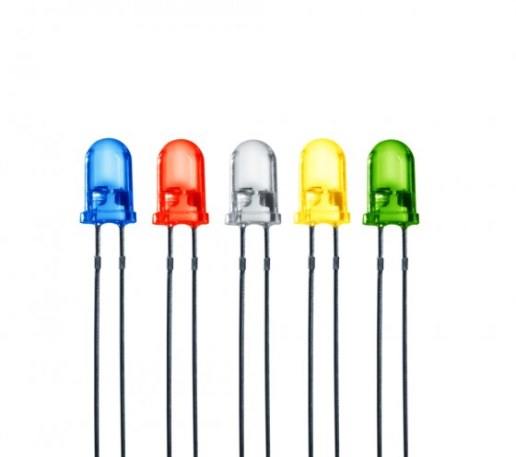
What is an LED?
What is an LED?
Positive and Negative
Anode and Cathode

Slide 10
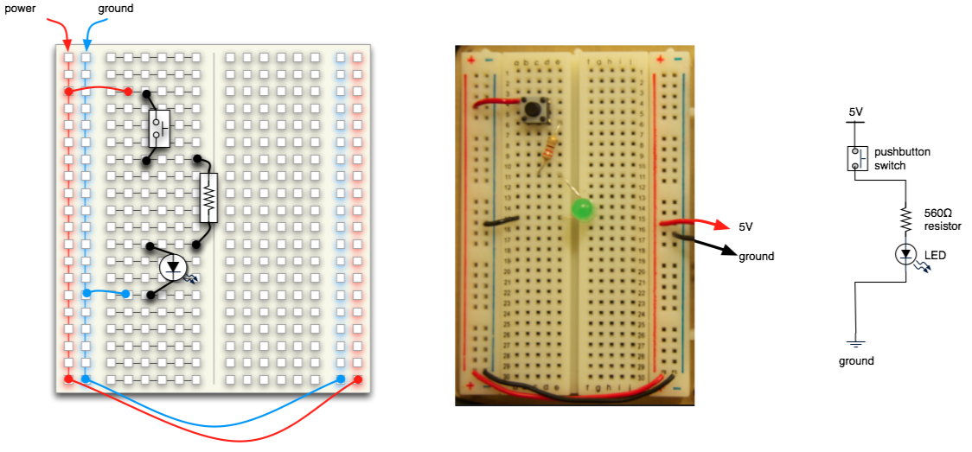

Slide 11
How can I talk to them all with one wire?
36 LEDs with one wire? Really!
+5
Data
In
Data
Out
GND

Slide 12
Blink
Make the first pixel go on and off

