Slide 1

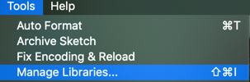

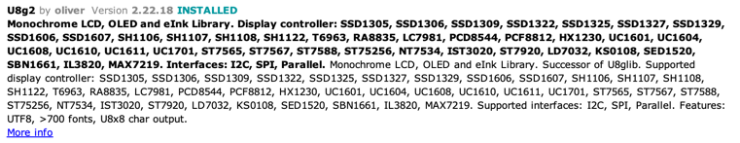

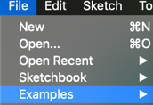

128x64 OLED Drawing Lab
Arduino Moving Rainbow
Kit Contents
Arduino Nano with CH340 driver - $2.40
1/2 breadboard (400 tie points) - $1.20
USB cable (mini-b) - $1.20
128x64 OLED - $17
Step 1: Download the Arduino Integrated Development Environment (IDE)
Download the Arduino IDE software from https://www.arduino.cc/en/Main/Software
This guide assumes you have version 1.8.8 running
Step 2: Install the u8g2 Library
Step 3: Find the U9g2 Page Buffer HelloWord Example
Step 4: Uncomment the SSD1306 128x64 unnamed Page Buffer 4-Wire Hardware SPI Constructor
// U8g2 Contructor List (Picture Loop Page Buffer)
U8G2_SSD1306_128X64_NONAME_1_4W_HW_SPI
#include <Arduino.h> #include <U8g2lib.h> #include <SPI.h> #include <Wire.h> U8G2_SSD1306_128X64_NONAME_1_4W_HW_SPI u8g2(U8G2_R0, 10, 9, 8); void setup(void) { u8g2.begin(); } void loop(void) { u8g2.firstPage(); do { u8g2.setFont(u8g2_font_ncenB10_tr); u8g2.drawStr(0,24,”CoderDojo Rocks!"); } while ( u8g2.nextPage() ); }

Slide 2
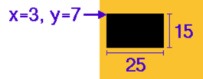
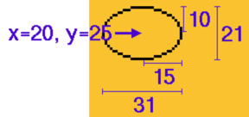
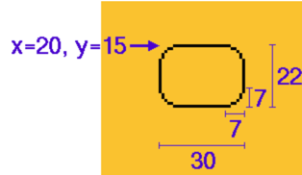
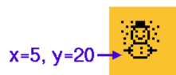
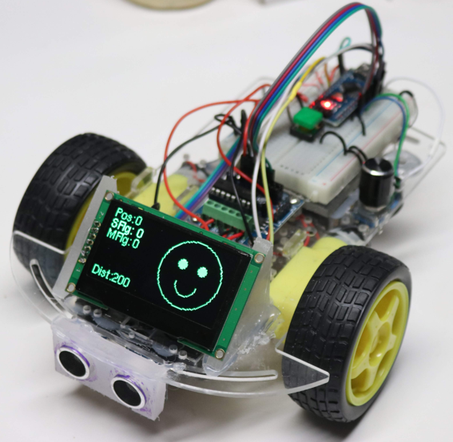
u8g2 Code Examples
Sample Draw
Sample Labs
Draw a circle
Draw a rectangle for the border
Update the center of the circle with the counter modulo the screen size
Get the circle to “bounce” off the edges of the screen
Screen
Coordinates
0
127 (x)
63 (y)
Sample Drawing Functions
drawStr(X, Y, "CoderDojo Rocks!")
drawFrame(x, y, width, height)
drawCircle(X, Y, radius, U8G2_DRAW_ALL)
drawDisc(X, Y, radius, U8G2_DRAW_ALL)
drawFilledEllipse(X,Y, height, width)
drawLine(x1, y1, x2, y2)
drawHLine(x, y, width)
drawVLine(x, y, height)
drawTriangle(x0, y0, x1, y1, x2, y2)
getDisplayWidth()
getDisplayHeight()
home()
drawBox(x, y, width, height)
drawEllipse(20,25, 10, 15, U8G2_DRAW_ALL))
drawRBox(x, y, w, h, corner_radius)
u8g2.setFont(u8g2_font_unifont_t_symbols);
u8g2.drawGlyph(5, 20, 0x2603);
/* dec 9731/hex 2603 Snowman */
https://github.com/olikraus/u8g2/wiki/u8g2reference
FaceBot Example
https://github.com/dmccreary/coderdojo-robots/blob/master/docs/face-bot.md

