Slide 1

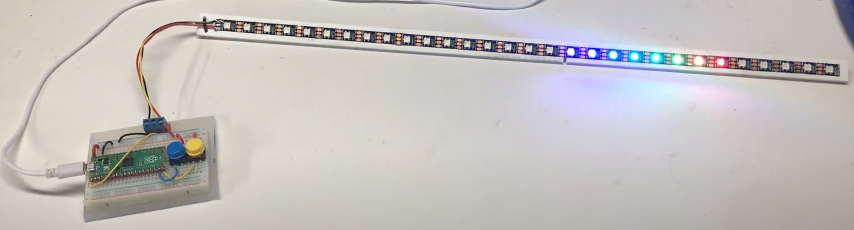
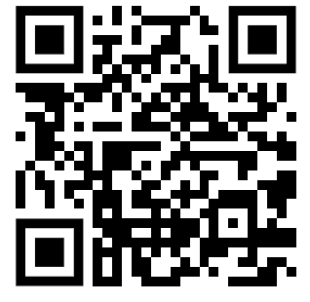
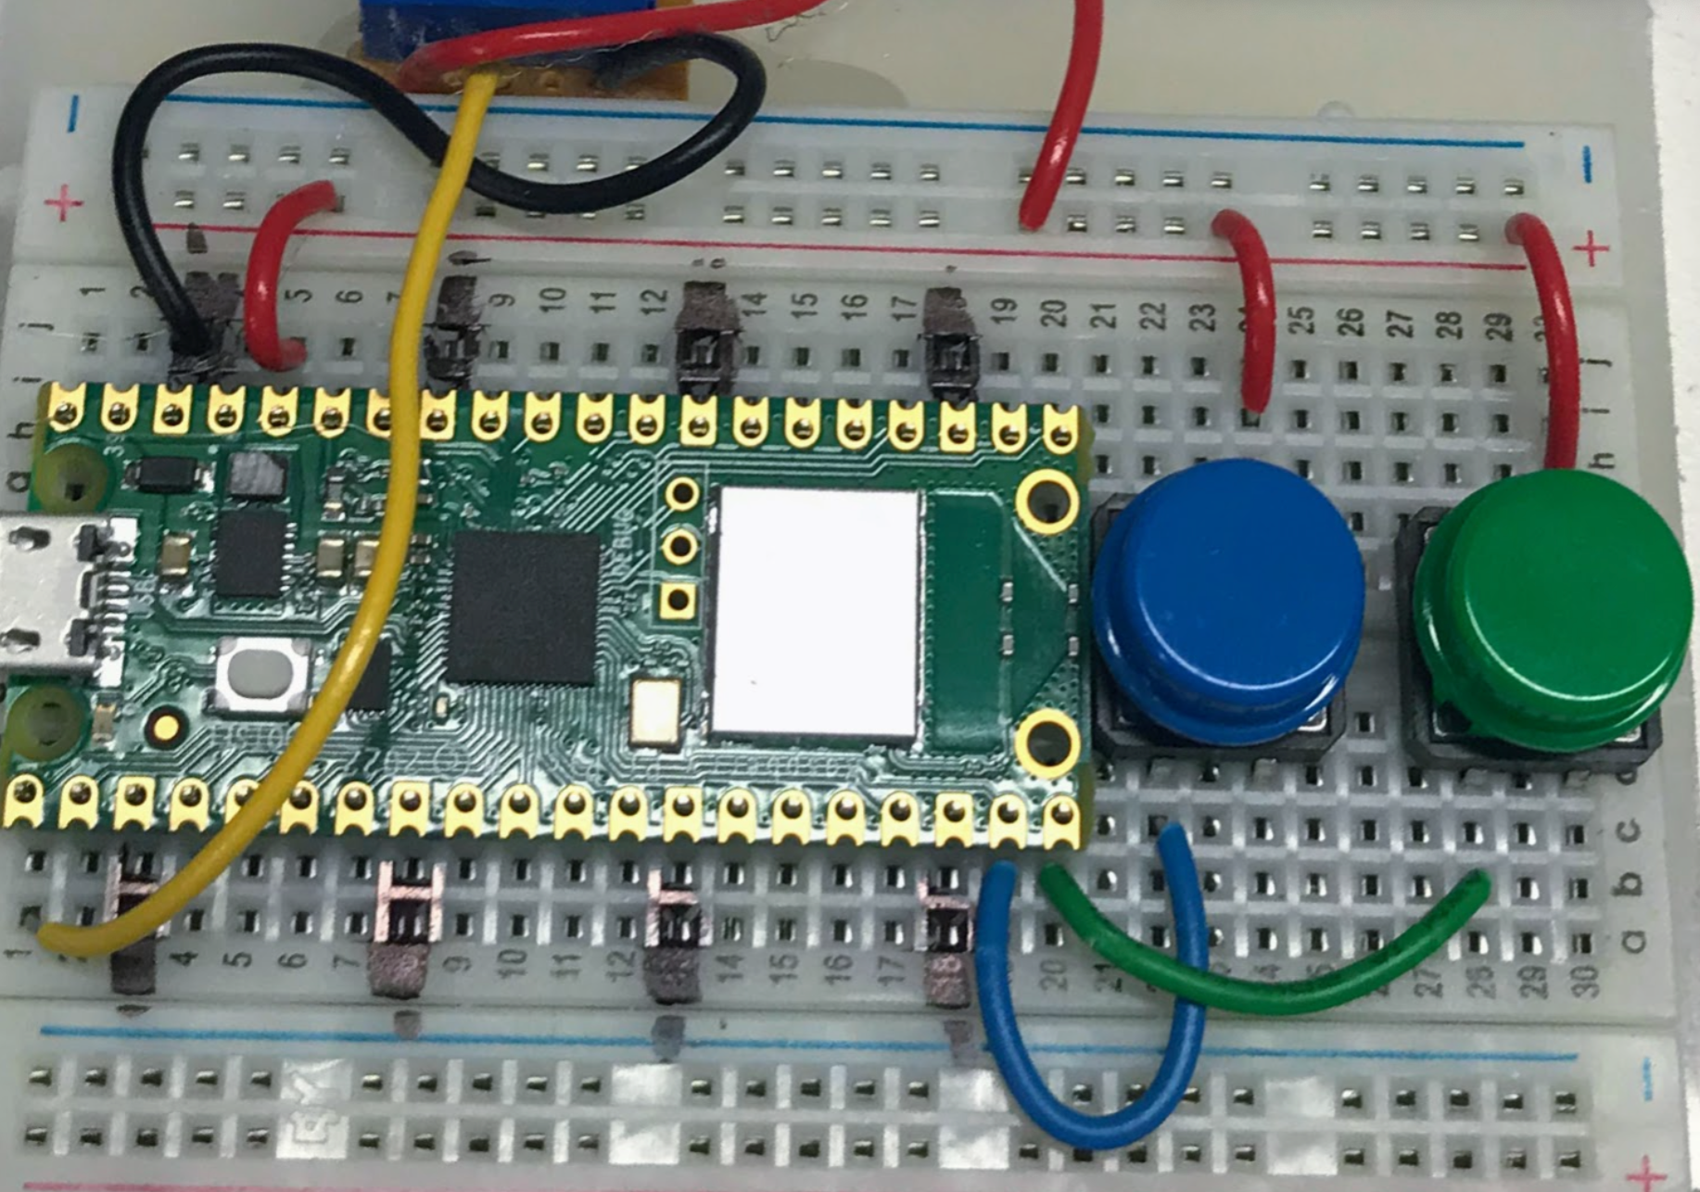
Code Savvy Moving Rainbow Labs
Moving Rainbow
Costume Contests!
Fun ways to learn Python!
Kit Contents
Raspberry Pi Pico - $4
Breadboard - $1.50
2 momentary switches – 5 cents each
Screw header - 20 cents
LED strip (SW2812B) – $4 to $7.5
Sample Lesson Plans (MicroPython)
Blink a pixel red
Blink red, green and blue
Color mixing
Heartbeats
Swipe a color
Move a dot
Move a comet
Random colors
Random patterns
Random motions
Star flicker
Theater chase
Move a pattern
Collisions
Rotating bands
10. Patterns
11. Candle flicker
12. Rainbow patterns
13. Holiday themed patterns
http://dmccreary.github.io/moving-rainbow/
FWD
REV
Mode Buttons

