Slide 1

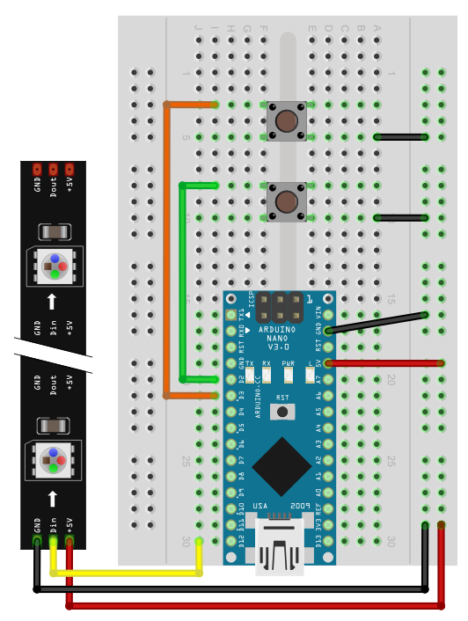
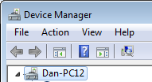

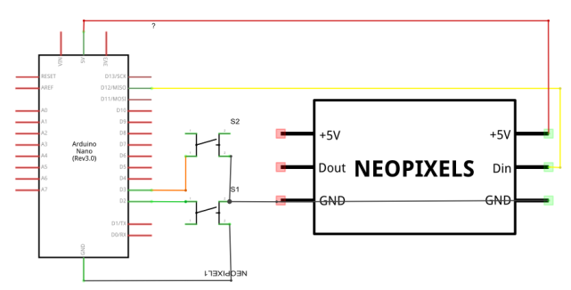

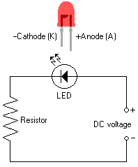
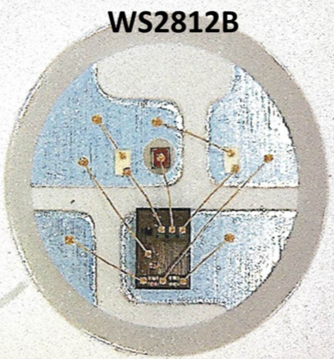
Moving Rainbow Arduino Kit
Detailed Instructions
http://moving-rainbow.readthedocs.io/en/latest/README/
…or Google "Arduino Moving Rainbow"
Setup
Breadboard Layout
Load Arduino software (IDE) on your PC or Mac¹
Load "CH341SER" Arduino serial drivers²
Connect USB
Verify power LED is on
In IDE, set board to "Nano"
In IDE, select USB port
Load NeoPixel libraries from Sketch -> Include Libraries-> Manage Libraries
Run "StrandTest"
Load Moving Rainbow Tools
Try example patterns
Write your own color patterns!
https://www.arduino.cc/en/Main/Software
http://www.wch.cn/download/CH341SER_EXE.html
https://github.com/adafruit/Adafruit_NeoPixel
Window Device Manager
Circuit Diagram
Solderless Breadboard

Slide 2
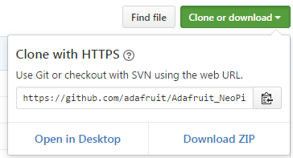
Programming Arduino WS2811B (NeoPixel) LED Strips
Getting NeoPixel Libraries from Github
Go To: https://github.com/adafruit/Adafruit_NeoPixel
Click the green "Clone or download" button and "Download ZIP"
Rename the file Adafruit_NeoPixel-master.zip to remove the "-master"
Uncompress the zip file (right click and look for the word "uncompress")
Place the file in your Home Arduino Libraries
Windows: C:\Users\dmccreary\My Documents\Arduino\libraries\Adafruit_NeoPixel
Mac: /Users/dmccreary/Documents/Arduino/libraries/Adafruit_NeoPixel
Header
#include <Adafruit_NeoPixel.h>
#define LEDPIN 12 // connect the Data from the LED strip to this pin on the Arduino
#define NUMBER_PIXELS 12 // the number of pixels in your LED strip
Adafruit_NeoPixel strip = Adafruit_NeoPixel(NUMBER_PIXELS, LEDPIN, NEO_GRB + NEO_KHZ800);
Setup
setup() void setup() {
pinMode(2, INPUT_PULLUP); // Pin 2 is pulled up to 5v when the switch is open
pinMode(3, INPUT_PULLUP); // Pin 3 is pulled up to 5v when the switch is open
strip.begin(); // sets up the memory for the LED strip
Serial.begin(9600);
Serial.println("Setup is done.");
}
Main Loop to Blink Pixel 0 to be Red
void loop() {
strip.setPixelColor(0, 255, 0, 0); // set pixel 0 to be red (index, r, g, b)
strip.show(); // send data to the strip
delay(1000); // wait one second
strip.setPixelColor(0, 0, 0, 0); // turn pixel 0 off
strip.show(); // send data to the strip
delay(1000); // wait a second
};
strip.setPixelColor(index, r, g, b)
is how we set a specific pixel's color
Move Orange Pixel Down Strip
void loop() {
for (int i=0; i<strip.numPixels(); i++) {
strip.setPixelColor(i, 255, 165, 0); // set pixel i to be orange
strip.show();
delay(100);
strip.setPixelColor(i, 0, 0, 0); // turn pixel i off
strip.show();
delay(100);
}
}
Use for loop to walk down the strip
"i" is the index or position on the strip
strip.numPixels() is the number of pixels

