Slide 1

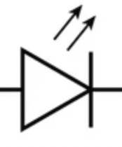
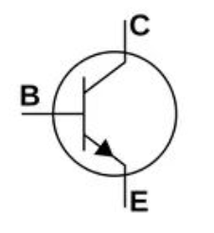
5V
220 Ohm
10K Ohm
2N2222
max 800 mA
From Raspberry Pi Pico
GND

