Slide 1

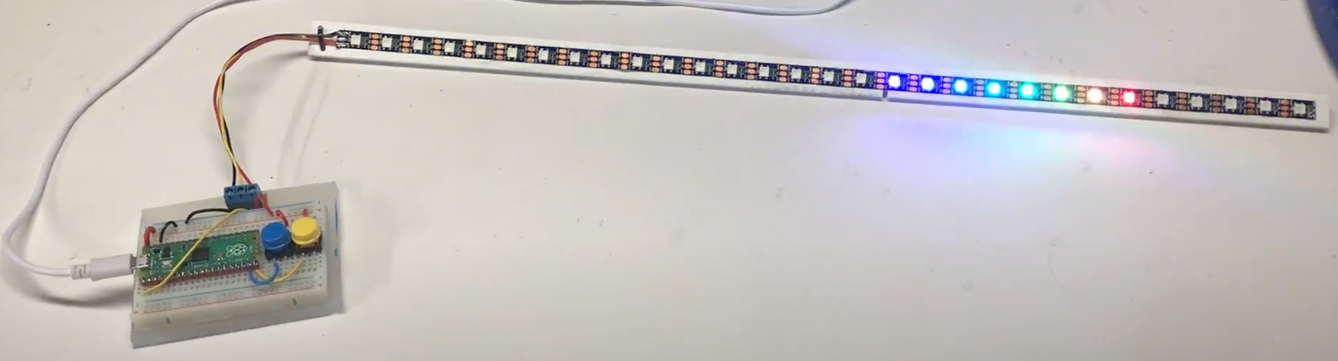
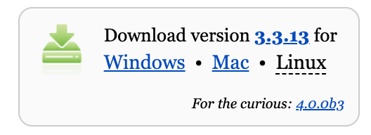
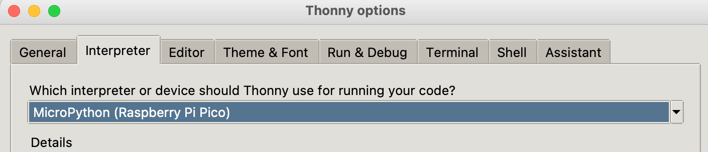
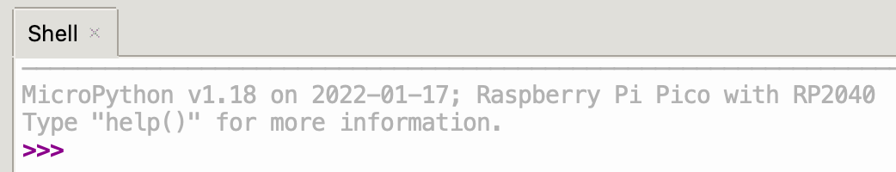
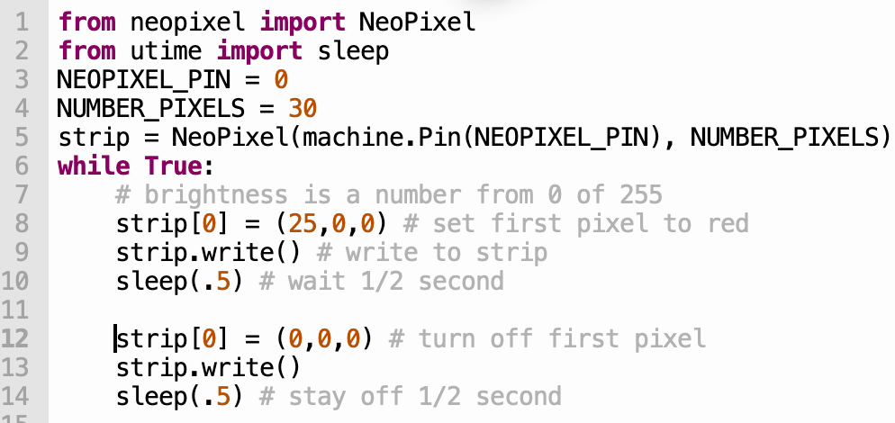
2022 STEM Day at The Thinking Spot
Moving Rainbow
Kit Contents
Raspberry Pi Pico - $4
Breadboard - $1.50
2 momentary switches – 5 cents each
Screw header - 20 cents
LED strip (SW2812B) - $2.5
Step 1: Use buttons to change the mode
What do the buttons do? Do they go forward and backward in pattern?
How many ”modes” are there? What is your favorite pattern?
Step 2: Install Thonny on your Mac or PC
Go to https://thonny.org
Download the version for your PC or Mac
Set the Interpreter to be MicroPython (Raspberry Pi Pico)
Step 3: Connect the USB to the Pico
Connect the USB from your PC to the Pico.
Test the command line.
Step 4: Run the Blink program
http://dmccreary.github.io/moving-rainbow

Slide 2
MicroPython NeoPixel Code Examples
Sample Preamble
#include <Adafruit_NeoPixel.h>
#define LEDPIN 12 // connect the Data from the strip to this pin on the Arduino
#define NUMBER_PIXELS 60 // the number of pixels in your LED strip
Adafruit_NeoPixel strip = Adafruit_NeoPixel(NUMBER_PIXELS, LEDPIN, NEO_GRB + NEO_KHZ800);
Sample Setup
void setup() {
strip.begin(); // initialize all the variables – don’t forget this line!
strip.setPixelColor(0, 255, 125, 0); // set pixel 0 to be yellow
strip.show(); // send the data to the LED strip – must do this after any change
delay(1000); // wait 1 second
}
Sample Moving Pixel
void loop() {
for (int i=0; i<NUMBER_PIXELS; i++) {
strip.setPixelColor(i, 255, 0, 0); // turn the "i"th pixel on
strip.show(); // send the data to the LED strip
delay(100); // wait 1/10th of a second – a lower number makes it go faster
strip.setPixelColor(i, 0, 0, 0); // turn the "i"th pixel off
}
}
Sample Labs
Learn how to solder solid wires to ends of battery pack
Hook up battery to breadboard rails
Hook up LED circuit in series with 330 ohm resistor
Add a button to turn on and off the LED
Plug in Arduino Nano to breadboard
Connect 5v and GND wires and verify the LEDs on Arduino work
Download Arduino IDE software and plug in USB cable
Get "blink" lab to work (configure board and port) and use upload button
Change the “delay” time in the blink lab from 10 to 1000 milliseconds
Download NeoPixel libraries
Connect NeoPixel strip to pin 12
Run NeoPixel example programs (strandtest)
Find Moving Rainbow examples
Work though various examples
On moving rainbow github/src find mini-maker-fair LED strip two buttons program
Wire button from D2 (interrupt) to ground
Try all the modes
Create your own mode pattern

