Slide 1
Teaching Computational Thinking
Example: LED Strips
A Froebel Gift for the digital age

Slide 2
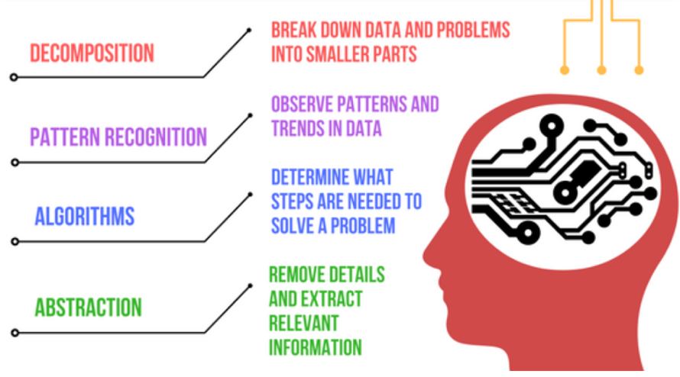
Computational Thinking
Definition: A set of problem-solving methods that involve expressing problems and their solutions in ways that a computer can execute.
https://en.wikipedia.org/wiki/Computational_thinking

Slide 3
Two Key Question
What is the simplest device that you can give a student to take home that shows their mastery of computation thinking?
What can we do to make these devices accessible to disadvantaged communities?

Slide 4
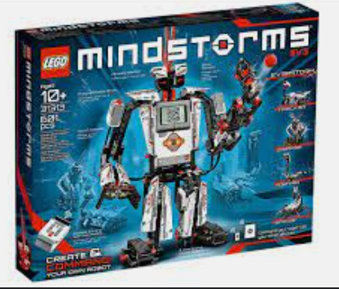
Focus on Disadvantaged Youth
There are many $400 robot kits being purchased by wealthy families with high disposable incomes
Not all schools can provide these kits to each student to take home
Can we teach computational thinking for less?
Can we cut the costs?
Can we make these kits accessible?

Slide 5
Three Dimensions of Accessibility
Low cost: target price under $20
Free curriculum that teachers can modify (Creative Commons license)
Can we show teachers, mentors and community leaders how to use these kits?

Slide 6

Social Constructionism
Students learn more when the build things with others
How can we get students to work together to solve problems without boundaries?
Break down boundaries
  Other genders – boys and girls working together
  Other races
  Other religions
  Other background
  Other skills
https://en.wikipedia.org/wiki/Social_constructivism#Education

Slide 7
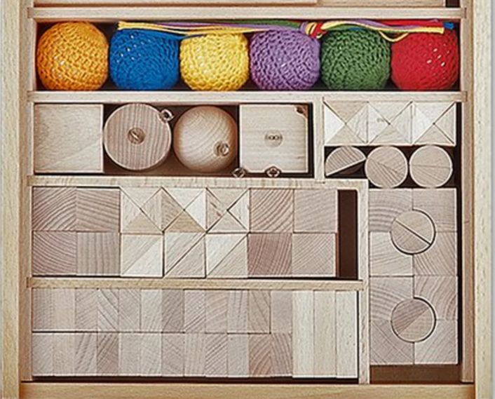
Froebel Gifts
In the 1830s, Friedrich Froebel (the inventor of Kindergarten) created as set of toys that he believed would help them learn about the world
The toys were designed from the very simple ball of wool to increasingly complex blocks with geometric shapes
https://en.wikipedia.org/wiki/Froebel_gifts

Slide 8
NeoPixels (WS281X standards)
Around 2013 manufactures started to standardize the way that LED strips were made and controlled using shift registers
Factories focused on automating the assembly of red, green and blue LEDs on a structure that could be programmed with a single data wire
This type of LED became widely known for its ease of use in creating colorful lighting effects with microcontrollers

Slide 9
How Do NeoPixels Work?

Slide 10
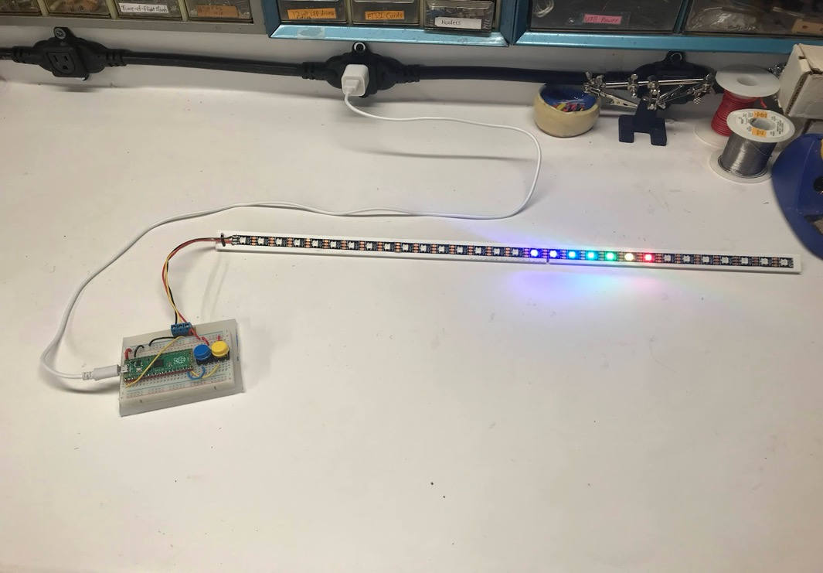
LED Strips as a Digital Froebel Gift
We have been studying interactive tools for teaching computational thinking for over ten years.
We believe that the combination of the RP2040 microcontrollers, micropython and LED strips have allowed us to create a new low-cost (under $10) toy that can be a key step in education

Slide 11

Our Journey
Dan: Teaching my three daughters about electronics taught me some important lessons
  They love “hands on” learning
  They love the beautiful colors of LEDs
  They love taking their inventions home to show their friends!
We created kits for friends and family made from simple boxes with switches and single-color LEDs
Students loved to throw them in their backpacks and show their friends!

Slide 12
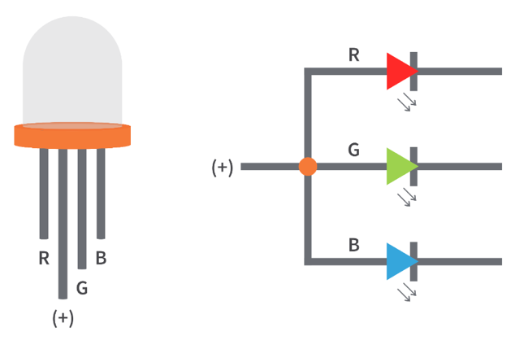
Changing Colors
LEDs with Red, Green and Blue can be mixed together to form any color of the rainbow
Four wires, three resistors – too complicated for many young students

Slide 13
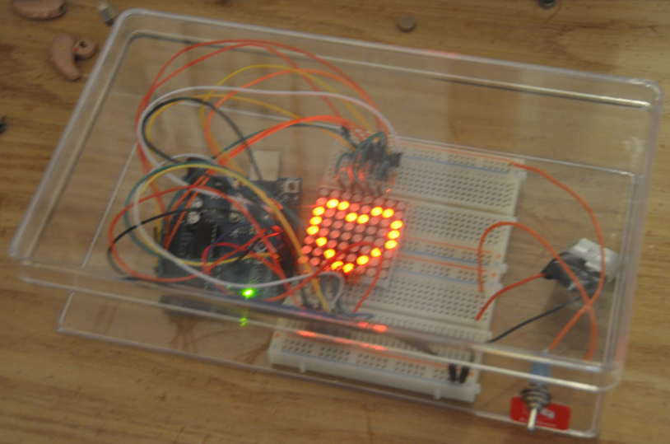
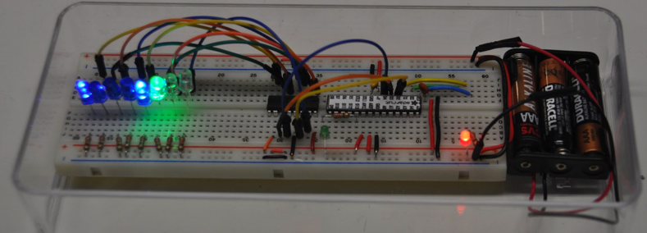
2014: Arduino
In 2014 I started to use the Arduino to control LEDs
They were expensive, hard to wire (lots of soldering) and required out students to learn C
Each RGB LED required four wires

Slide 14
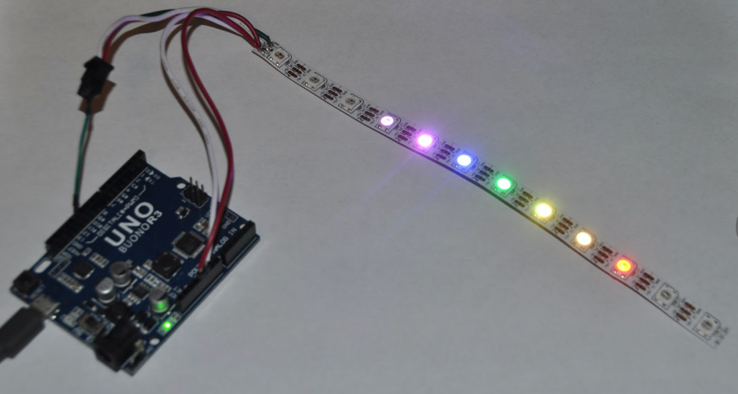
2015: LED Strips
Only three wires to connect
1 meter of 60 RGB LEDS for $25
But the Arduino Uno was still too expensive ($25)

Slide 15
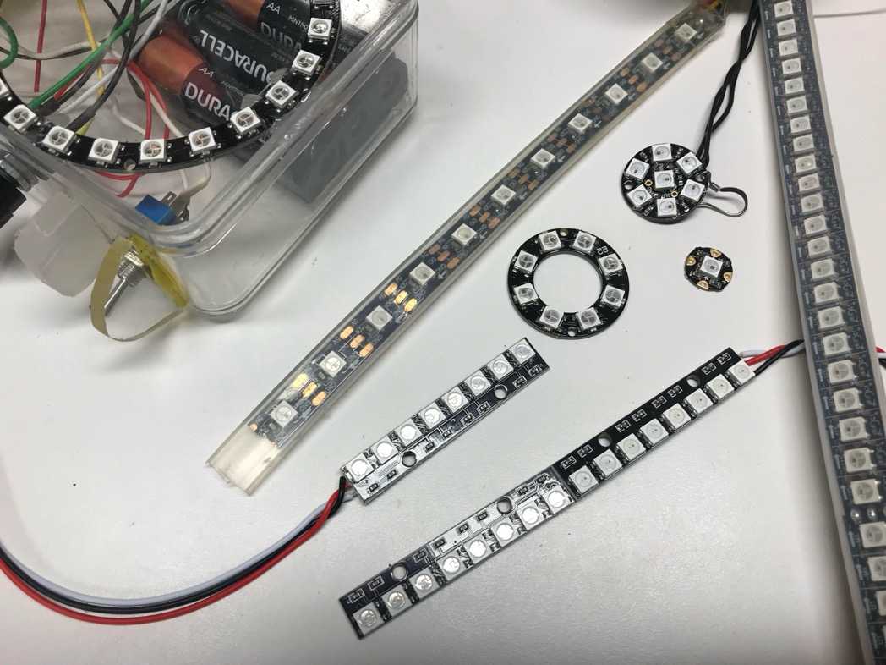
NeoPixel Strips and Rings
Many shapes and sizes
Easy to connect
  Ground
  Power
  Data

Slide 16
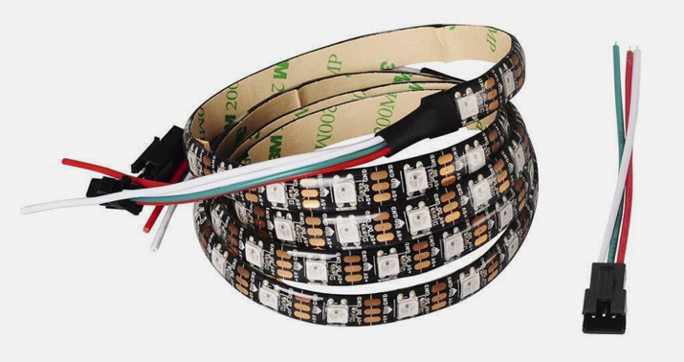
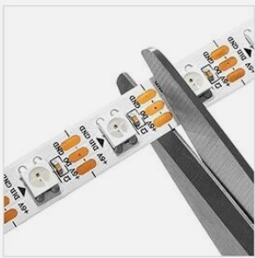
Low Cost and Standard Connectors
1-meter-long LED strips with 60-pixels per meter can cost as little as $3 per strip
3-pin SM JST “dummy proof” connectors make it easy for anyone to connect these strips without any soldering
LED strips can be cut to any length but the new strips will require soldering

Slide 17
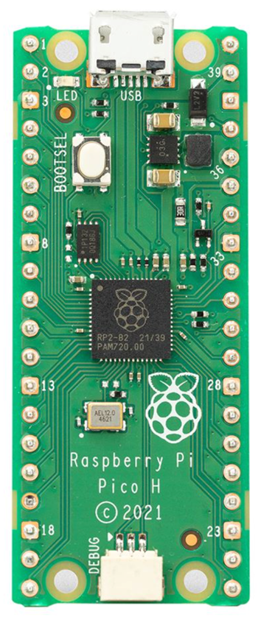
January 2021: Python comes to a $4 microcontroller!
Retail list price: $3.99!
Enough RAM to run Python and store thousands of patterns

Slide 18
The Basic NeoPixel Circuit – three wires
Retail list price: $3.99!
Enough RAM to run Python and store thousands of patterns

Slide 19
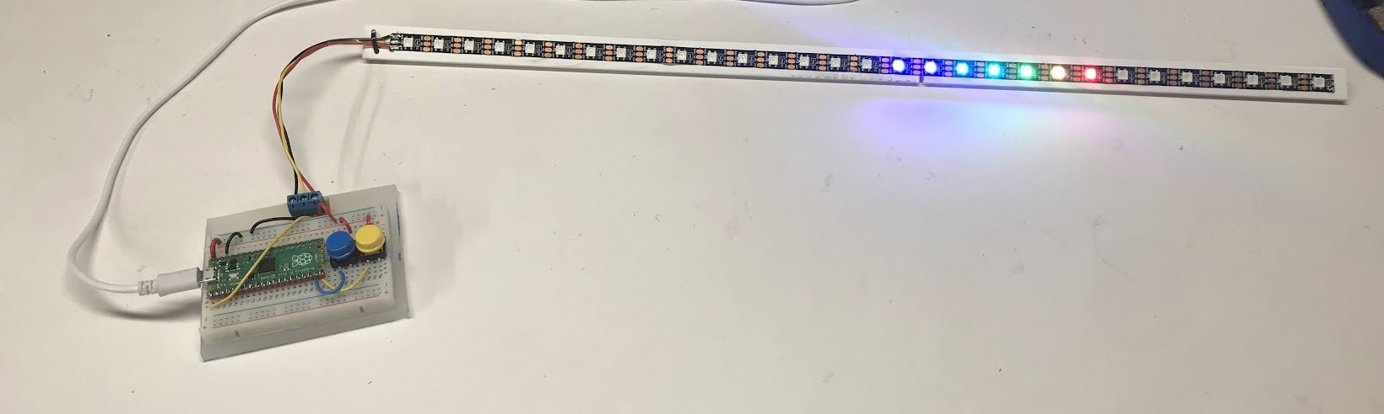
The 2022 “Moving Rainbow Kit”
30 RGB LEDs
Two momentary push buttons
Thousands of patterns!
Volume prices under $10!

Slide 20
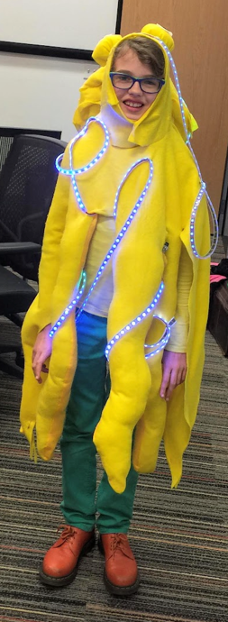
Costumes
Add bling to your
  Neckless
  Hats
  Belts
  Armbands

Slide 21
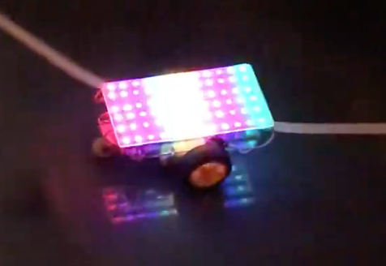
Colorful Robots
Robot with 72 RGB LEDs

Slide 22
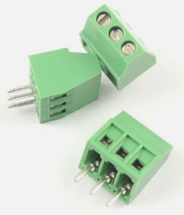
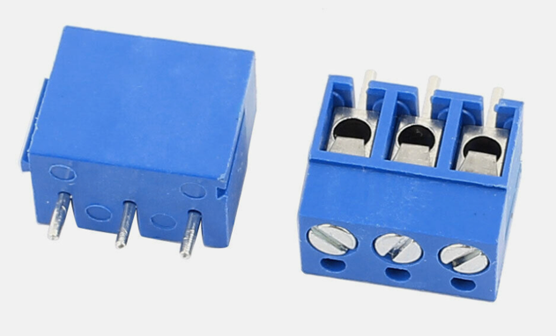
Modularity: Screw Headers
Our boards have 3-wire screw headers to allow for quick changes of the types of LED connectors

Slide 23
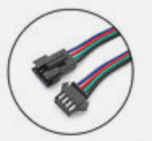

Modularity: JST Connectors
3 Pin SM JST LED Strip connectors and extension

Slide 24
Summary
We need your help!
Help us
  Teach computational thinking
  Promote low-cost kits
  Help us build on-line content (lesson plans)
Connect us with
    Schools
    Coding clubs
    Community centers
    Libraries
    Maker groups

