Slide 1

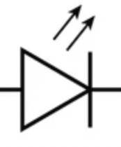
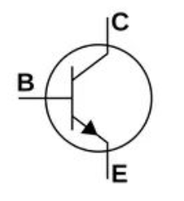
5V
220 Ohm
10K Ohm
2N2222
max 800 mA
From Raspberry Pi Pico
GND

Slide 2
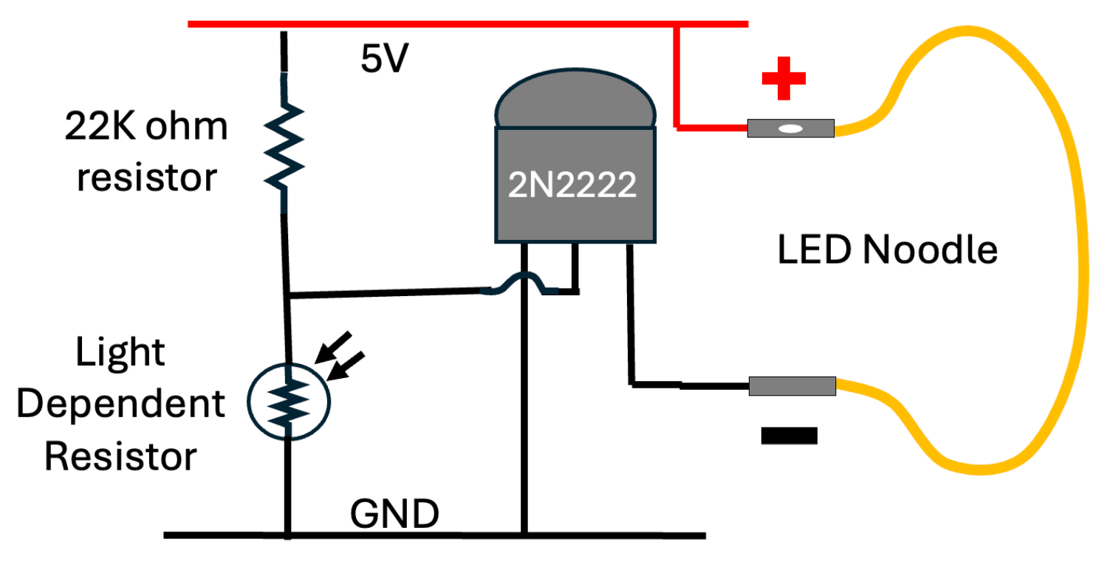
10K Ohm

Slide 3
10K Ohm

Slide 4
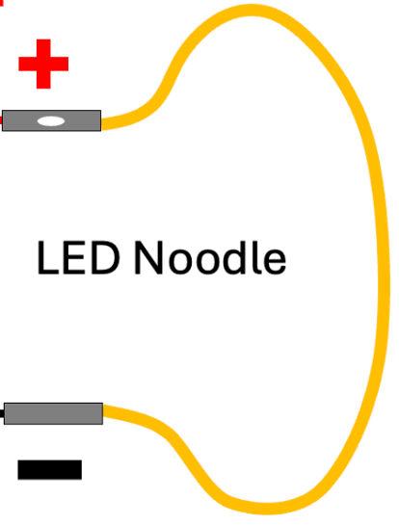
2N2222
10K Ohm
B
E
C

