Slide 1
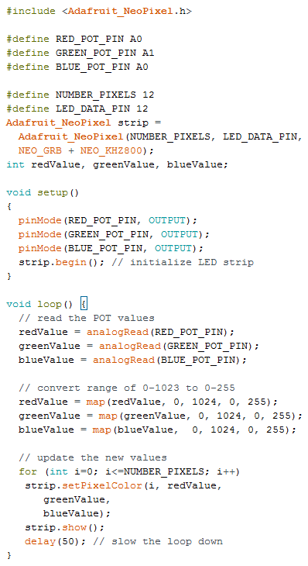
RGB Lab
RGB Lab
Turn potentiometers to make red, green or blue change. Mix RGB values to make any color you want!
Turn potentiometers to make red, green or blue change. Mix RGB values to make any color you want!

