Slide 1

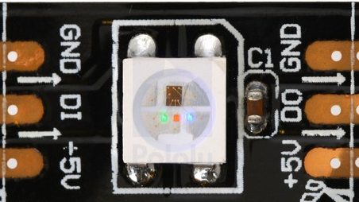
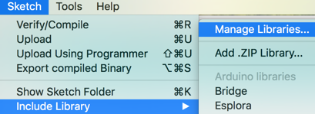


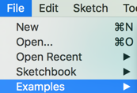

Page 4
Page 1
Arduino Moving Rainbow
Color | Red | Green | Blue
Off | 0 | 0 | 0
Red | 255 | 0 | 0
Green | 0 | 255 | 0
Blue | 0 | 0 | 255
Yellow | 255 | 125 | 0
Orange | 200 | 160 | 0
Purple | 255 | 0 | 255
White | 255 | 255 | 255
Hook Up the LED Strip
Arduino
GND
Data Pin (12)
VCC (5V)
Install the NeoPixel Library
Pattern Names
Moving Pixel
Swipe
Comet
Sparkle
Candle
Random Color
Larson Scanner (Cylon)
Theater Chase
Open the NeoPixel Example: Strandtest
Sample Ideas
Turn first pixel on and off (“blink” lab)
Change the “delay” time in the blink lab from 10 to 1000 milliseconds
Run NeoPixel example programs (strandtest)
Find Moving Rainbow examples
Work though various examples
On moving rainbow github/src find mini-maker-fair LED strip two buttons program
Wire button from D2 (interrupt) to ground
Try all the modes
Create your own mode pattern
Sample Preamble
#include <Adafruit_NeoPixel.h>
#define LEDPIN 12 // connect the Data from the strip to this pin on the Arduino
#define NUMBER_PIXELS 12 // the number of pixels in your LED strip
Adafruit_NeoPixel strip
= Adafruit_NeoPixel(NUMBER_PIXELS, LEDPIN, NEO_GRB + NEO_KHZ800);

Slide 2
Page 2
Page 3
Adafruit NeoPixel Uberguide
https://learn.adafruit.com/adafruit-neopixel-uberguide/arduino-library-use
NeoPixel Functions
Three Key Functions
strip.begin()
strip.setPixel(index, red, green, blue)
strip.show() – this sends the data to the LED Strip
N = strip.numPixels() // get the number of pixels
Sample Preamble Set
#include <Adafruit_NeoPixel.h>
#define LEDPIN 12 // connect the Data from the strip to this pin on the Arduino
#define NUMBER_PIXELS 30 // the number of pixels in your LED strip
Adafruit_NeoPixel strip
= Adafruit_NeoPixel(NUMBER_PIXELS, LEDPIN, NEO_GRB + NEO_KHZ800);
Sample Setup
void setup() {
strip.begin(); // initialize all the variables – don’t forget this line!
strip.setPixelColor(0, 255, 125, 0); // set pixel 0 to be yellow
strip.show(); // send the data to the LED strip – must do this after change
delay(1000); // wait 1 second
}
Debugging
Did you use the right LED pin?
Did you call strip.begin() in setup()?
Are you calling strip.show() after changing pixel color?
Sample Moving Pixel
void loop() {
for (int i=0; i<NUMBER_PIXELS; i++) {
strip.setPixelColor(i, 255, 0, 0); // turn the "i"th pixel on
strip.show(); // send the data to the LED strip
delay(100); // wait 1/10th of a second – a lower number makes it go faster
strip.setPixelColor(i, 0, 0, 0); // turn the "i"th pixel off
}
}
http://moving-rainbow.readthedocs.io/en/latest/README/

