Slide 1
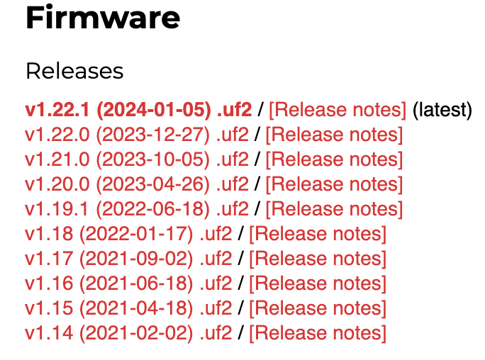
Click Here

Slide 2
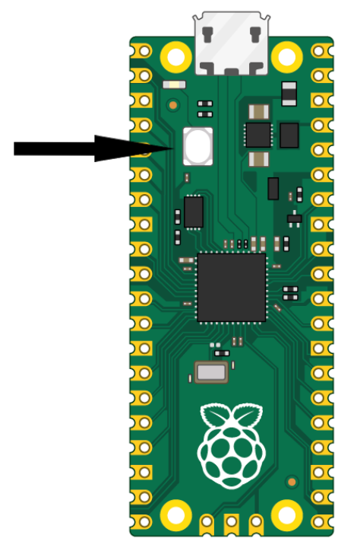
BOOTSEL
Button
Hold down during power on

Slide 3
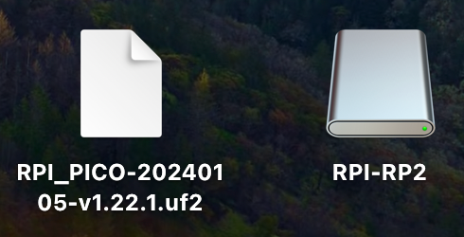
Drag the .uf2 file over the RPI-RP2 folder

Slide 4
Thonny
Desktop
File System
MicroController
File System

