Slide 1
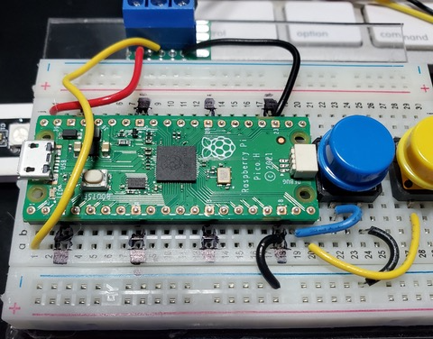
Raspberry Pi Pico
Button to Ground
Pin 14
Pin 15
Ground Rail
Pico to Ground

