Slide 1
Image to Sim

Slide 2
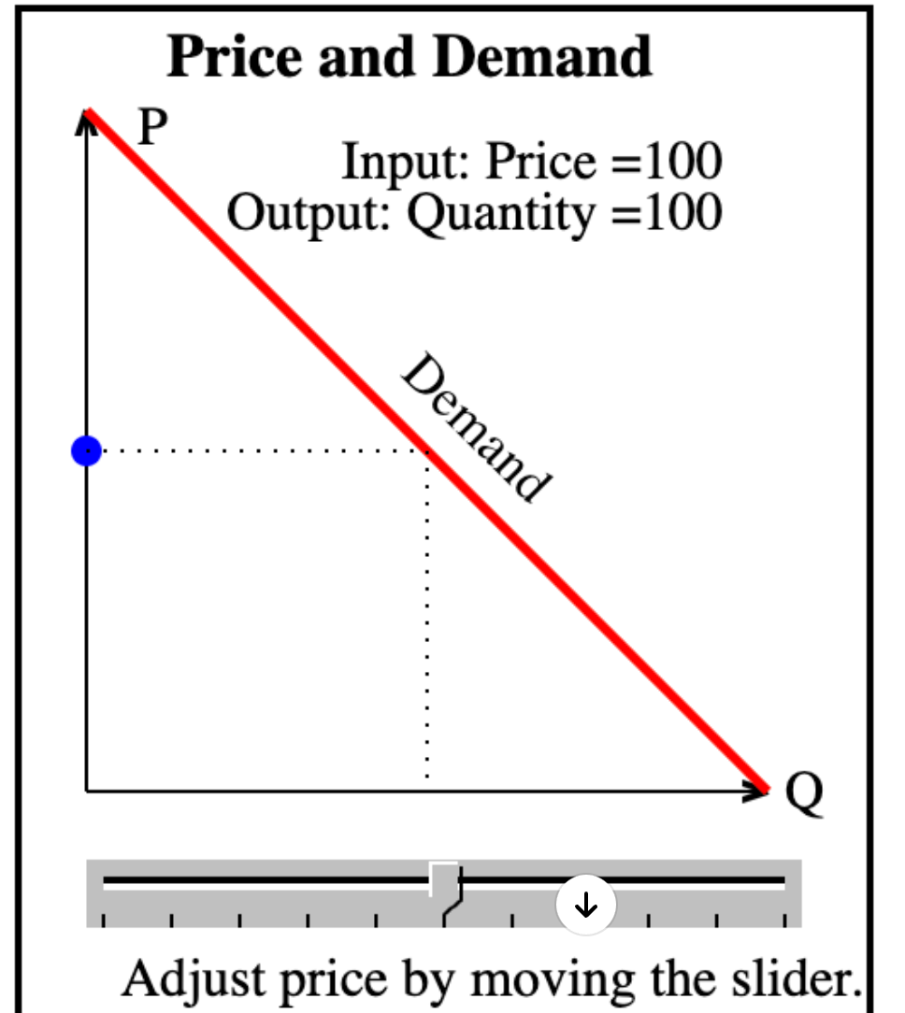
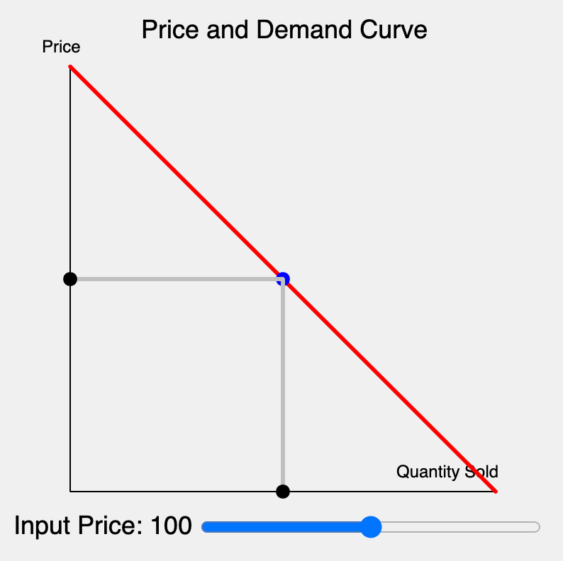
Image on left
10 min ->
Working Simulation
Image Uploaded

