Slide 1
Claude Desktop User Interface Review
Part of the Crash Course in AI
Guide to Screen Regions for July 20th, 2026
Version 1.22209.3 (babe11)

Slide 2
Key Fact: Daily Updates
Claude Desktop is being co-written by Claude Mythos – one of the most powerful models in history
As a result, new features are being added daily
This UI guide will be out of date in a few days

Slide 3
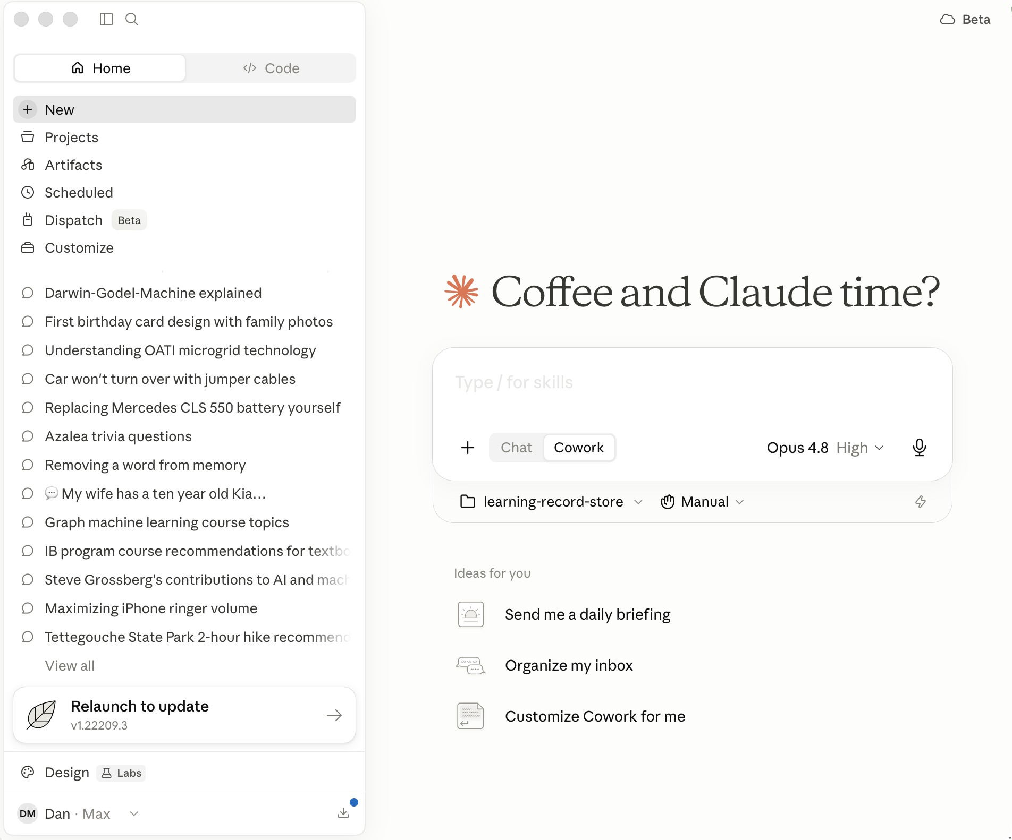
Home Screen
Toggle
Sidebar
Cloude Continue
Search
Pair Mobile Phone
Code
Toggle
Model Selector
Task
Scheduler
UI Design
Approval Mode
Get Apps

Slide 4
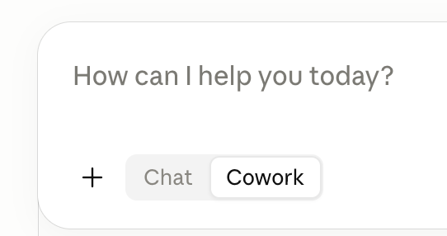
Chat (Cloud) vs. Cowork
Note that you can toggle between Chat (which run in the cloud and does not have access to your local desktop) and Cowork which communicates with your desktop tools but within a remote virtual machine

Slide 5
Chat vs. Cowork
The key difference is file access and autonomy.
Chat is for regular back-and-forth conversation. Claude responds to your messages one at a time and can offer guidance, but it can't directly read, edit, or create files on your computer.
Cowork is agentic. You describe an outcome, and Claude takes on complex, multi-step tasks and executes them on your behalf—reading, editing, and creating files in folders you specify, using connected tools. You can step away and come back to finished work (documents, organized files, research). It completes tasks rather than just describing how to do them. It does not go outside your desktop. (See Code)

Slide 6
Claude Cowork vs. Claude Code
The key difference is who they're built for and the kind of work they do, even though both run on the same underlying agentic architecture.
Claude Code is built for software engineering—writing, debugging, and shipping code. It's aimed at developers and lives in the terminal, IDEs like VS Code and JetBrains, and the desktop app.
Cowork is built for non-coding knowledge work—research, analysis, document creation, organizing files, and other multi-step tasks. It's aimed at knowledge workers and professionals, requires no terminal, and lets Claude read, edit, and create files in folders you specify so you can describe an outcome, step away, and come back to finished work.
In short: same engine, different audience. Code targets engineers in a developer environment; Cowork targets everyone else doing general knowledge work.

Slide 7
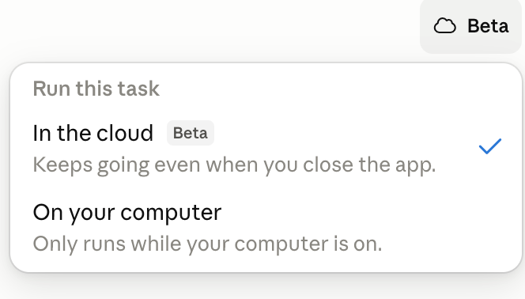
Cloud Continuation

Slide 8
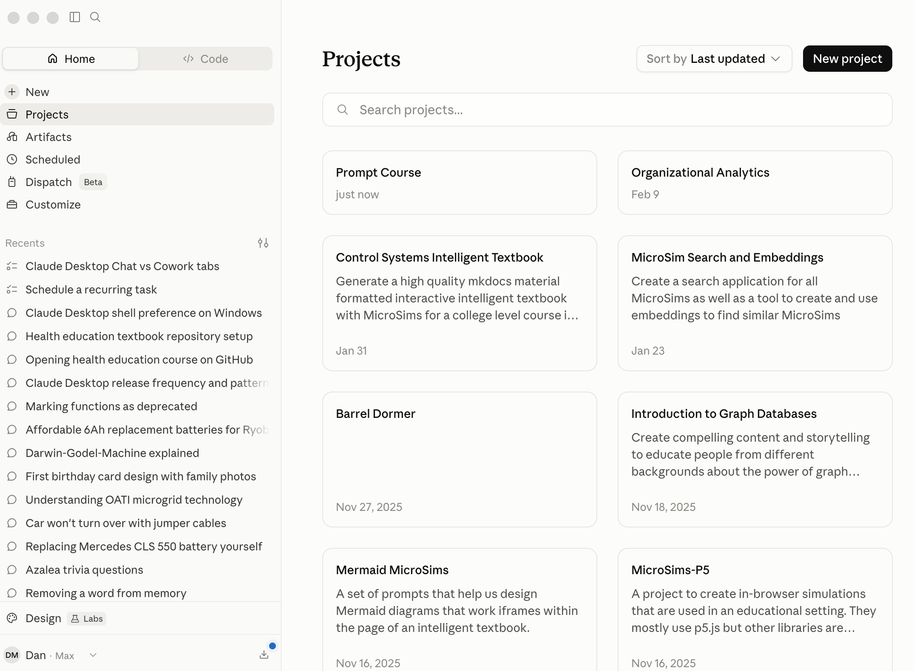
Projects
Projects allow you put prompt resources together
Home projects (Chat and Cowork) are different than Code projects

Slide 9
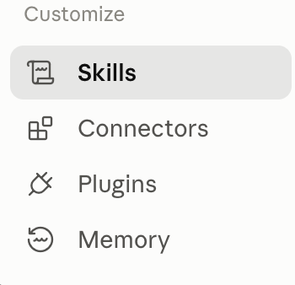
Customize
Packages of precise rules for specific tasks
Ways to connect to applications and database
Ways to connect to applications and database
What Claude remembers between sessions.

Slide 10
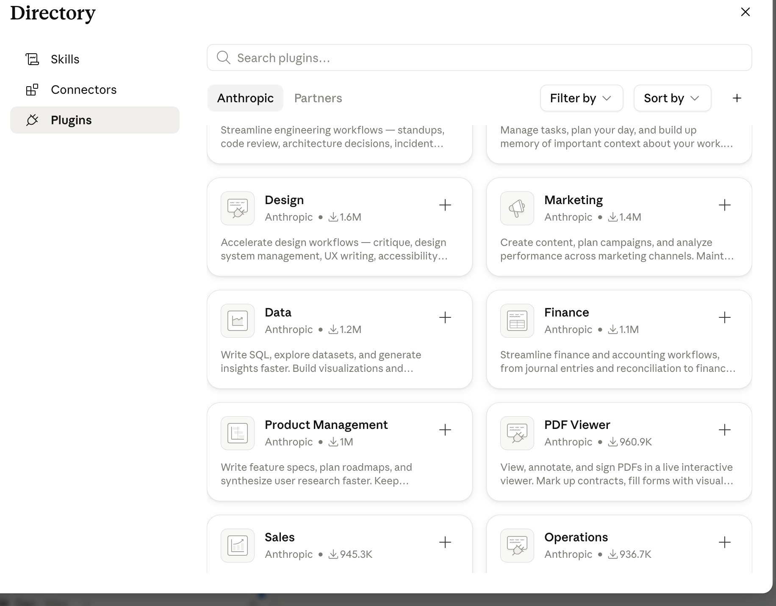
Plugins

Slide 11
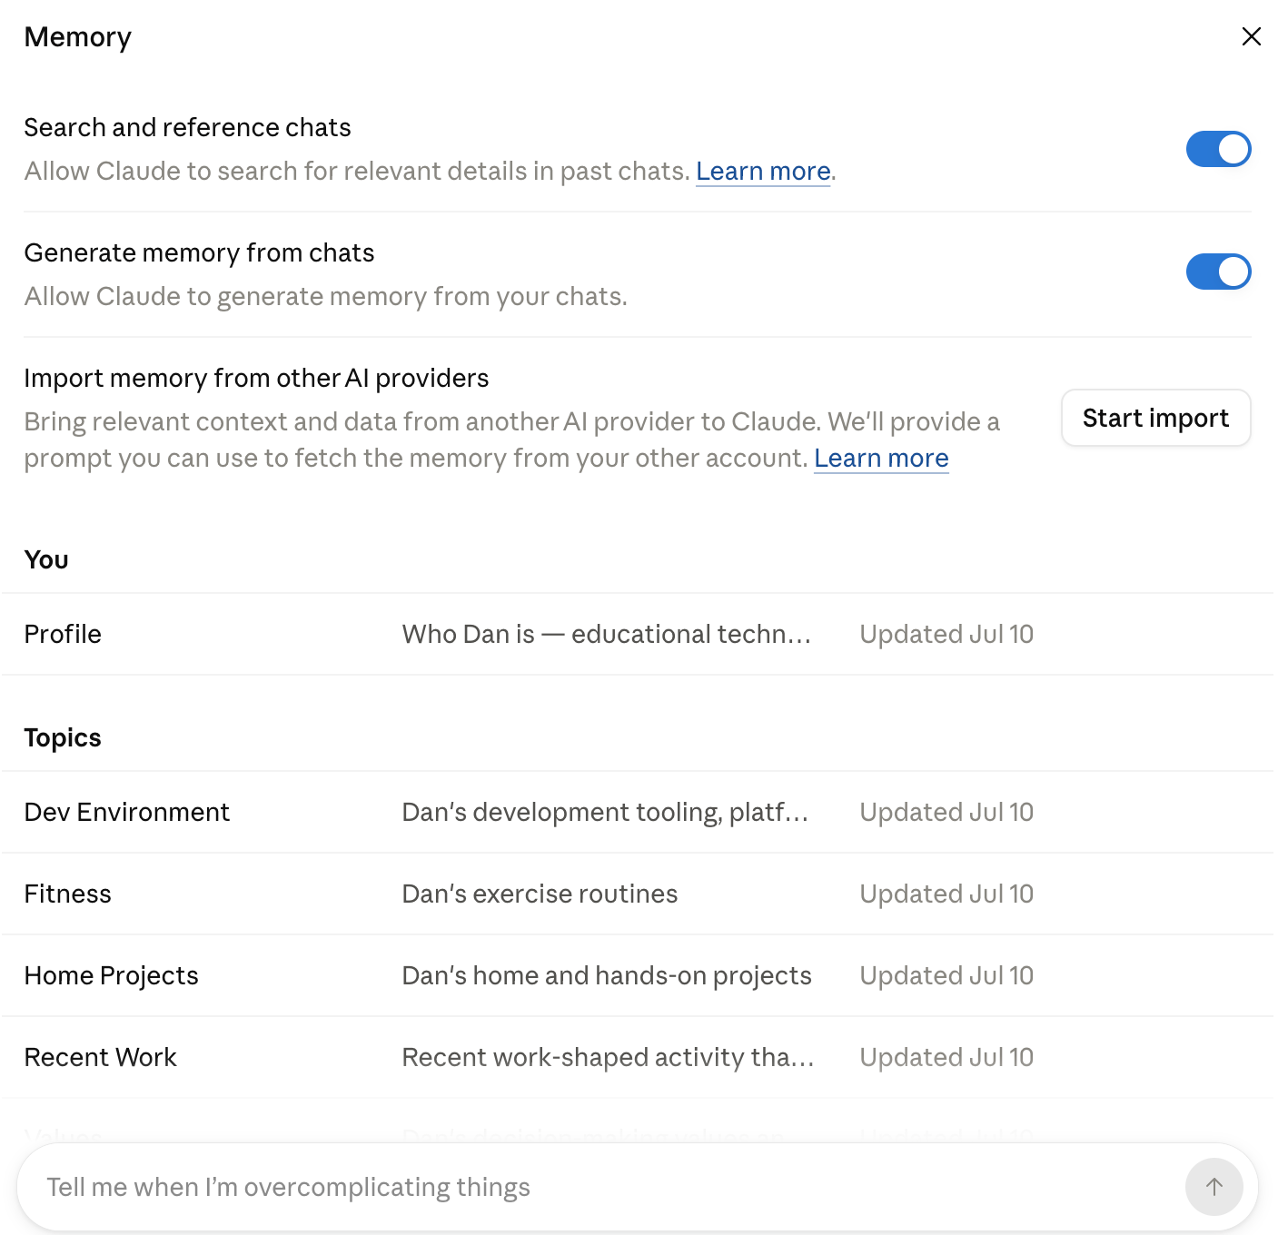
Memory

Slide 12
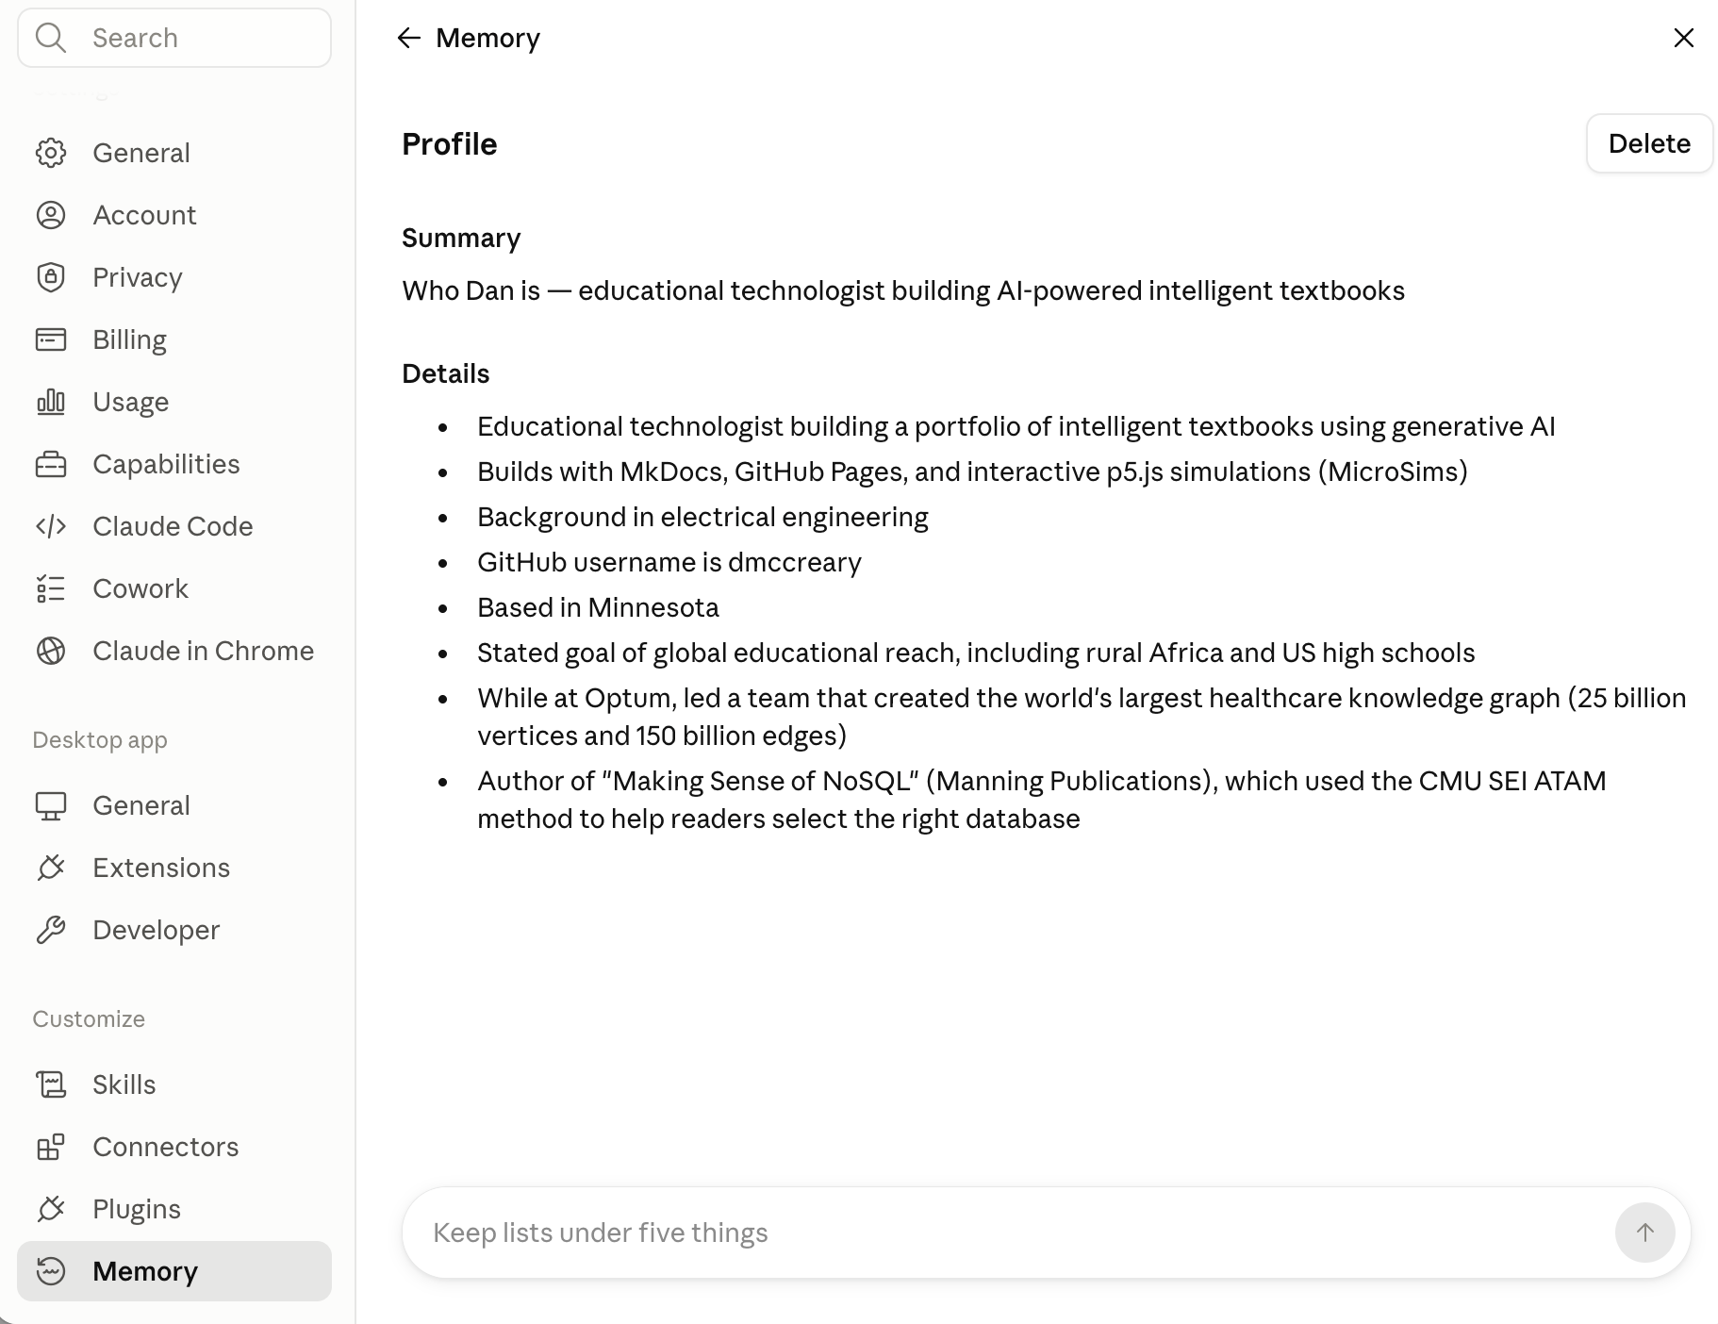
User Profile

Slide 13
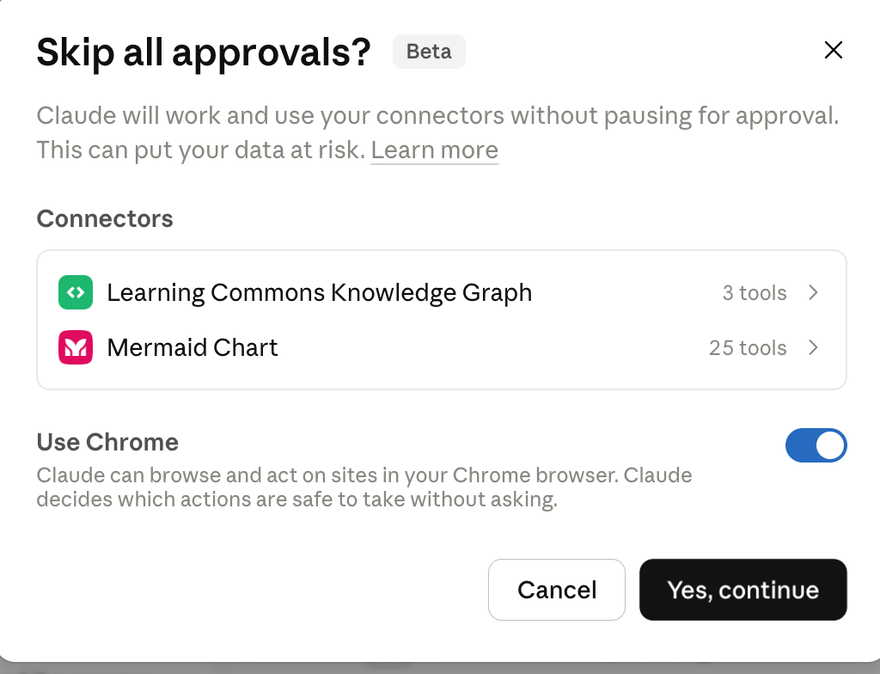
Skip All Approvals/Connectors/Chrome
Allow Claude to
Use Chrome browser

Slide 14
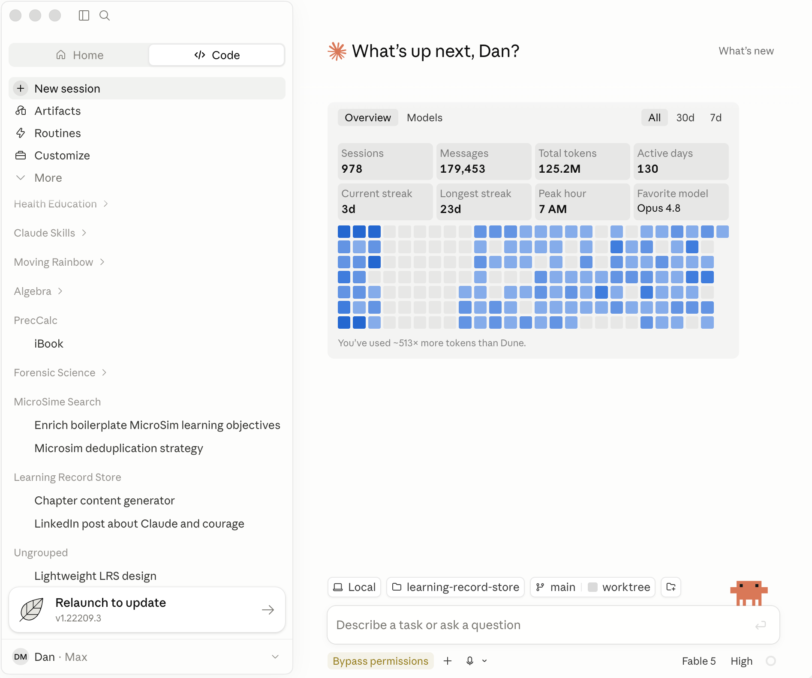
Claude Desktop Screen Regions

Slide 15
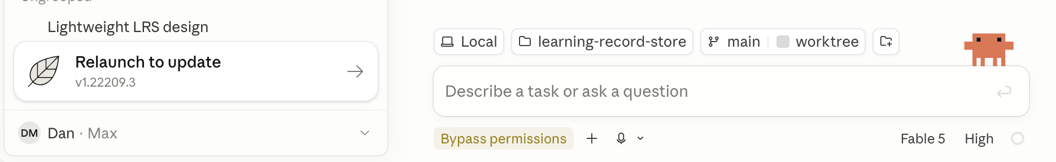
Regions of the Claude Desktop Footer
Local or
Cloud
File System
Update Reminder
Git
Branch
Working
Tree
Add
Files
Claude
Mascot
Directory
Account
Permissions
and
Planning
Voice
Dictation
Model
Selector
Effort
Level
Resources
Remaining
Circle
Plan

Slide 16
Installing Claude Desktop on Windows
Requires that the Windows System for Linux (WSL) is installed
https://support.claude.com/en/articles/12622703-deploy-claude-desktop-for-windows

