Slide 1
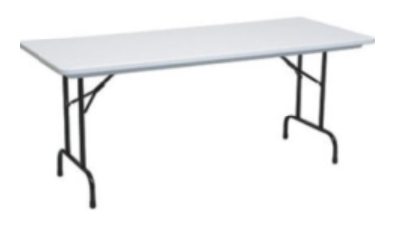
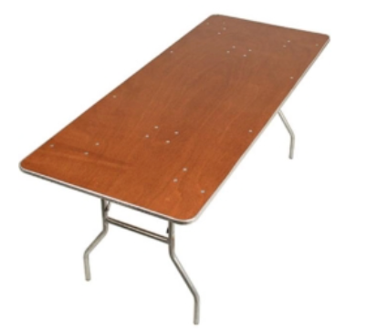

Rental Table Standards
6 ft.
2.5 ft.
The typical dimensions for a six-foot long rectangular table, often used in events and rental settings, are as follows:
Length: 6 feet
Width: About 30 inches (76 cm)
Height: Generally, around 30 inches (76 cm)
These dimensions are standard “banquet tables”, allowing for comfortable seating and dining space but they work great for these events

Slide 2

Robot Day Room Layout – 6 6’x30” tables in a 24’ x 36” room
Volunteer
Volunteer
Volunteer
Welcome
Table
Batteries
Table
Motors
Table
Checklists
& Badges
1
2
3
Robot
Corral
Entrance
Traffic Flow
Greeter
Sensors
Table
Displays
Table
Microcontroller
Table
4
5
6
Volunteer
Volunteer
Volunteer
1 in = 2.5 ft

Slide 3
Robot Day Room Layout – 8 6’x30” tables in a 24’ x 36” room
Volunteer
Volunteer
Volunteer
Volunteer
Welcome
Table
Batteries
Table
Motors
Table
Sensors
Table
1
2
3
4
Entrance
Robot
Corral
Greeter
Displays
Table
Microcontrollers
Table
Coding
Table
AI Racing League
Table
5
6
7
8
1 in = 2.5 ft
Volunteer
Volunteer
Volunteer
Volunteer

