Slide 1
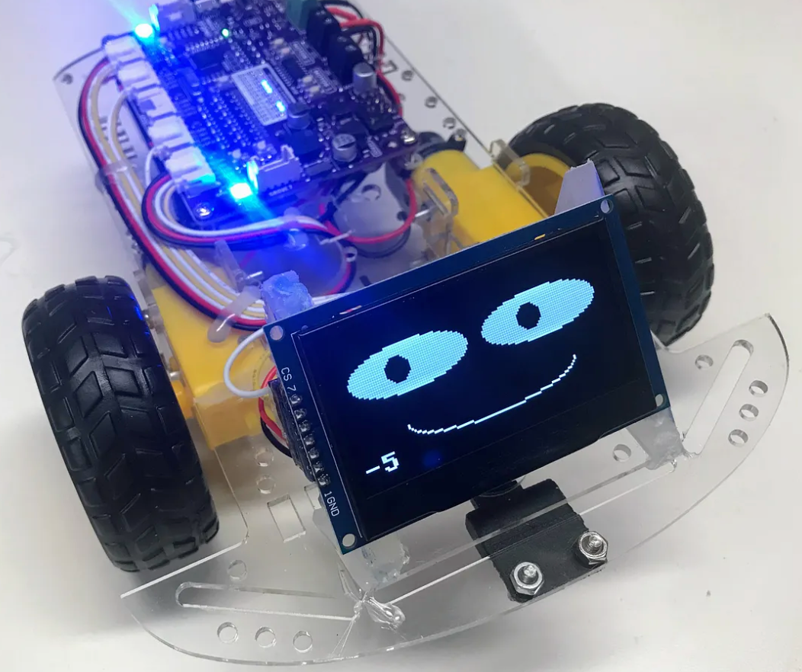
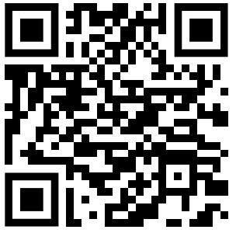
Dan’s Robot Labs
We have created hundreds of hands-on labs and MicroSims that help kids learn about many STEM topics. Our focus is creating fun labs using low-cost parts for under-privileged youth. The QR Code below can be used to go to a webpage that lists many of these sites.
$35 Robot
Beginning Python
MicroPython for Kids (over 25K visits)
Moving Rainbow (LEDs, NeoPixels, LED Noodles)
MicroSims
STEM Robots
Robot Faces
MicroPython Clocks and Watches
AI Racing League
Beginning Electronics
Circuits
Signal Processing (with the Univ. of MN)
Introduction to Data Science with Python
Generative AI for Teachers
Prompt Engineering
Systems Thinking
Learning Graphs
Graph Learning Management Systems
AI Assisted Geometry
Note: All content is licensed under Creative Commons SA NC. You may use and remix these most your classes free of charge. Attribution is appreciated. You may not resell this content. See the license terms on the websites for details

