Slide 1
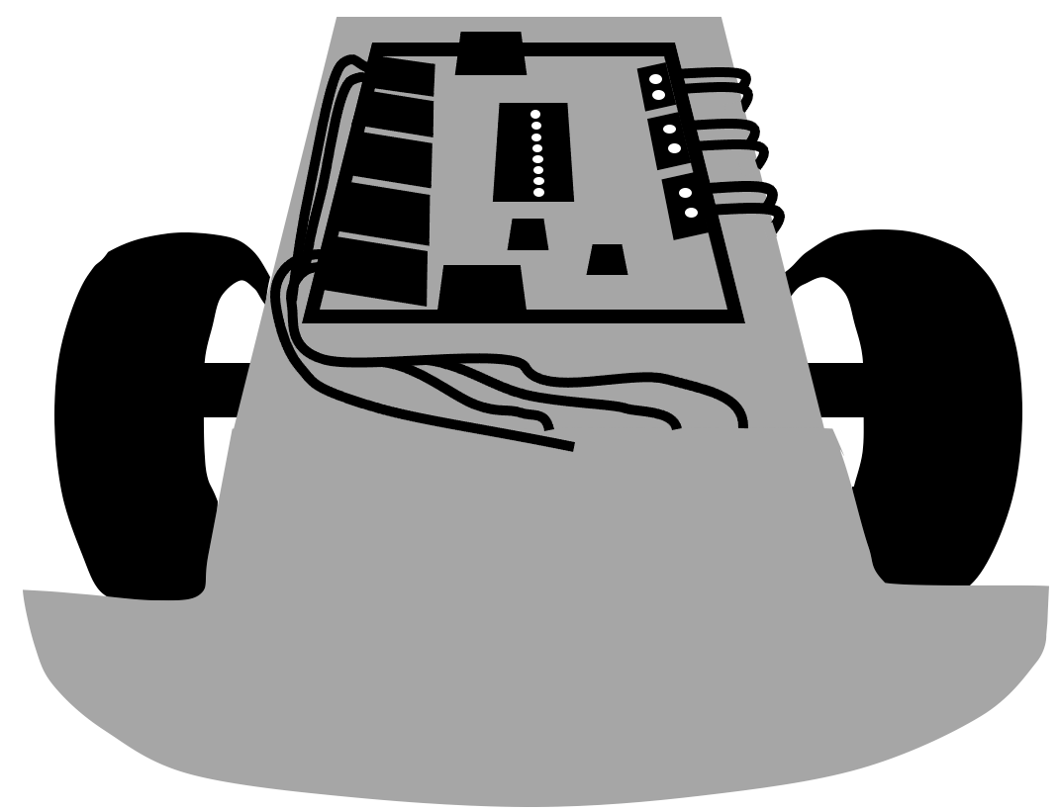
Bakken
Bakken
Bakken
Bakken
Robot Expert
Robot Expert
Robot Expert
Robot Expert
Bakken
Bakken
Bakken
Bakken
Robot Expert
Robot Expert
Robot Expert
Robot Expert
Bakken
Bakken
Bakken
Bakken
Robot Expert
Robot Expert
Robot Expert
Robot Expert
Bakken
Bakken
Bakken
Bakken
Robot Expert
Robot Expert
Robot Expert
Robot Expert
Bakken
Bakken
Bakken
Bakken
Robot Expert
Robot Expert
Robot Expert
Robot Expert

