Slide 1
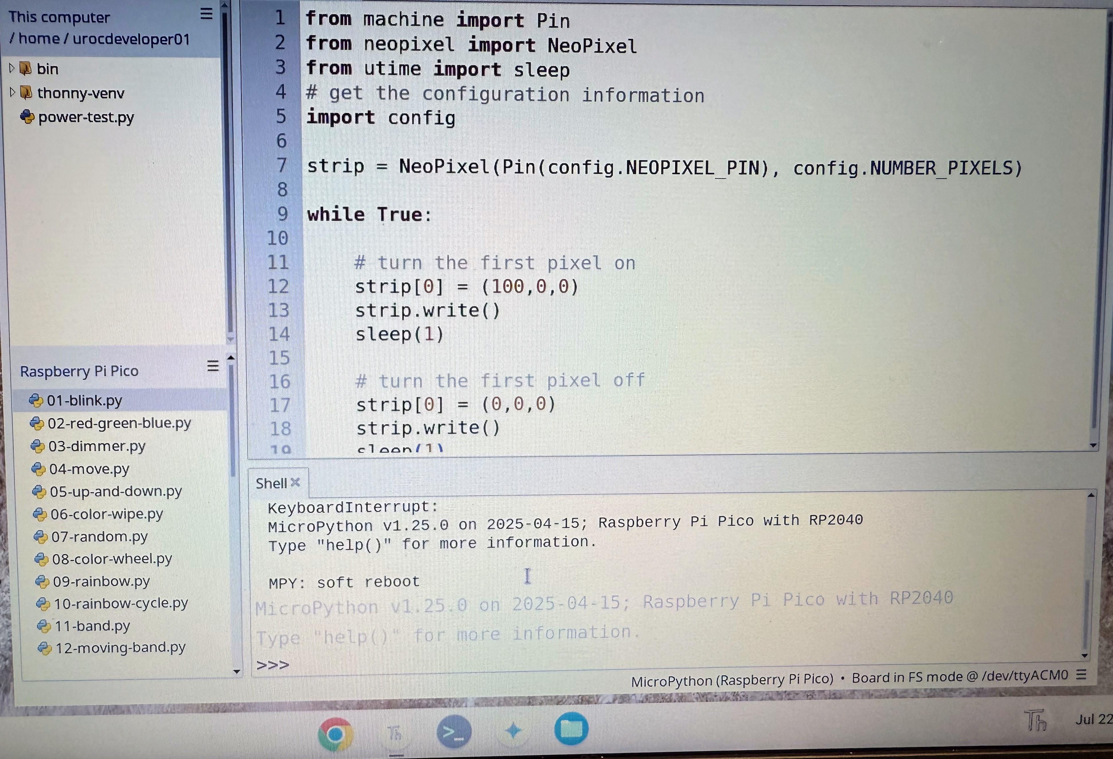
File Viewer
Thonny Icon on Desktop
Port /dev/ttyACM0

