Slide 1
Robot Distance Sensors
Micro-Switch
(bump sensor)
Infrared
Sensors
Ultrasonic
Sensor
HC-SR04
Time-of-Flight
Laser Sensor
VL53L0X
Value: On-Off
Price: .50
Value: Binary
Price: $1
Adjustable Distance
These sensors may not
work well in bright lights.
Value: Distance
Medium: Ultrasonic Sound
Price: $5
Resolution: 3 mm
Response: 50 milliseconds
Range: 0.02 meters to 4 meters
Value: Distance
Medium: Infrared Light
Price: $3
Resolution: 1 mm
Response: 1 millisecond
Range: 0.03 meters to 2 meters
Communicates using I2C bus
Notes:
Robot Sensor ChatGPT Questions: https://chat.openai.com/share/704f3ebb-daae-4561-9ee0-4e97791e38cb

Slide 2
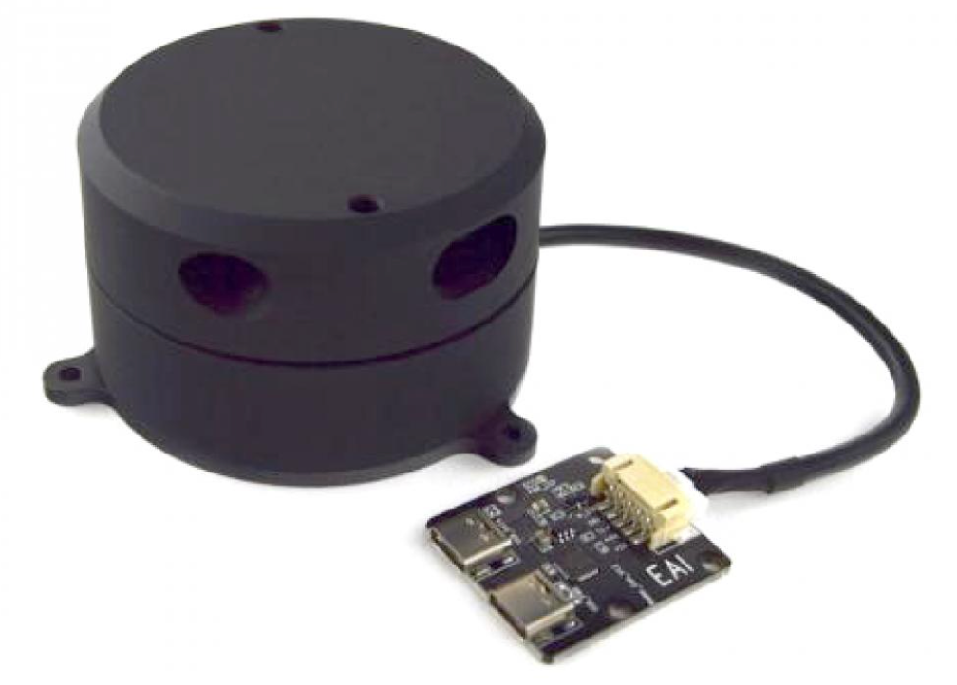
LIDAR
Value: 360 Distance
Medium: Infrared Laser light
Price: $300
Resolution: 10 millimeters
Response: 10 milliseconds
Range: 1 to 16 meters

