Slide 1
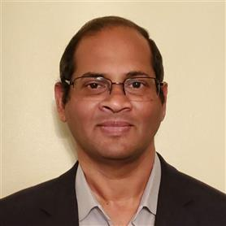
Deepak Chitnis
Specialist Leader – Cloud Engineering
Morristown, NJ
Mobile: (732) 609 - 3767
Email: dchitnis@deloitte.com
Relevant Experience
As a practice lead, led the technical language office for Python at a major financial advisory company, to enable the adoption of Python as a development platform, setting standards, processes, security guard rails, building out Infrastructure and pivoting the company to be ready for advanced analytics, data science and AI. In the process working with and leading multiple groups in the organization. The adoption of Python increased from 300 to over 650 professionals within a period of a year.
As a program lead, led 4 onshore/offshore teams (50 team members) for a major health care company who set out to prioritize member experience on their primary web asset, an initiative worth $8M (2 years). There were various experiences that were identified for digital improvements. Appointments being a critical part, inclusive of pre appointment reminders, questionnaires, instructions, check-in process, directions to the facility and all other experiences related to making the journey of the member as smooth and simple prior to and at the appointment.
As a technical lead, led a 3 teams' effort for a major oil & gas company to build a system for optimizing the movement of commodities through their network. This involved large amounts of data that was sourced from various systems to be edited in the UI and then processed through an optimizing engine. The initial MVP of the system was delivered in about 3.5 months using SAFe (Scaled Agile Framework). Among the firsts for the company was an implementation of Cosmos DB as transactional data repository, Azure Data Lake as long term data repository, Databricks for the optimizer engine and the Scaled Agile Framework for building out the system in iterations.
Deepak’s experience in the IT services industry dates twenty plus years, across many domains, of late focusing on LSHC. He is a rare blend of leadership skills augmented with technical abilities. He is well suited for Delivery Lead and/or Solution Architect roles on Cloud development and integration projects.
He can lead multi zonal teams to deliver Agile Cloud solutions. He is a Trusted Advisor to clients; often called on when client needs to discuss critical deliverables and to build the strategy on how to achieve the milestones. He offers highly scalable, secured & quality focused Digital solutions to help them realize their digital transformation vision.
He enjoys keeping himself cloud technology aware and likes to be on the cutting edge of event driven architectures. And when not working, he likes traveling the world and discovering different cultures.
Industry Experience
Life Science & Health Care
Energy, Resources & Industrials
Technology, Media & Telecommunications

