Slide 1

5G-AKA A Formal Verification

Slide 2
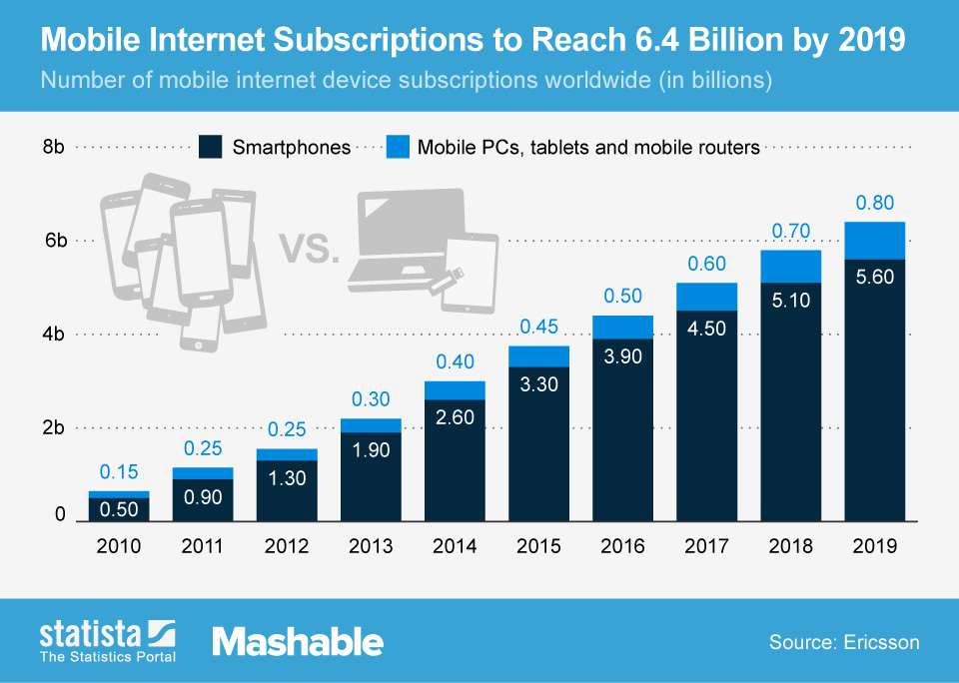
Growth of Mobile

Slide 3

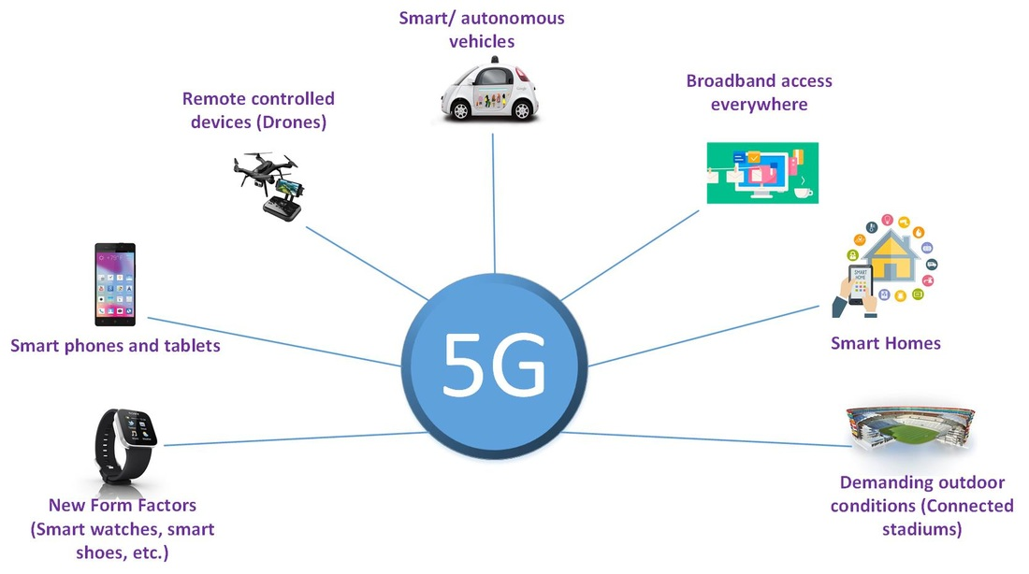
Goals of 5G
Not JUST the next generation
Mobile is the world’s gateway to the internet
IOT
Autonomous Cars
Utilities
Machine-to-Machine communications

Slide 4
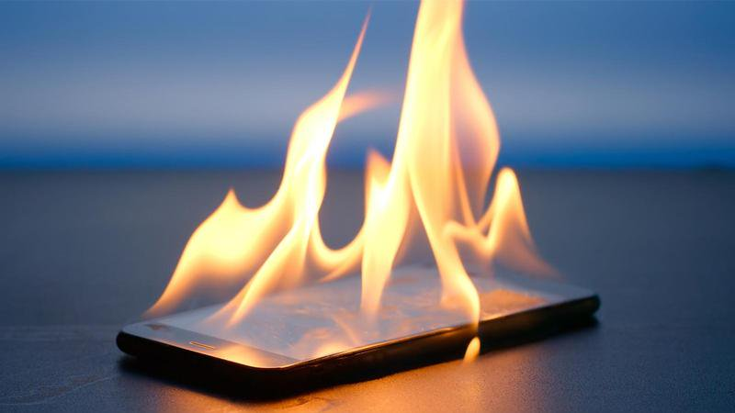
Security Implications
Mobile devices become high value targets
Wrecked vehicles
Hijacked medical devices
Hacked financial accounts
Expanded potential for mayhem

Slide 5
5G-AKA: What does it do?
5G- Authentication and Key Agreement
Authenticates UE to network and network to UE
Establishes session keys
Establishes a secure connection for other protocols over the RAN

Slide 6
5G Network Elements
4 Primary players in AKA protocol
UE – User Equipment
SEAF – Security Anchor Function
AUSF – Authentication Server Function
ARPF - Authentication credential Repository and Processing Function

Slide 7

5G Network Elements
UE
Identified by SUCI
Subscription Concealed Identifier
And SUPI
Subscription permanent identifier
Key stored on SIM card

Slide 8
5G Network Elements
SEAF
Part of the serving network
Creates key, K_{seaf ,} used during authentication
K_{seaf} used to derive session key post authentication

Slide 9
5G Network Elements
AUSF
Part of the home network
Handles authentication requests
Informs the UDM (contains ARPF) of the result of authentication

Slide 10
5G Network Elements
ARPF
Located in UE home network
Network’s most secured component
Stores SUPI, SUCI and UE’s key
Creates IV critical to authentication process

Slide 11
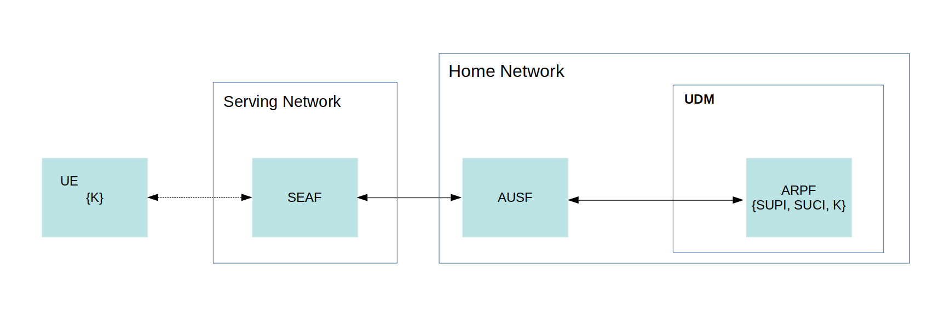
Network Map

Slide 12
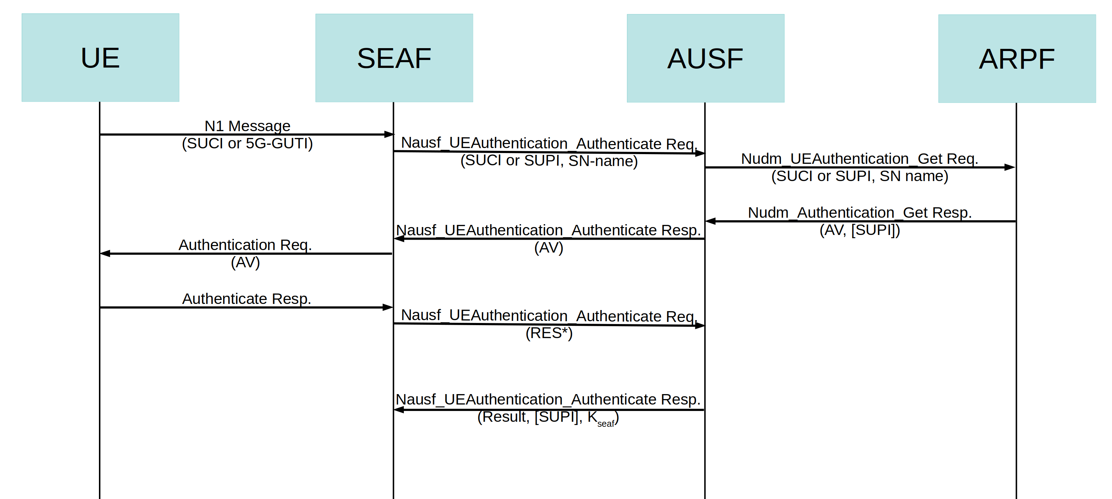
How The Protocol Works

Slide 13
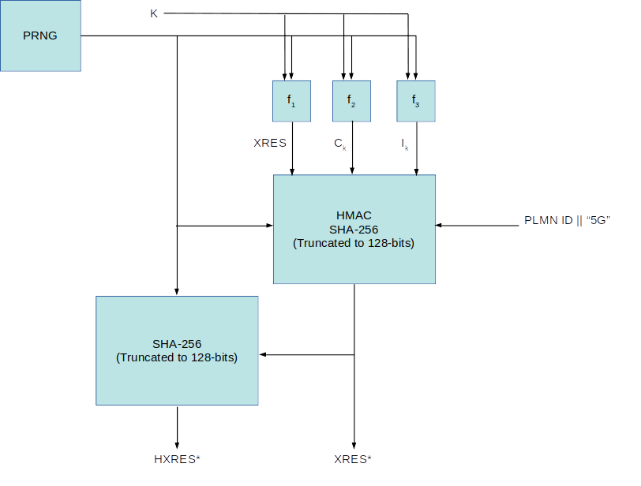
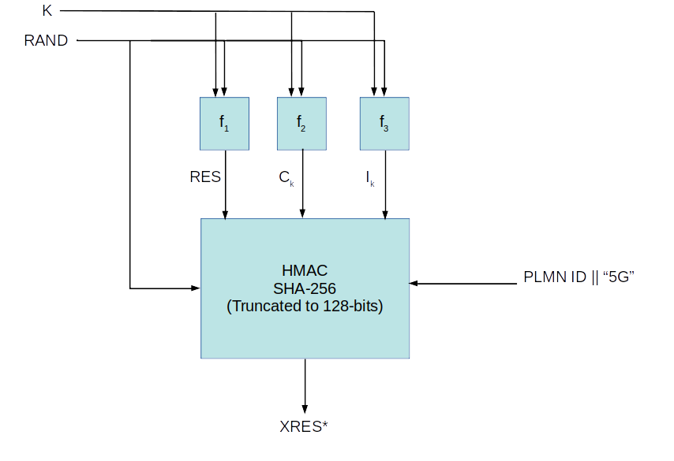
How The Protocol Works
ARPF
UE
XRES*

Slide 14
Why Formal Verification
It allows systematic testing of a protocol through mathematical verification
Increasingly preferred over simulation or testing
Automated with modern software

Slide 15
Types of Verification
Two classes of verification
Model Checking-Represents the protocol as a state machine and systematically tests that the protocol behaves as intended
Logical Inference-Mathematical proof that’s seldom automated and relies on verifier’s understanding of the system

Slide 16
Verification Software
Several Tools available:
Tamarin Prover
ProVerif
AVISPA
Maude-NPA

Slide 17
Methodology
Model 5G-AKA in the Tamarin Language
Test the protocol using the Dolev–Yao adversary model
Analyze the results

Slide 18
The Tamarin Language
Two elements of Tamarin language
Rules-Composed of facts
Lemmas-What to prove

Slide 19
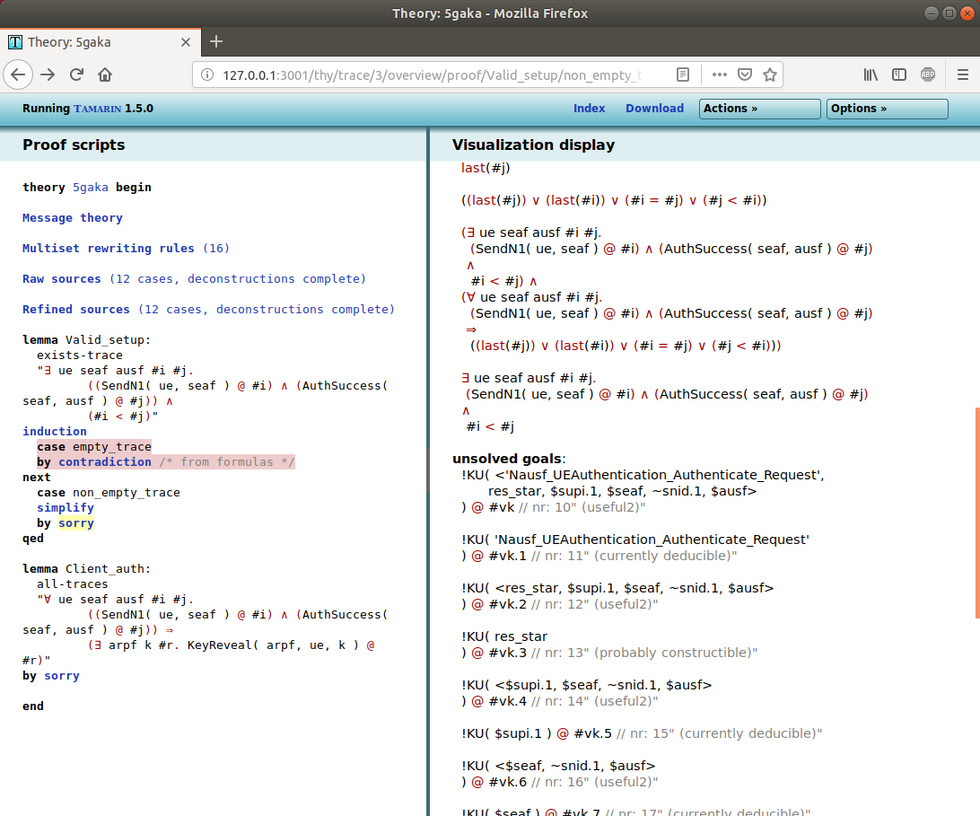
Tamarin: Analyzing Results

Slide 20
Findings

Slide 21
Discussion

Slide 22
Conclusion

