Slide 1

5G-AKA A Formal Verification

Slide 2
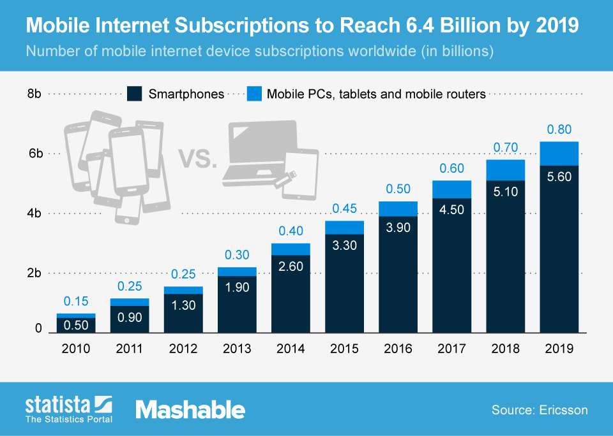
Growth of Mobile

Slide 3

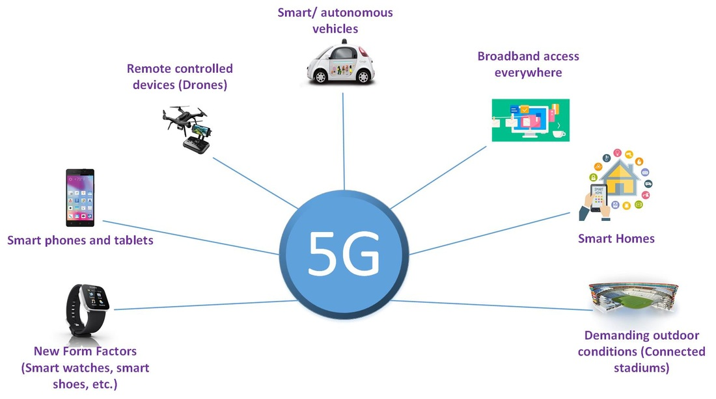
Goals of 5G
Not JUST the next generation
Mobile is the world’s gateway to the internet
IOT
Autonomous Cars
Utilities
Machine-to-Machine communications

Slide 4
5G-AKA: What does it do?
5G- Authentication and Key Agreement
Authenticates UE to network and network to UE
Establishes session keys
Establishes a secure connection for other protocols over the RAN

Slide 5
5G Relevant Network Architecture
4 Primary players in AKA protocol
UE – User Equipment
SEAF – Security Anchor Function
AUSF – Authentication Server Function
ARPF - Authentication credential Repository and Processing Function

Slide 6
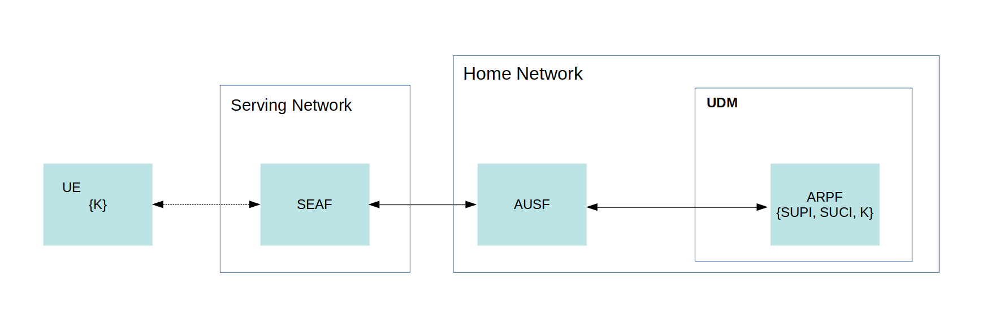
Network Map

Slide 7
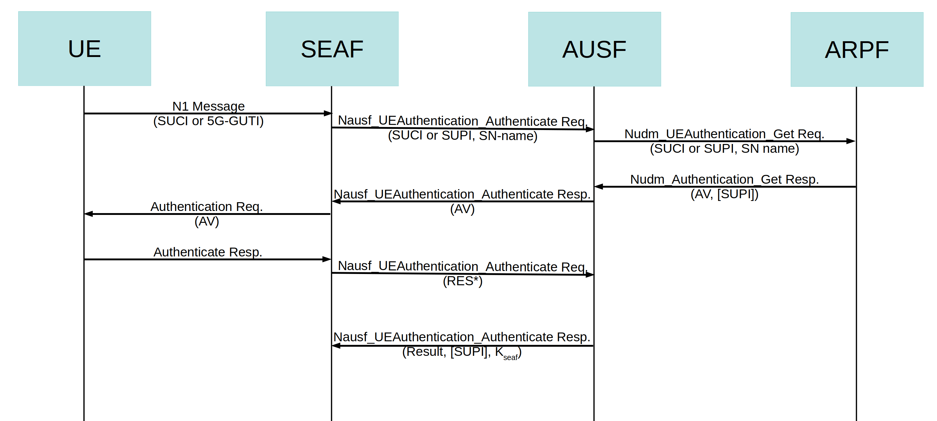
How The Protocol Works

Slide 8
Why Formal Verification
It allows systematic testing of a protocol through mathematical verification
Increasingly preferred over simulation or testing
Automated with modern software

Slide 9
Types of Verification
Two classes of verification
Model Checking-Represents the protocol as a state machine and systematically tests that the protocol behaves as intended.
Logical Inference-Mathematical proof that’s seldom automated and relies on verifier’s understanding of the system

Slide 10
Verification Software
Several Tools available:
Tamarin Prover
ProVerif
AVISPA
Maude-NPA

Slide 11
Methodology
Model 5G-AKA in the Tamarin Language
Allow the software to test the protocol using the Dolev–Yao adversary model
Analyze the results

Slide 12
Findings

Slide 13
Discussion

Slide 14
Conclusion

