Slide 1

SECURING WebRTC
Dennis MCMeekan (dj-mcmeekan@wiu.edu)
M.S. Thesis Defense Presentation
School of Computer Sciences
Western Illinois University

Slide 2
Layout
Introduction
Importance
Motivation
Security Concerns
Related Research
Problem Statement
Confidentiality Violations
Covert Channels
WebRTC API
Research Method
Unsecure/Secure Prototype
Performance Results
IP Leaks
Distributed Hash Table
Conclusion
Future Work
References

Slide 3
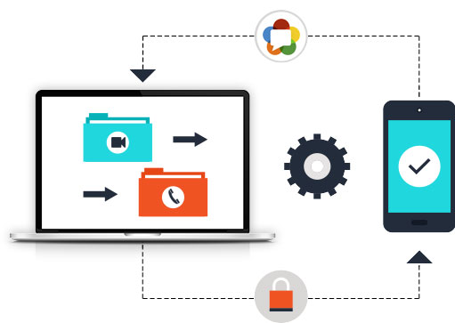
Introduction
Real-Time Video Communication
No Added Plugins or Installs
Relatively New
How WebRTC Works
Web Browser Specification
Two or More Clients
Server

Slide 4

Importance
Immense Growth of Media Communication (Virtual Environments)
Open-Source
Not All Security Protocols Have Been Examined

Slide 5
Motivation
New and Not Fully Examined Specification
Lasting Impact on Computer Science and Real-Time Communication
Increase of Virtual Environments
Further Security
Increase Potential Specification Use
Mitigate Vulnerabilities: Hidden Data Transfer & Sensitive Information Leaks

Slide 6
Security Concerns
Confidentiality Violations
IP Leaks
Among Others, Two Chosen by Committee
Allowed for Prototype Implementation
Time Permitting

Slide 7
Related Research
Knowledge Development
Use Teachers as Growth, Create New Horizons: Constructivism in Computer Science Education, Mordechai
Confinement Problem
Limitations of Executions outside Base Program: A Note on the Confinement Problem, Lampson

Slide 8
Problem Statement
“WebRTC has the foundation to allow for a secure and simple connection to be made by two users without installing native apps or plugins.”
Relatively New and Immense Potential
Security Vulnerabilities do Exist, Need Exploration

Slide 9

Confidentiality Violations
Peer-To-Peer Connection -> Real-Time Data
WebRTC API
Great for Development, Concerning with Hackers/Exploits
Covert Channels

Slide 10
Covert Channels
Sending Data Unintentionally
Can be Harmless/Harmful
How It Works
Exploit Certain Elements (WebRTC API) to Send/Receive Data
Threat
Sending Sensitive Data
Malware

Slide 11
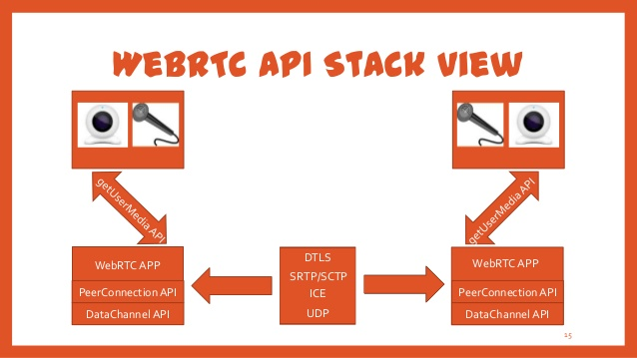
WebRTC API
Detailed & Resourceful
Research -> Examples -> Prototype
JavaScript & HTML5

Slide 12
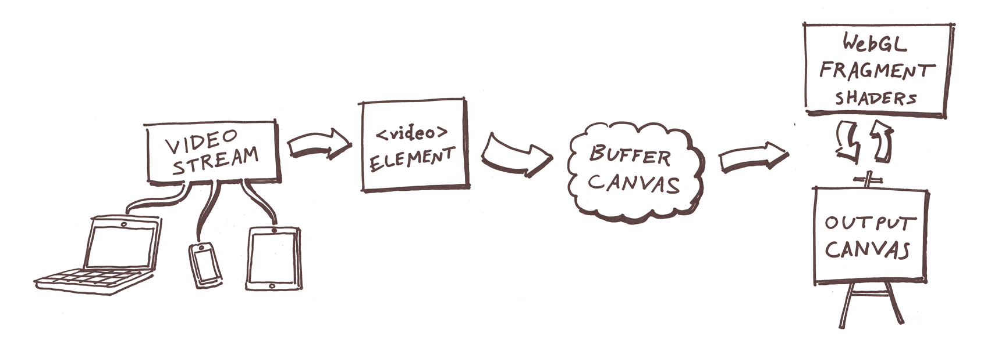
Covert Channel Implementation
via Image Filtering: JavaScript Method
Local -> Remote
Local -> Canvas -> Remote
Delay Implemented Using Canvas Element

Slide 13
Research Method
Effectiveness of Covert Channels
Error Rate & Covert Channel Bandwidth
Lower Error Rate: Effective Covert Channel
Higher CCB: Quicker Data Can be Sent
Two Prototypes
Unsecure: Covert Channels
Secure: Mitigating Covert Channels
Black Screen/”Sample Presentation” Method – 10 Separate Tests for Each Graph

Slide 14
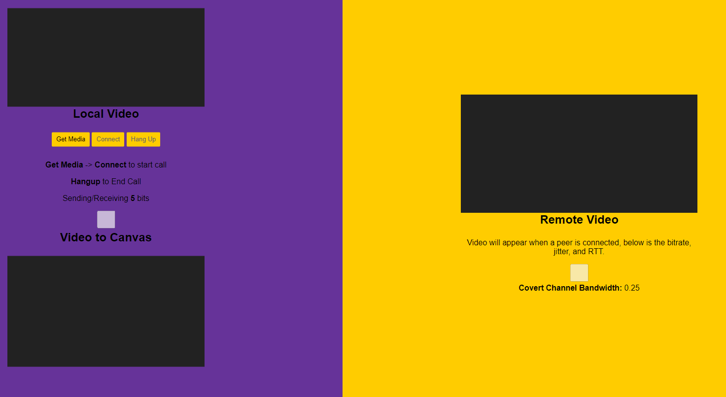
Unsecure Prototype
Covert Channel -> Send & Receive a Bit
Implement Delay, Sense the Delay, Receive Bit
Error Rate
Covert Channel Bandwidth
T or Input Rate

Slide 15
Unsecure Prototype - Demo

Slide 16
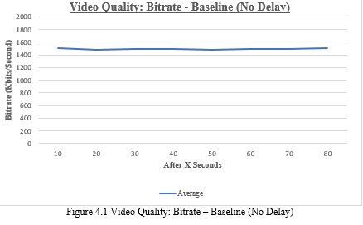
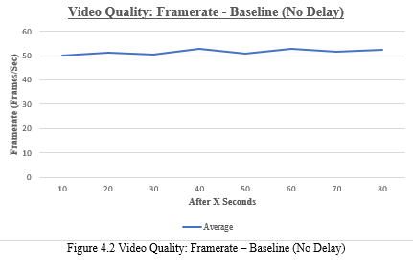
Results (Unsecure) - Baseline

Slide 17
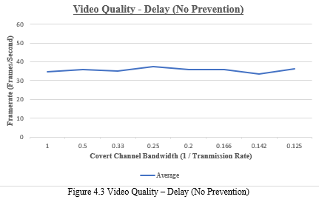
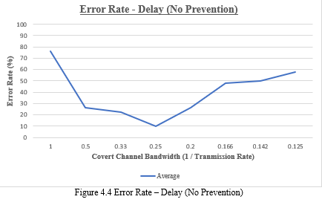
Results (Unsecure) – Delay Implementation

Slide 18

secure Prototype - Mitigation
Expand Unsecure Prototype - Mitigate Covert Channels with Delays
Constant Delay
Random Delay
Simulate Control by Admin
Performance Concerns
Increase in Error Rate

Slide 19
secure Prototype - Demo

Slide 20
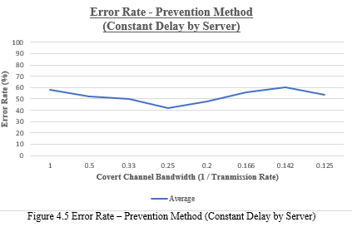
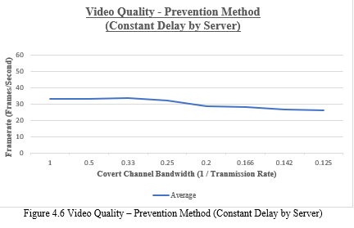
Results (secure) – Constant Delay

Slide 21
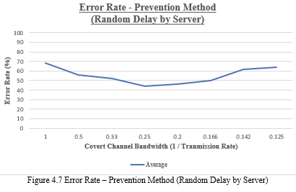
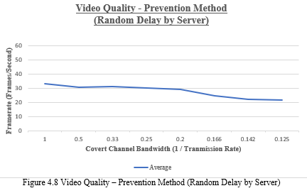
Results (secure) – Random Delay

Slide 22
Ip Leaks
Sensitive Data Can Be Obtained
Geographical Location via Public IP Address
Public IP is Required Through STUN/TURN Protocols
Google Implementation

Slide 23

Distributed Hash Table
Mitigating IP Leaks
Current: STUN/TURN Protocol for Server Implementation
New: Distributed Hash Table Server
Seen with TOR

Slide 24
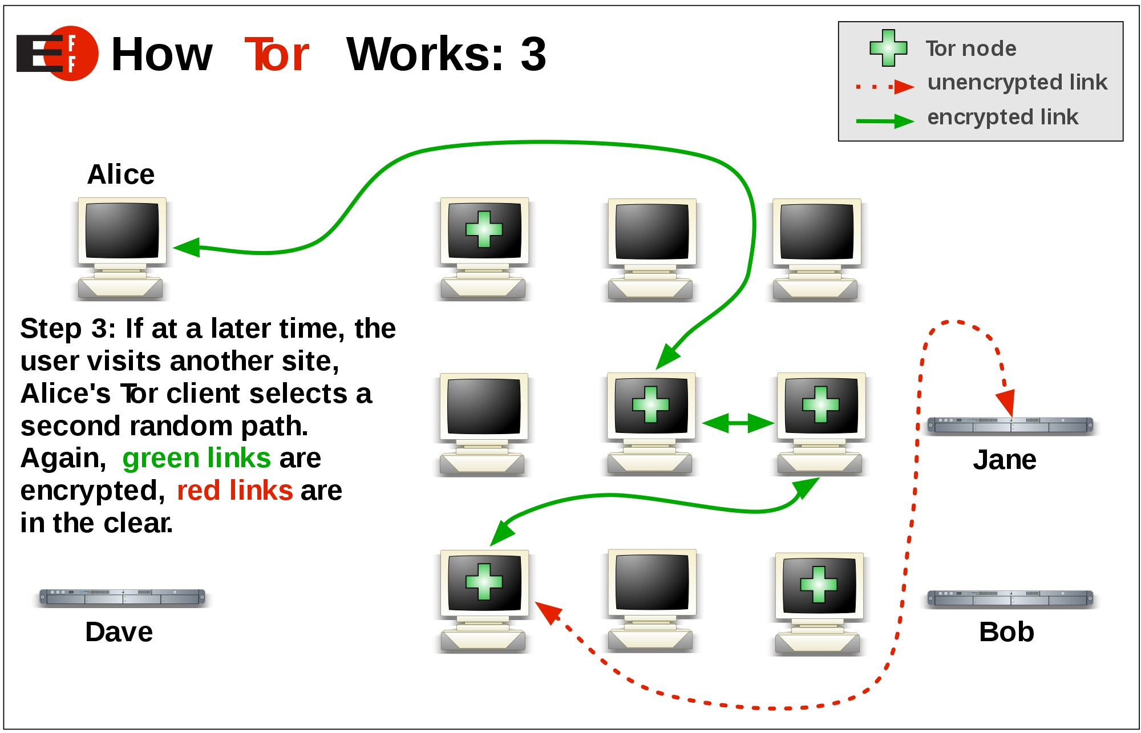
DHT Implementation

Slide 25
Conclusion
WebRTC is susceptible to Covert Channels
Image Filtering allows Fluctuating Bitrates
Bit can be sent, and received
Mitigation Method of Delay Mechanisms
Constant
Random
WebRTC is susceptible to IP Leaks
Distributed Hash Table Implementation

Slide 26

Future Work
Network Concerns (Two Separated Clients)
Prototype Implementation of DHT
Development, Testing, & Analysis

Slide 27
References
[WebRTC Transparent Logo]. (2020). https://www.pnglib.com/wp-content/uploads/2020/01/webrtc-logo_5e2e9f5f06511.png
[WebRTC Overview]. (2017). https://fameglob.com/wp-content/uploads/2017/08/web_rtc_wht_we_do_graphic.jpg
[Security Vulnerabilities]. (2015). https://betanews.com/wp-content/uploads/2015/03/freak_security_vulnerability.jpg
B. Mordechai, “Constructivism in Computer Science Education,” in Proceedings of the Twenty-Ninth SIGCSE Technical Symposium on Computer Science, SIGCSE ’98, pp. 257-261, 1998.
B. Lampson, “A Note on the Confinement Problem,” in Comunications of the ACM, 1973.
[Hacker]. https://www.lifewire.com/thmb/sC-xsCCN9WdW9l5h-T6XqpuPGR0=/5697x3446/filters:fill(auto,1)/hacker-with-laptop-922359280-5c32d4a546e0fb00011bb991.jpg
[Image Filtering]. (2018). https://sudo.isl.co/webrtc-real-time-image-filtering/flow-6807f3324c.png
[WebRTC API]. https://image.slidesharecdn.com/webrtcup-130320110314-phpapp02/95/webrtc-15-638.jpg?cb=1363777440
[Padlock]. https://img.pngio.com/lock-icon-this-is-a-graphic-representation-of-a-pad-lock-the-kind-of-png-50-px-lock-and-key-png-free-1600_1600.png
[TOR]. (2011). https://www.loudtechie.com/wp-content/uploads/2015/08/Tor-logo-2011-flat.svg_.png
[TOR]. (2018). https://images.idgesg.net/images/article/2018/07/tor-3-100763520-orig.jpg
[Future Work]. (2017). https://www.kochiesbusinessbuilders.com.au/wp-content/uploads/2017/10/robot.jpg
[Thank You]. https://i.pinimg.com/originals/66/1a/08/661a08971315878673a562cd5f2c7220.jpg

Slide 28

Questions?

