Slide 1

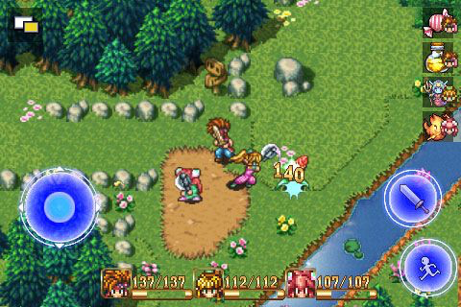
Lost in Peril
Not actual gameplay
Tim Mardesen & Dennis McMeekan

Slide 2
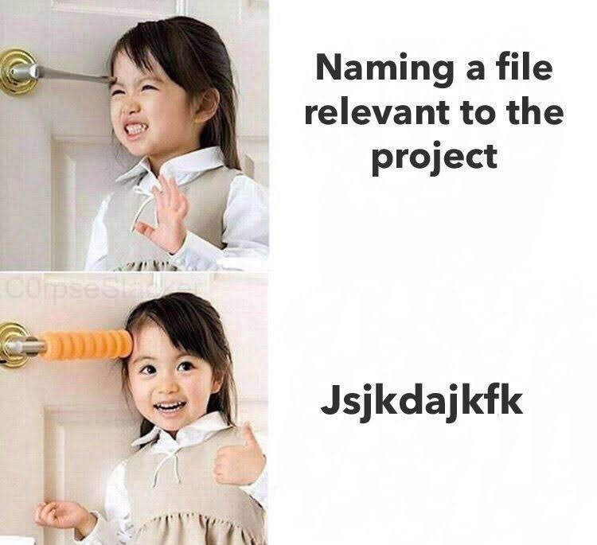
Agenda
SRS Overview
Demo Unveil
Questions?

Slide 3
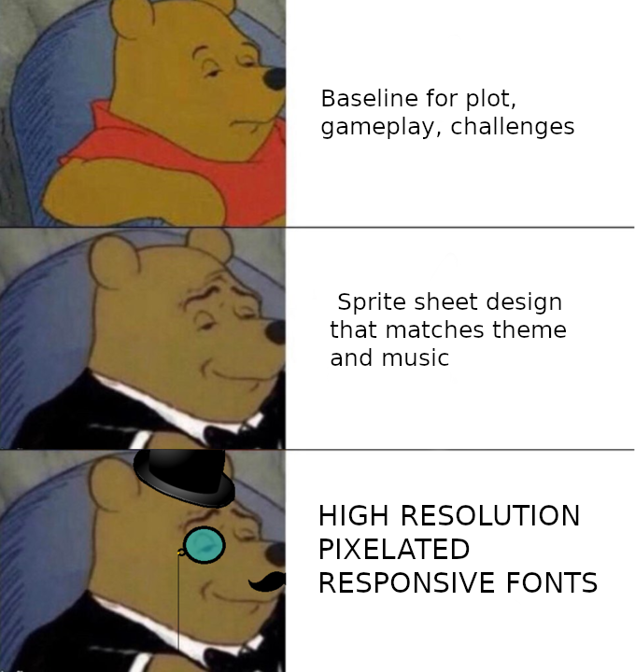

SRS: Amendments
Operating Environment
Java Runtime Environment 11
System must support OpenGL 2.0
Intel Celeron IGP
GeForce 6 6000X
Radeon R300 Series

Slide 4
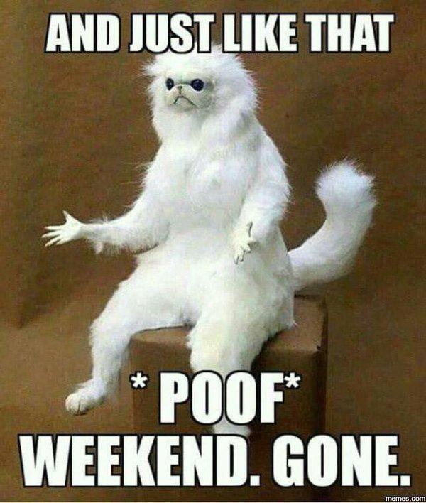
The Next Step
Research
Programming
Add tutorial type windows to intro
Incorporate sprite maps
Build larger maps using Tiled
Testing
Use jenkins to test git pushes for compile errors

Slide 5
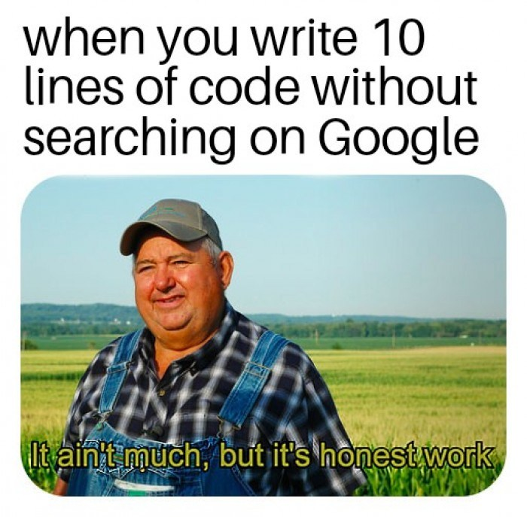
Questions?

