Slide 1
Art Non-profit
Informational and Planning Meeting
December 20, 2020

Slide 2
Overview
Summary of Current Project and Status
Overview of Potential Non-profit Purpose and Goals
Survey of Participants and Potential Next Steps

Slide 3
Holy Child Project Overview
Mother Seton Hall art schema finished
Five main hallway sections, plus intro, closing, and side hallways
Focus is on reproductions of masterpiece paintings and will not include photos of statues and other architecture
Each main section to cover an era of history
Also looking to highlight art history
Intro section complete
10 paintings for just over $10k
Modern Era Funding Promised – Currently in RFQ Stage
Two pieces awaiting final down select
15 paintings for $10.5k-14k
Fundraising and final selection remains for following sections
Cradle of Civilization and OT
Greece and Rome
Paschal Mystery
Early Church to Medieval Era
Estimated Costs remaining: ~40 paintings for $35k plus lighting
Planning not yet begun for Blessed Miguel Pro Hall
Mother Seton Hall Nearly 1/3 Complete!!!

Slide 4
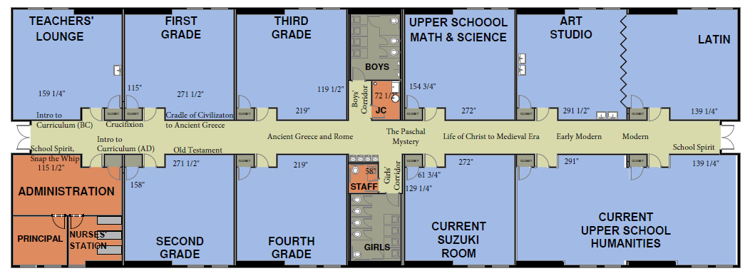
Mother Seton Hall Art Schema
Completed
In-progress
Planning Stages

Slide 5
Non-profit Purposes Asset Protection
Asset protection is critical to fundraising in parishes/dioceses where future friendliness toward classical education and great art is in question
Barbarian bishops and modernist priests have destroyed much church art and sold off numerous assets to pay abuse settlements
Most people have stories of friends/family saving church art from literal dumpsters
Non-profit can hold assets in trust and give them away to other schools if unfriendly powers take control and want to dispose of the art

Slide 6
Non-profit Purposes Project and Concept Promotion
Holy Child is pioneering something new
Never before have modern printing methods been combined with the ever-growing library of high resolution photos of museum paintings to bring the best masterpiece paintings in the western canon to schools
The classical school movement is rapidly expanding and pioneering new ways to bring the a traditional education to the modern world
Many schools would likely be interested if they could see this project
Ways to promote concept
Speak at educational conferences
News coverage
Publishing in academic journals and educational magazines
Partnerships with local art museums
Partnerships with other schools

Slide 7
Non-profit Purposes Connecting School Communities and Museums
Reproductions shouldn’t be the only art children see
Most masterpiece paintings live in museums
Traveling exhibits bring masterpieces to even smaller cities like Albuquerque
Reserving a section of wall to display the best of local art museums would encourage families to visit
Requires working with museum staff to acquire rights and select pieces for display
Provides visibility of museum exhibits to school families
Provides visibility of school in the wider community
Win-win for families, museum, and school
Strong partnerships generate opportunity for positive media interest and coverage
Museum staff will likely lead this effort

Slide 8
Non-profit Purposes Connecting Likeminded School Communities
Serve as central resource to connect classical schools that want to implement this idea
Provide planning and logistical support to schools lacking expertise
Can help schools with planning and piece selection
Holy Child has already looked at thousands of paintings and has presentations with hundreds of potential candidates
Provide logistical support to schools
Connect with Duraplaq and Derek Brooks
Develop connections to companies in other parts of the country/world as time progresses
Provide support to schools looking to circulate loaned paintings
Similar to how most museums have traveling exhibits
Help connect schools with their local art community

Slide 9
Starting a Non-profit
Decide on purpose for organization and general goals
Feedback - Disagreement on goals in previous slides or other ideas?
Select board model
Recruit and vote on transition board members (with future in mind)
Highlight business/non-profit experience, time, motivation, and art expertise
Avoid conflicts of interest
Decide on committees - both business and art related
Vote on a name
Set board meeting dates for regular meetings
Set due dates and goals for tasks
Write Articles of Incorporation and Bylaws
Select annual meeting date (mostly set in stone)
Formally vote on board members
Work with volunteer legal help to
Submit paperwork to state of NM
Submit paperwork to IRS
Get training for IRS paperwork and business aspects of tax deductibility
Prioritize art-related projects and get to work
Can’t do everything at once – Figure out projects with high impact and low difficulty to begin

Slide 10
Questions and Feedback

Slide 11
Resources

