Slide 1
Mechanical Engineering Career Overview
Douglas Coombs
April 8, 2021
Notes:
1

Slide 2
Overview
Personal Intro
Types of Engineering
Educational Requirements
Career Overview
Succeed in Any Career
Q & A
Disclaimer: These are the presenter’s opinions and do not necessarily reflect those of his employers, past and present

Slide 3
Brief Personal Intro
Name: Douglas Coombs
Employer: Sandia National Laboratories
Title: Principal Member of the Technical Staff
Job Roles:
Audit scientific and engineering work to ensure national security
Perform system analyses to ensure safety
Manage software projects to help engineers work more productively
Contribute to R&D efforts to advance product lines
Did that make any sense?

Slide 4


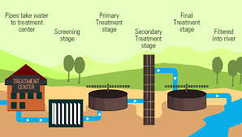


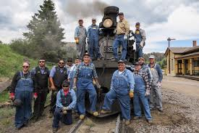
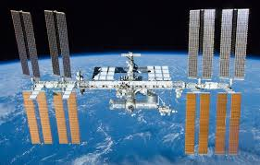
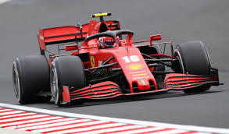

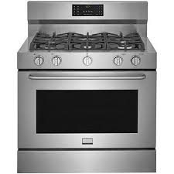
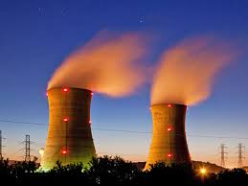
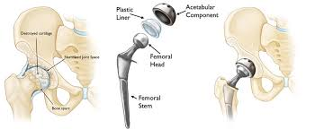


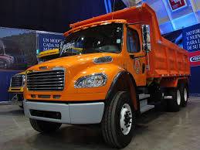

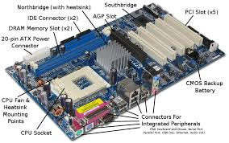
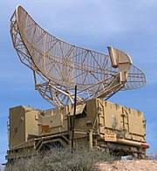
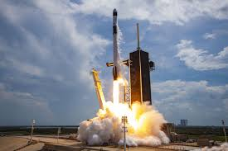
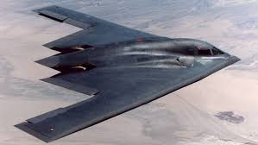




Types of Engineering
What do engineers do?
We solve scientific and technical problems to create the infrastructure and products that enable modern life
Train engineers vs. technical engineers
Types of Engineers
Civil, Mechanical, and Electrical (most engineers)
Niche fields
Chemical, Bio-Medical, Materials, Industrial, Aerospace, Mining, Petroleum, Nuclear, Marine, Agricultural, Environmental
Wide range of pay depending on industry, difficulty and educational level attained ($50k-$250k, median ~85k)
Commodities vs cutting edge technologies
Scalability of product
Good bread and butter job to support a family with
Most people can do it if they work hard enough – not like sports or acting where only the top .01% succeed and make enough money to support a family
Electrical Engineering
Computers, Phones, Communication Infrastructure, General Electronics
✓
Mechanical Engineering
Rockets, Trucks, Cars, Household Appliances, Airplanes, Machines in General
Civil Engineering
Bridges, Roads, Dams, Skyscrapers, Sewage Treatment

Slide 5
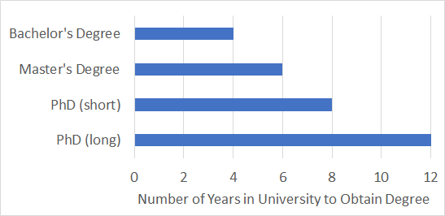
Educational Requirements
A bachelors degree in engineering ➔ entry level jobs
A master’s (minimum) is required for more advanced projects
Most flexible degree. Takes an extra two years after getting a bachelor’s degree
More advanced engineering pays better – Excellent investment of time
A PhD is required for very high level projects
Can narrow opportunities. Increases pay in many fields but can take a long time to attain (typically 2-8 years, average of 3-4).
Sometimes the monetary pay-off isn’t there – Succeed or fail quickly is a good strategy
Engineers get paid to go to graduate school. They only take out loans for undergrad.
Get paid to go to school

Slide 6

Career Overview
High School and College Jobs
Picked produce at local farms
Yard work for elderly
Campus workstudy: mailroom and computer lab
Built homes for local construction company
Bachelor’s degree @ University of Portland
Internship @ Boeing: Maintained manufacturing equipment for Boeing 747 and 737
Master’s degree @ University of Cincinnati
Taught classes and worked on suspension modeling of pickup trucks
York International
Designed and produced air handlers to keep things comfortable and quiet in schools, concert halls, and hospitals
Moog-CSA Engineering
Projects: Space Launch System (rocket to go to the moon), ESPA (mount lots of small satellites on big rockets), NICER (looking at the sun’s energy from the International Space Station to feed environmental models for global warming calculations), XSS-11, DSX, Giant Magellan Telescope (six 27’ mirrors to make an 80 ft visible spectrum telescope, resolution 10 times better than Hubble), Recon Optical telescopes for pods on F-15 jets.
Sandia National Laboratories
Evaluate the engineering work of others to ensure that it meets technical rigor in order to keep our country safe
Step 1: Learn to work hard
Step 2: Learn a Valuable Skill
Step 3: Get Paid to Work Hard at Job Using Your Valuable Skill

Slide 7





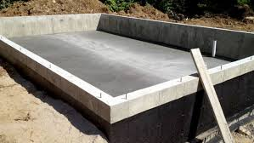
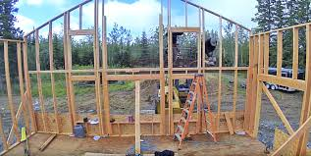








Step 1: Learn to Work Hard
High School and College Jobs
Picked produce at local farms
Yard work for elderly
Campus workstudy: mailroom and computer lab
Built homes for local construction company

Slide 8
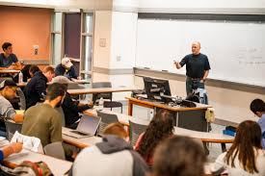
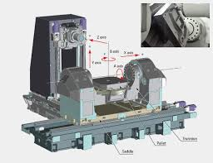
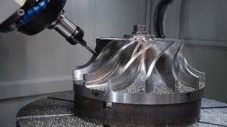
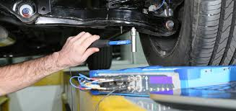
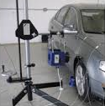
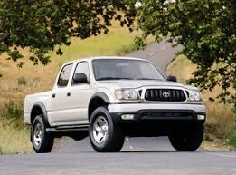
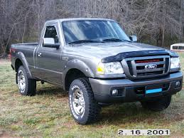
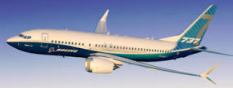
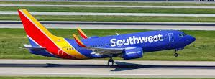

Step 2: Learn a Valuable Skill
Bachelor’s degree @ University of Portland
Internship @ Boeing: Maintained manufacturing equipment for Boeing 747 and 737
Master’s degree @ University of Cincinnati
Taught classes and worked on suspension modeling of pickup trucks

Slide 9
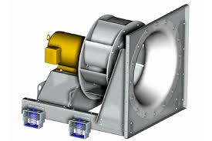
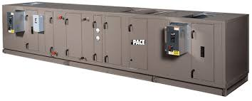
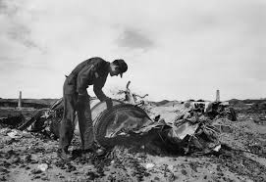
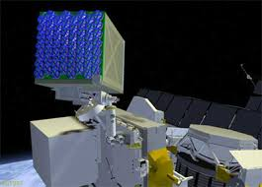

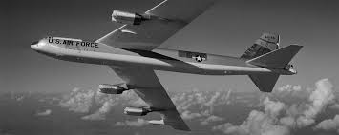
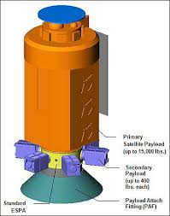
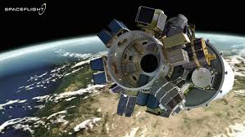
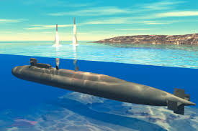
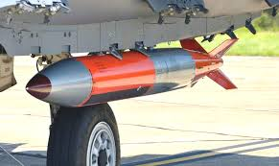
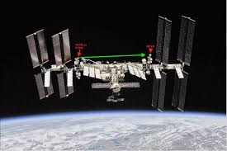
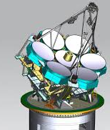
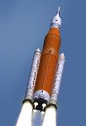
Step 3: Work Hard at Job Using Valuable Skill
Moog-CSA Engineering
Projects: Space Launch System (rocket to go to the moon), ESPA (mount lots of small satellites on big rockets), NICER (looking at the sun’s energy from the International Space Station to feed environmental models for global warming calculations), XSS-11, DSX, Giant Magellan Telescope (six 27’ mirrors to make an 80 ft visible spectrum telescope, resolution 10 times better than Hubble), Recon Optical telescopes for pods on F-15 jets.
Sandia National Laboratories
Evaluate the engineering work of others to ensure that it meets technical rigor in order to keep our country safe
York International
Designed and produced air handlers to keep things comfortable and quiet in schools, concert halls, and hospitals

Slide 10
Succeed in Any Career
What are the most important ingredients to a successful career?
Hard work
Learn as much as possible about the field
Formal education
Internships
Apprenticeships
Very difficult and very dangerous jobs pay better than easy jobs
Examples: doctors and underwater welders
Jobs that can replicate at scale pay better than jobs that require individual attention
Software development vs. early childhood education
Pay isn’t the only factor in deciding on a career
The pay is terrible for artists, priests and stay-at-home moms, but the spiritual and emotional rewards are great – money isn’t the most important thing in life

Slide 11
Questions?

