Slide 1
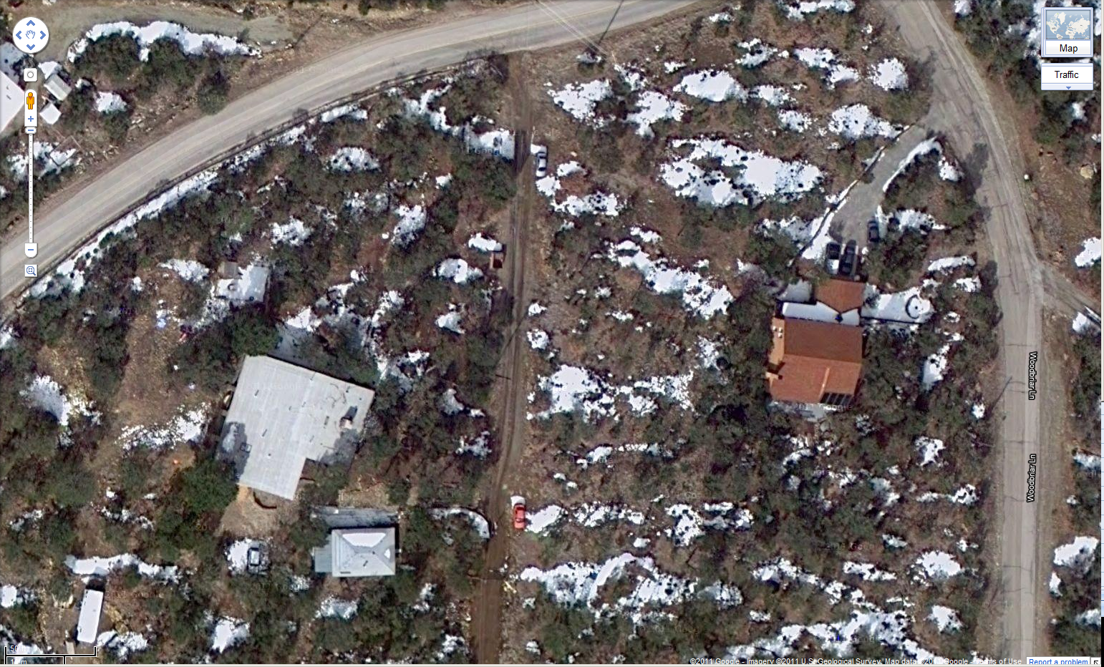
β2: Smith’s House
β1: Coombs’ House

Slide 2
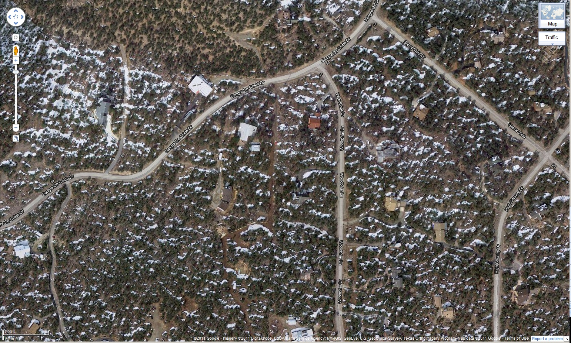
α2: Smith’s House
α1: Coombs’ House
α3: Brannock’s Home Site

Slide 3
β2
β1

Slide 4
α1
α2
α3

