Slide 1
HCCS Network Printer Installation
Douglas Coombs
February 6, 2018, Rev. 0

Slide 2
Overview
Description of Current Printers
Printer Installation Instructions

Slide 3
Current Printers
Teacher’s Lounge
Color HP Wireless (Model #): 192.168.1.57
HP Color Laserjet 3500: 192.168.1.58
Mrs. Teeter’s 1/2nd Classroom
BW: HP Laserjet 4050N: IP Address TBD (ideally 192.168.1.59)
Outside Mrs. Sanchez Classroom
BW: HP Laserjet 4100: 192.168.1.97

Slide 4
Installing a Network Printer Using TCP/IP (1/4)
Overview of steps
Control Panel -> Devices and printers
Add a printer
Add a Local Printer
Create a New Port
Select Type of Port: Standard TCP/IP Port
Type IP Address in Hostname or IP address: 192.168.1.##
Installing the Printer Driver Add Printer -> Have Disk
Print Test Page

Slide 5
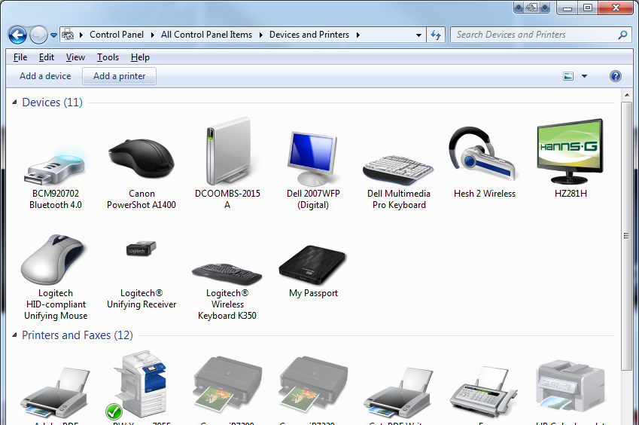
Installing a Network Printer Using TCP/IP (2/4)
Control Panel -> Devices and printers
Add a printer
Add a Local Printer

Slide 6
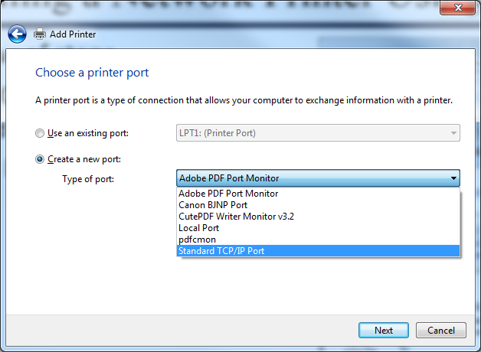
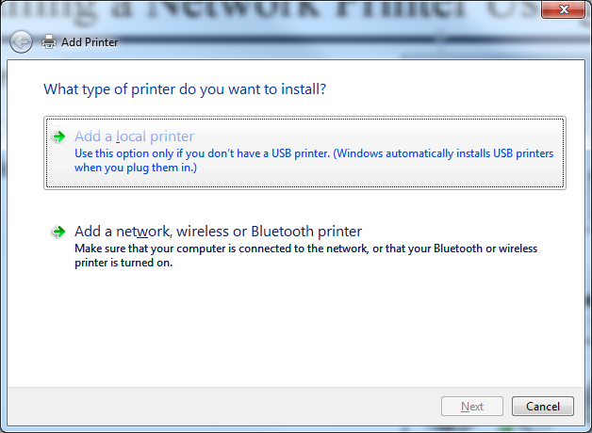
Installing a Network Printer Using TCP/IP (3/4)
Add a Local Printer
Create a New Port
Select Type of Port: Standard TCP/IP Port

Slide 7
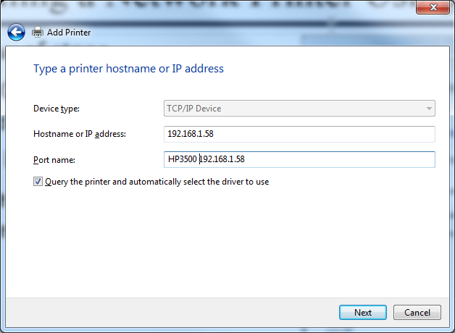
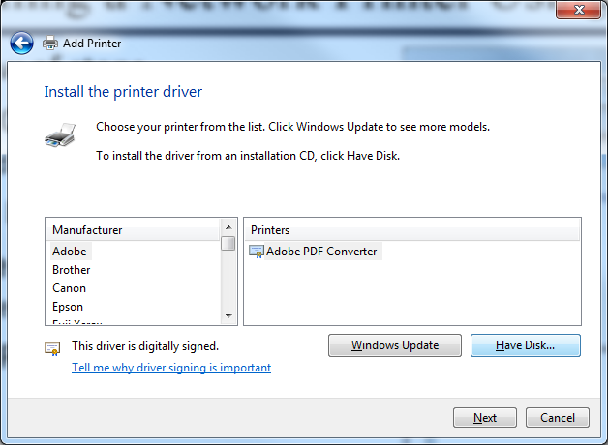
Installing a Network Printer Using TCP/IP (4/4)
Type IP Address in Hostname or IP address: 192.168.1.##
Installing the Printer Driver Add Printer -> Have Disk

