Slide 1





Mechanical EngineeringCareer Overview
Douglas CoombsApril 8, 2021

Slide 2
Overview
Personal IntroTypes of EngineeringEducational RequirementsCareer OverviewSucceed in Any CareerQ & ADisclaimer: These are the presenter’s opinions and do not necessarily reflect those of his employers, past and present

Slide 3
Brief Personal Intro
Name: Douglas CoombsEmployer: Sandia National LaboratoriesTitle: Principal Member of the Technical StaffJob Roles: Audit scientific and engineering work to ensure national securityPerform system analyses to ensure safetyManage software projects to help engineers work more productively Contribute to R&D efforts to advance product linesDid that make any sense?

Slide 4

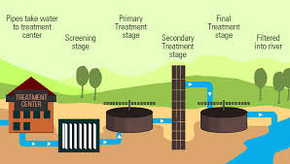

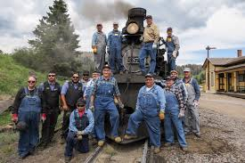



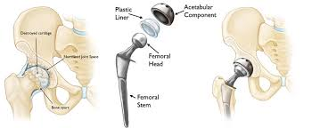

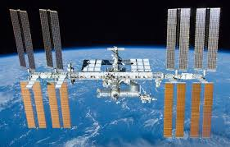


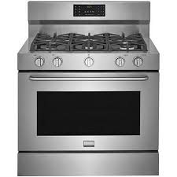




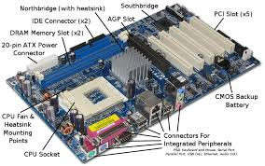
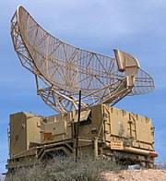


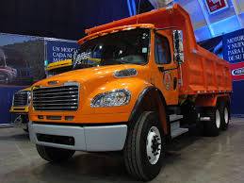
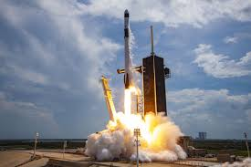
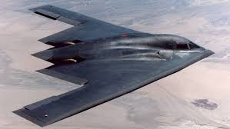
Types of Engineering
What do engineers do? We solve scientific and technical problems to create the infrastructure and products that enable modern lifeTrain engineers vs. technical engineers Types of EngineersCivil, Mechanical, and Electrical (most engineers) Niche fieldsChemical, Bio-Medical, Materials, Industrial, Aerospace, Mining, Petroleum, Nuclear, Marine, Agricultural, EnvironmentalWide range of pay depending on industry, difficulty and educational level attained ($50k-$250k, median ~85k)Commodities vs cutting edge technologiesScalability of productGood bread and butter job to support a family withMost people can do it if they work hard enough – not like sports or acting where only the top .01% succeed and make enough money to support a family
Electrical Engineering Computers, Phones, Communication Infrastructure, General Electronics
✓
Civil Engineering Bridges, Roads, Dams, Skyscrapers, Sewage Treatment
Mechanical Engineering Rockets, Trucks, Cars, Household Appliances, Airplanes, Machines in General

Slide 5
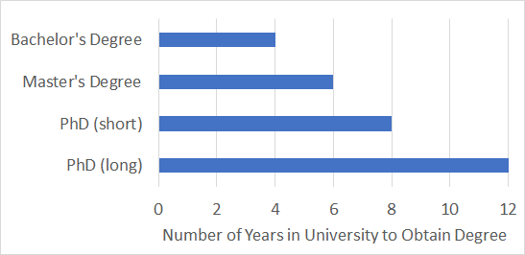
Educational Requirements
A bachelors degree in engineering ➔ entry level jobsA master’s (minimum) is required for more advanced projects Most flexible degree. Takes an extra two years after getting a bachelor’s degreeMore advanced engineering pays better – Excellent investment of timeA PhD is required for very high level projects Can narrow opportunities. Increases pay in many fields but can take a long time to attain (typically 2-8 years, average of 3-4).Sometimes the monetary pay-off isn’t there – Succeed or fail quickly is a good strategyEngineers get paid to go to graduate school. They only take out loans for undergrad.
Get paid to go to school

Slide 6

Career Overview
High School and College JobsPicked produce at local farmsYard work for elderlyCampus workstudy: mailroom and computer labBuilt homes for local construction companyBachelor’s degree @ University of PortlandInternship @ Boeing: Maintained manufacturing equipment for Boeing 747 and 737 Master’s degree @ University of CincinnatiTaught classes and worked on suspension modeling of pickup trucksYork InternationalDesigned and produced air handlers to keep things comfortable and quiet in schools, concert halls, and hospitalsMoog-CSA Engineering Projects: Space Launch System (rocket to go to the moon), ESPA (mount lots of small satellites on big rockets), NICER (looking at the sun’s energy from the International Space Station to feed environmental models for global warming calculations), XSS-11, DSX, Giant Magellan Telescope (six 27’ mirrors to make an 80 ft visible spectrum telescope, resolution 10 times better than Hubble), Recon Optical telescopes for pods on F-15 jets.Sandia National Laboratories Evaluate the engineering work of others to ensure that it meets technical rigor in order to keep our country safe
Step 1:Learn to work hard
Step 2:Learn a Valuable Skill
Step 3:Get Paid to Work Hard at Job Using Your Valuable Skill

Slide 7





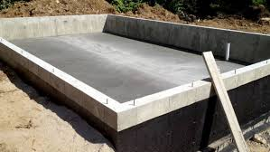
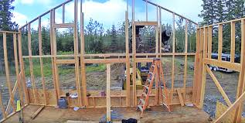








Step 1: Learn to Work Hard
High School and College JobsPicked produce at local farmsYard work for elderlyCampus workstudy: mailroom and computer labBuilt homes for local construction company

Slide 8

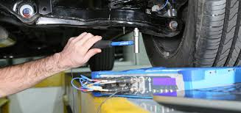
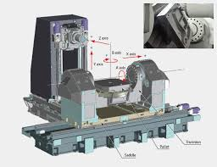
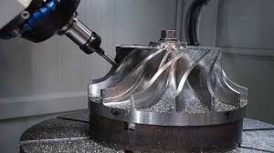
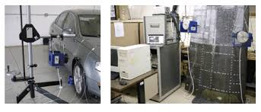
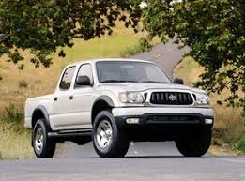
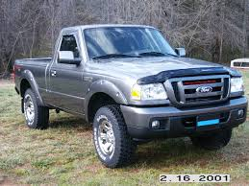

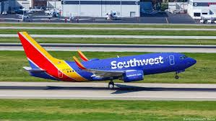

Step 2: Learn a Valuable Skill
Bachelor’s degree @ University of PortlandInternship @ Boeing: Maintained manufacturing equipment for Boeing 747 and 737 Master’s degree @ University of CincinnatiTaught classes and worked on suspension modeling of pickup trucks

Slide 9
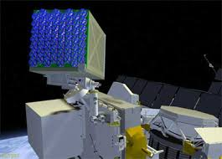


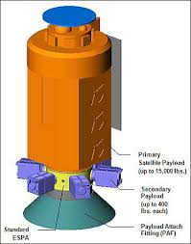
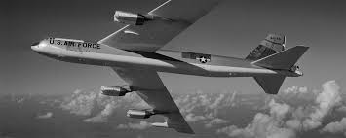
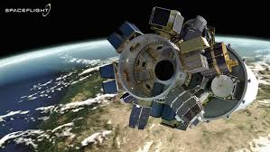
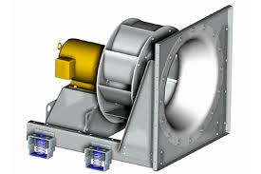
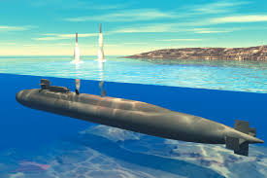
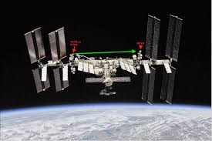
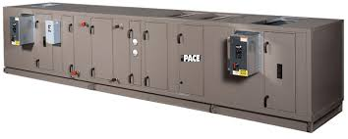
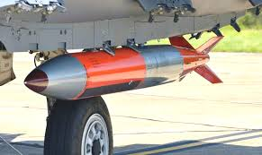
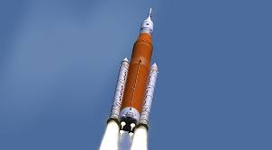
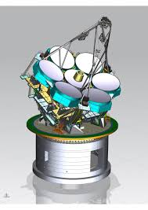
Step 3: Work Hard at Job Using Valuable Skill
Moog-CSA Engineering Projects: Space Launch System (rocket to go to the moon), ESPA (mount lots of small satellites on big rockets), NICER (looking at the sun’s energy from the International Space Station to feed environmental models for global warming calculations), XSS-11, DSX, Giant Magellan Telescope (six 27’ mirrors to make an 80 ft visible spectrum telescope, resolution 10 times better than Hubble), Recon Optical telescopes for pods on F-15 jets.
Sandia National Laboratories Evaluate the engineering work of others to ensure that it meets technical rigor in order to keep our country safe
York InternationalDesigned and produced air handlers to keep things comfortable and quiet in schools, concert halls, and hospitals

Slide 10
Succeed in Any Career
What are the most important ingredients to a successful career?Hard workLearn as much as possible about the fieldFormal educationInternshipsApprenticeshipsVery difficult and very dangerous jobs pay better than easy jobsExamples: doctors and underwater weldersJobs that can replicate at scale pay better than jobs that require individual attentionSoftware development vs. early childhood educationPay isn’t the only factor in deciding on a careerThe pay is terrible for artists, priests and stay-at-home moms, but the spiritual and emotional rewards are great – money isn’t the most important thing in life

Slide 11
Questions?

