Slide 1
The Saint Luke Guild Checkout.com Requested Info
Douglas Coombs
July 1, 2022, Rev. 1

Slide 2
Transaction Information Data Request
A payment flow to properly understand what Checkout.com is exactly processing for.
See the next slide
Please provide further details on what the merchant will be accepting payments for.
We are accepting donations to fund
Art displays at schools
Projects to help schools in the selection of art (e.g., a timeline/database of art masterpieces)
Costs to attend educational conferences and educate schools on the value of art reproductions
Please provide the URL where payments will be accepted. Please also provide demo or Test login details to verify the website
www.saintlukeguild.com/projects (this will be updated when we begin taking payments)
Please confirm the annual processing volume
Maybe $5k-$10k/year to begin. It is hard to say. We currently bring in around $20k/year in large checks. Most larger donors will probably still choose to give via check.

Slide 3
Transaction Flow Chart for Website Donor Funds
Overhead costs are things like PO box and website fees
General funds are discretionary and can cover either overhead or project costs
Donors give to either a school project (restricted), a general support project, (restricted) or general funds (unrestricted)
General support project costs are for things like an art timeline database to help schools select art for their hallways
General support projects are not specific to any school
Project costs are school specific
Project costs are spent 100% on school art projects for specific schools

Slide 4
Website Donor Forms Entry Point for Project Funding
Simple Donate Button next to each project on website takes donors to a common donation form with a drop down menu to select a project
The Saint Luke Guild should be able to add projects to the list
All form information should be communicated to the Saint Luke Guild along with money
First Name: _______________________
Last Name: _______________________
Address: _________________________
City: ____________________________
State: [Drop Down ] Zip: ___________
Keep me anonymous to project schools. Project: [Drop Down List]
Pledge Amount: $ ___________
Credit Card Info
Donate Now

Slide 5
Website Donor Forms Ideal Point
In an ideal world, we would be able to have bar graphs showing how much money has been donated to a given project
Similar to Kickstarter
SLG staff would be able to enter check donations to move the bar
This would mean each project would have a standalone donor form.
$15,250 of $30,000 Raised
Project: Holy Child Catholic School
First Name: _______________________
Last Name: _______________________
Address: _________________________
City: ____________________________
State: [Drop Down ] Zip: ___________
Keep me anonymous to the above school.
Pledge Amount: $ ___________
Credit Card Info
$15,250 of $30,000 Raised
Donate Now

Slide 6
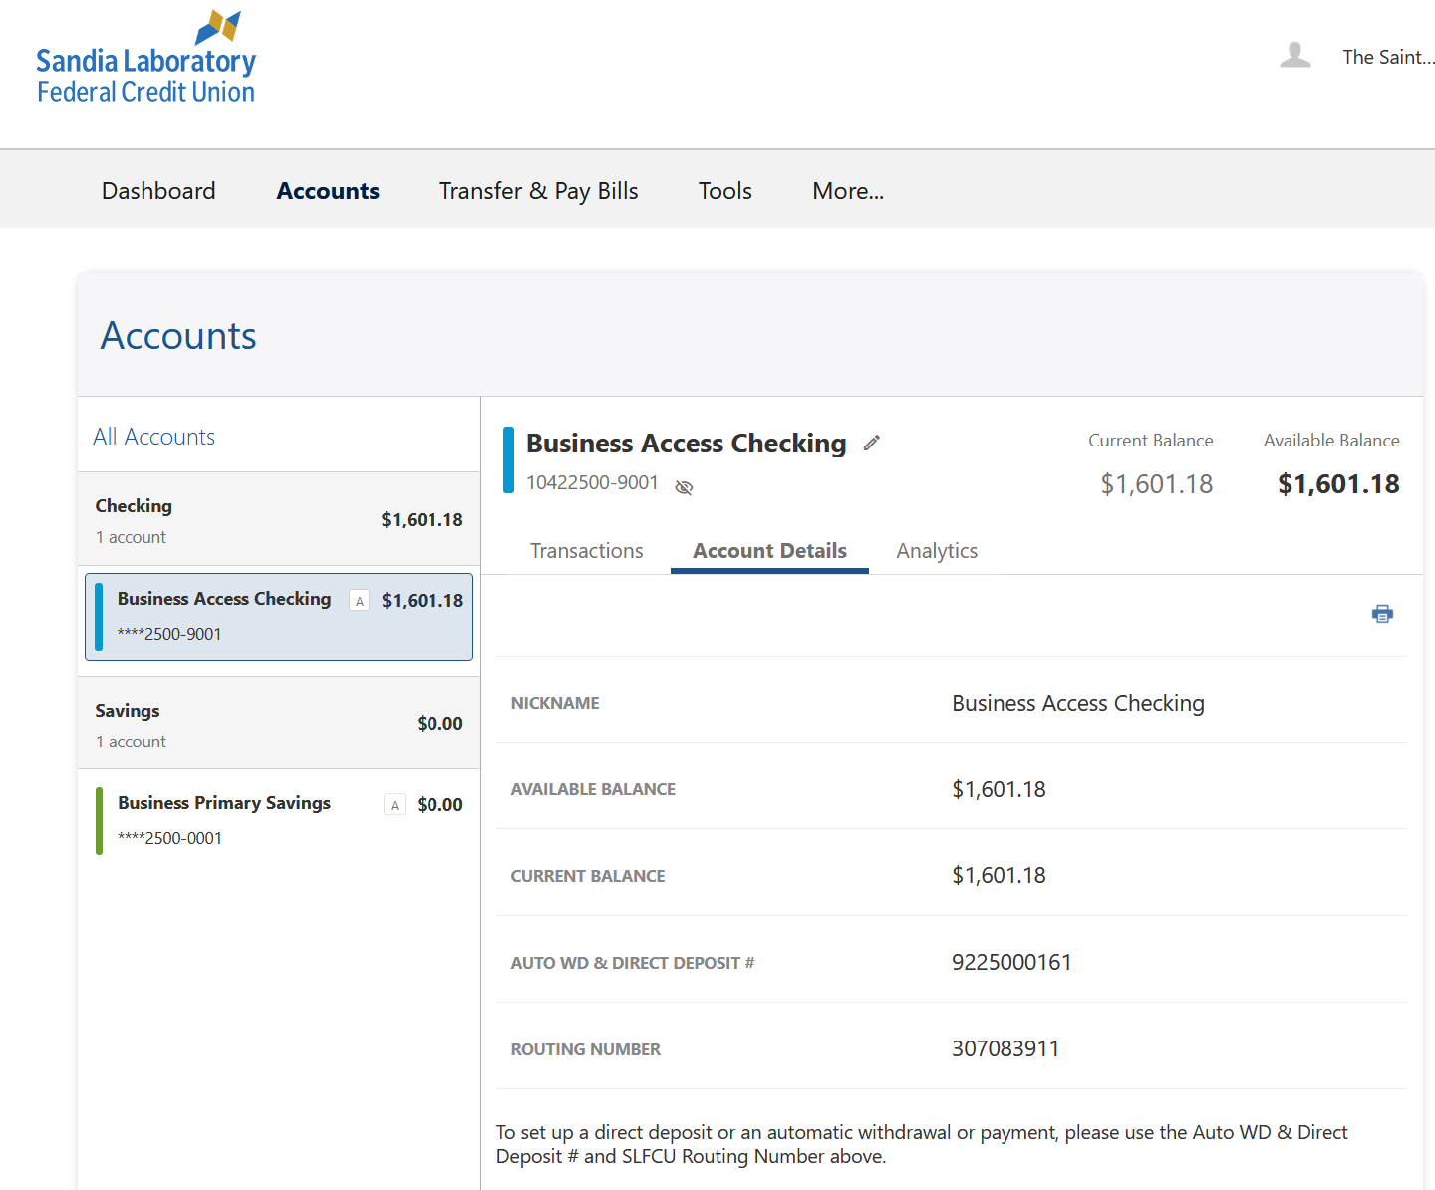
Bank Account Info
Routing #: 307083911
Auto WD and Direct Deposit #: 9225000161
Account #: 10422500-9001
Not used for electronic transactions

Slide 7
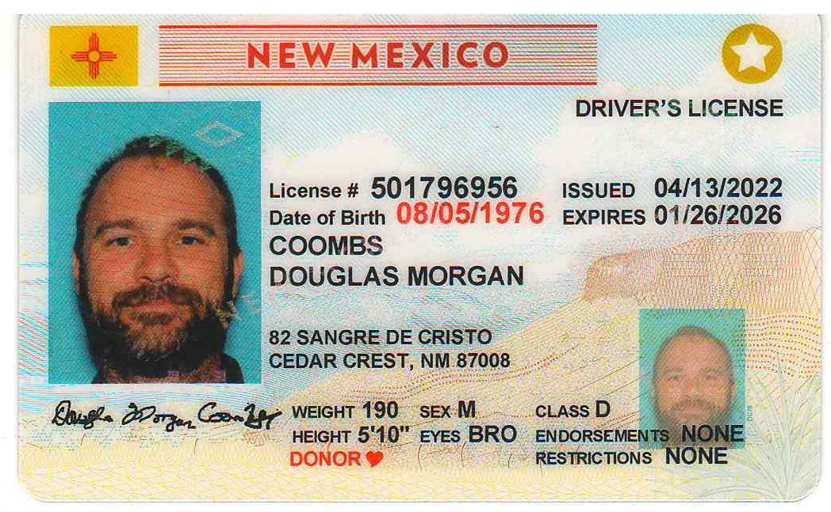
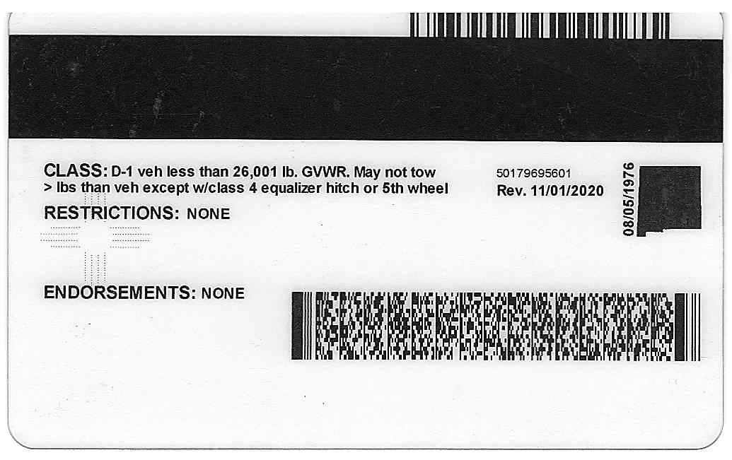
KYC documentation
Passport/Driver's License for Douglas Coombs

Slide 8
Legalese on Website
Legal entity name: The Saint Luke Guild
Governing jurisdiction: New Mexico
Merchant registered business address: 2718 University Blvd NE, Albuquerque, NM 87107
Privacy Policy
See next slide
Refund/Cancellation/Return Policy
See next slide
See www.SaintLukeGuild.com/About-Us
To be moved to www.SaintLukeGuild.com/Legalese at a future date

Slide 9
Privacy and Refund Policy
https://www.saintlukeguild.com/about-us
Refund Policy
The Saint Luke Guild does not deliver products to individuals; therefore cancellations and returns are not applicable. Also, donor refunds are not generally offered. Refunds will be considered on a case-by-case basis before money is distributed to the designated project (e.g., if someone accidentally entered the wrong donation amount and contact is made within one business day). To request a refund, contact us at refunds@saintlukeguild.com.
Privacy Policy
The Saint Luke Guild takes donor information and privacy very seriously. We will never sell donor information to a third party for any reason.
Donor information will only be shared with outside businesses as necessary to deliver services (e.g., processing credit card donations, etc.).
The exception is when donors choose a specific school project to donate to. When this occurs, donor information will typically be shared with the specified school, so that they can know to whom they should be grateful. Donors may opt out of information sharing on the donor form.

Slide 10
Regulatory Documents
License required to operate the business
NM_SoS_InitialReport_2016917025-502856.pdf
NM_ArticlesOfIncorporation_AoI_Approved.pdf
Licenses for all jurisdictions in which you intend to provide your services.
Starting in NM. Other locations unknown, so far.
Copy of AML/KYC policy and procedures
Not sure what this would look like. Are there examples?
Completed AML Questionnaire
Has this been done?

Slide 11
Corporate Documents
Please provide 501c3 document to confirm tax exempt status
The following are attached
IRS_f1023ez_SaintLukeGuild_20210711_AsSubmitted.pdf
IRS_fSS4_EIN_Letter_CP575Notice_1622224687610.pdf

