Slide 1
Nucleation and Growth of Crystalline Structures On A Treated Substrate From A Supersaturated Solution Of C12H22O11
Atoms and Molecules Session 14

Slide 2
Nucleation and Growth of Crystalline Structures On A Treated Substrate From A Supersaturated Solution Of C12H22O11
No!!! Too Complicated!
Atoms and Molecules Session 14

Slide 3
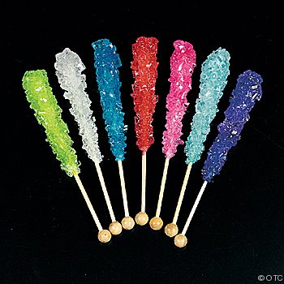
Better Title: Making Rock Candy!
And Other Crystals
Atoms and Molecules Session 14

Slide 4
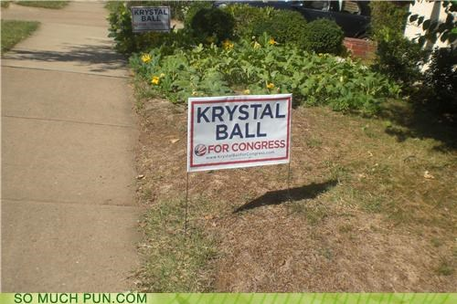
Funny Election Sign
Atoms and Molecules Session 14

Slide 5

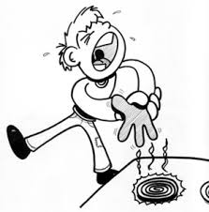
Lab Safety Today
We will be using a hot stove to make our rock candy solution. Let the adults do the cooking!
Be careful with your glass jars
Atoms and Molecules Session 14

Slide 6
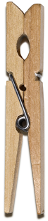

Experiment 1: Growing Rock Candy Crystals That You Can Eat
Materials:
Kettle or pot
Distilled water
Sugar
Wooden spoon
Ladle
Pint jar with lid
String
Paper clip
Clothespin
Flavorings
Food coloring
Wax paper
Clothespin
Piece of string
Sugar crystals
Hot sugar solution
Paper clip
Pint jar with lid
Atoms and Molecules Session 14

Slide 7
Now Let’s Go To The Kitchen
Atoms and Molecules Session 14

Slide 8
Procedure for Experiment 1
This makes enough solution for 16 pint jars.
In large kettles, boil 16 cups (4 quarts) of distilled water.
We will need 40 cups of sugar.
Slowly add 10 cups of sugar to each quart of boiling water, stirring until the sugar dissolves.
Allow the solution to cool for 20 minutes.
Fill each jar full of the solution using the ladle.
Add food coloring and flavoring to your jar!
Atoms and Molecules Session 14

Slide 9
Finishing Experiment 1
Tie one end of a 6-inch piece of string to the center of a clothespin and the other end to the end of a paper clip.
Dip your string into the sugar solution.
Roll your string in some sugar.
Let the string cool down.
Very Important: Shake off any extra sugar.
Lower the string into the jar of hot sugar solution, resting the clothespin on the jar lid.
Keep the bottom end of the paper clip a half inch or so above the bottom of the jar.
Put jar in a safe, warm place and wait one week.
Do not disturb the jar while you are waiting for the crystals to form.
Atoms and Molecules Session 14

Slide 10
Back To The Classroom
Atoms and Molecules Session 14

Slide 11

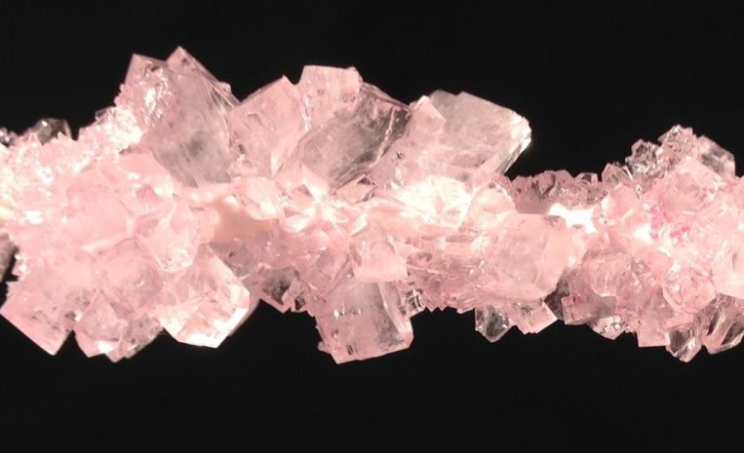
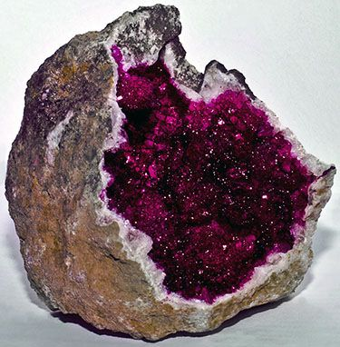
Some Beautiful Crystals
Geode with crystals inside
Atoms and Molecules Session 14

Slide 12
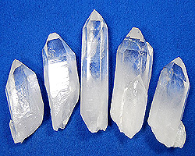
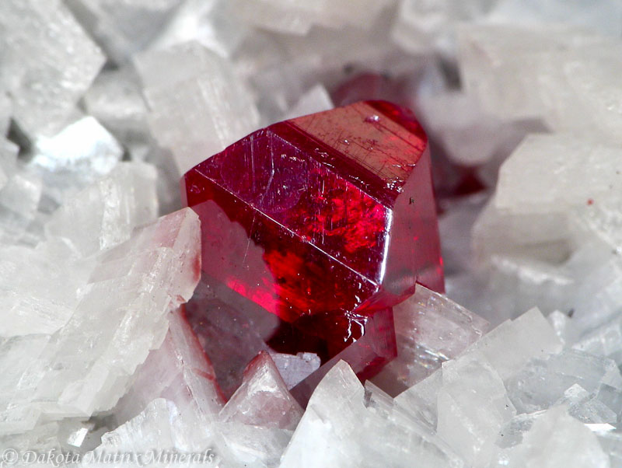
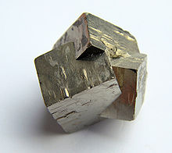
More Crystals!
Quartz
Cinnabar (mercury)
Pyrite (fool’s gold)
Atoms and Molecules Session 14

Slide 13
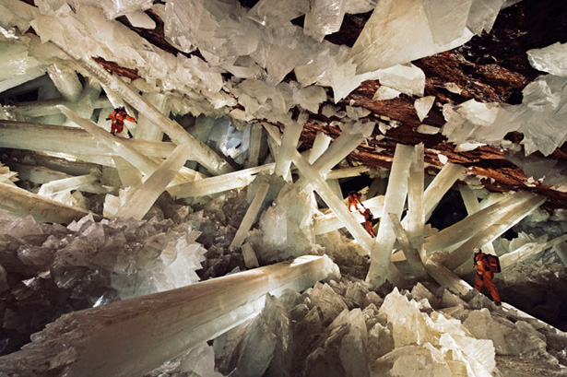
Cave of Crystals, Mexico (Gypsum)
Atoms and Molecules Session 14

Slide 14
So, What are Crystals?
Crystals are solids.
They have regular geometric shapes.
They have faces, or facets that meet at sharp angles.
They are mostly found in rocks (although there are ice crystals too).
They are orderly arrangements of a single kind of atom or molecule.
Atoms and Molecules Session 14

Slide 15
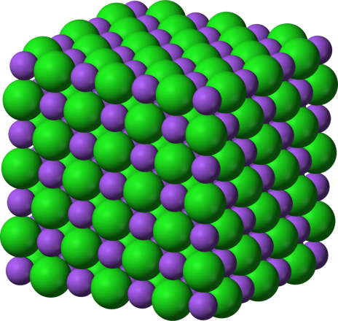
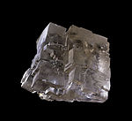
What Do I Mean by “Orderly”?
Orderly
Halite (salt)
Disorderly
Atoms and Molecules Session 14

Slide 16
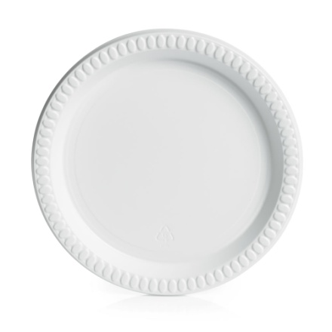
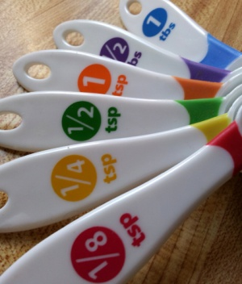
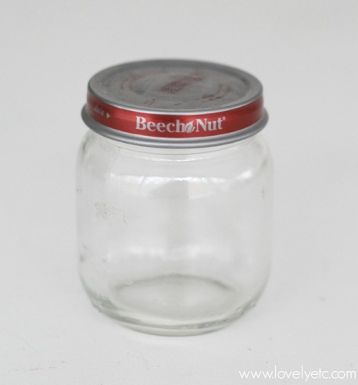
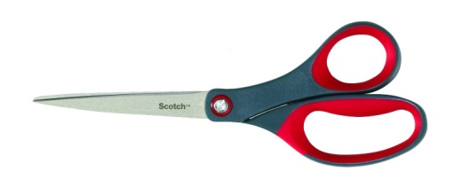
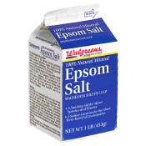
Experiment 2: Growing Needle-Shaped Crystals
Materials:
Plastic plate
Plastic bowl
Sheet of black construction paper
Baby food jar with lid
Tablespoon
Scissors
Epsom salt
Atoms and Molecules Session 14

Slide 17
Procedure for Experiment 2
Turn your bowl upside down on the construction paper and trace it.
Cut the circle out and fit it inside the plastic plate.
Fill the baby food jar half full of warm water, then add 2 Tablespoons of epsom salt.
Put the lid on and shake 60 times.
Let the contents of the jar settle for a couple of minutes.
Pour the liquid onto the black paper. Don’t pour any undissolved epsom salt onto the paper.
Wait a few days, then look at the crystals. What do they look like?
Atoms and Molecules Session 14

Slide 18
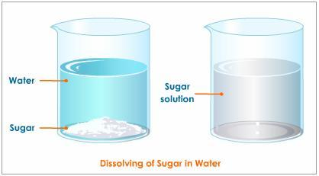
Science Vocabulary for This Week
Crystal – a large, orderly arrangement of atoms or molecules in neat rows.
Solvent – a liquid (like water) that you dissolve stuff in.
Solute – a solid (like sugar) that you dissolve in the solvent.
Solution – the mixture of solvent and solute (like sugar water).
Saturated solution – a solution (like sugar in water) that can’t hold any more solute.
Supersaturated solution – a solution that has been heated and holds more solute (like sugar) than it can at room temperature.
Nucleation – the process in which a sugar molecule (solute) comes out of the sugar water solution and sticks to the sugar crystals on the string.
Atoms and Molecules Session 14

