Slide 1
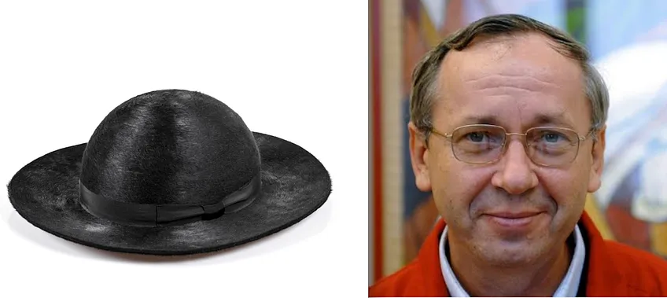
One of these is a symbol of scandal and clericalism. The other is a hat.

