Slide 1
Download Vibration GUI
by Tom Irvine
If you going to use this package, please send an Email to: tom@irvinemail.org
Go to:
https://vibrationdata.wordpress.com/
Download & extract the GUI package as shown on the next slide

Slide 2
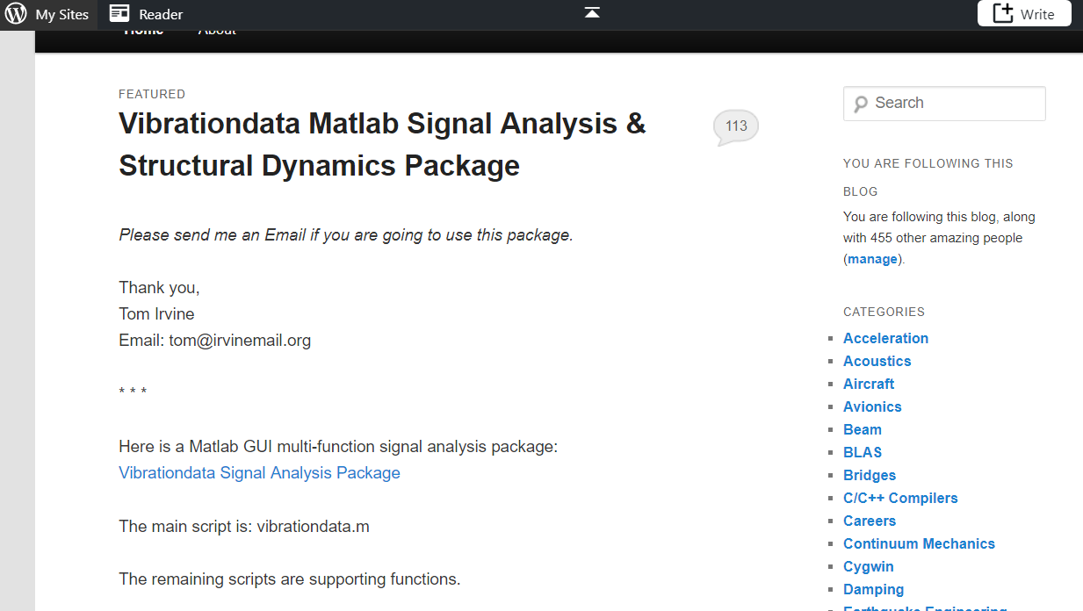

Slide 3
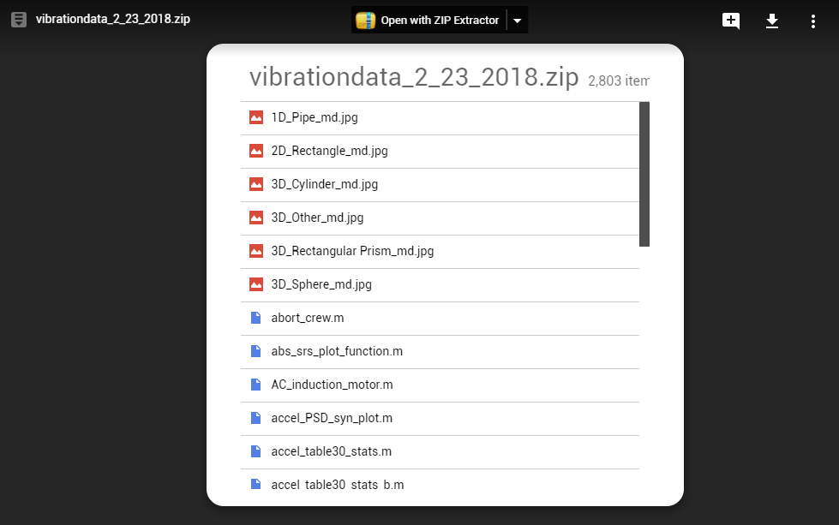
Download the newest version & extract the files

Slide 4
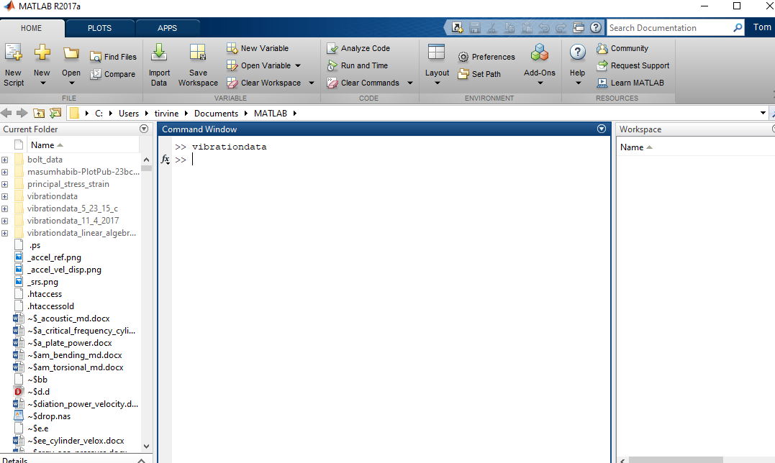
Set the path to the folder where the files have been extracted to.
Then type vibrationdata in the Command Window.

Slide 5
