Slide 1
What Makes a Great Scientist?
Knowing science and math facts
Being able to solve known scientific problems
Being able to acquire new data and assemble new theories to expand knowledge and answer specific questions about the universe
Is there something that many of our greatest scientists have in common?
Pictures of Newton, Einstein, and Feynman
Overlays of the Bible, Violin, and Congo drums
Lesson 18 Biology 2
1

Slide 2
Science: Left-Brain or Right-Brain Thinking?
Our perceptions of the world come from paying a certain kind of attention to it
Left-Brain Characteristics
Right-Brain Characteristics
Helps us manipulate the world
Clinical attention
Left hemisphere sees isolated details that are
Familiar
Known
Fixed
Graspable
Abstracted
Taken out of context
Categorizable
General in nature
Generally inanimate, because the process has completely isolated them from everything else and deanimated them
Grasping a tiny detail
Narrowly, focused, targeted attention to something it already knows about
Helps us understand the world
Rapt attention
Right hemisphere’s vision sees things that are
only partly known
only partly certain of what we are looking at
Fresh
Interconnected, and situated where they are in context
When we take them out of context, they change their nature
Flowing and changing, not fixed and graspable in a simple way
Unique rather than exemplars of a common theme
Embodied rather than abstracted and disembodied
Animate, rather than inanimate
Has the ability to look out for something we might be missing -- more skeptical
Assembles facts for application in an embodied world.
Reason is this ability to bring together the faculties of logic with the faculties of an intuitive, implicit, embodied understanding of what it means to be alive” –Iain McGilchrist
Lesson 18 Biology 2
2

Slide 3
Developing the Right-Brain
If we want to educate students to be world-class scientists, we need to develop and not dismiss right-brain thinking
Both left and right-brain thinking are critical for breakthrough science
Teach an understanding of and appreciation for Music, Art, and the Sacred
For example: band, drawing, family, and the pledge of allegiance/reveille
The Saint Luke Guild was founded to bring high quality, physical reproductions of the greatest works of art to students of average means
Enabled by two technological developments from the last 20 years
The explosion of high-resolution, digital imagery of the greatest works of art, previously reserved to museum visitors
The dramatic improvements in low-cost, museum quality photographic printing methods
Lesson 18 Biology 2
3

Slide 4
Example Project
Bring around 50 paintings showing both a timeline of art and world history to Holy Child Catholic School
$30k in artwork installed in the last 1.5 years
$30k in funding promised by donors to complete the hallway
Over 20 years projects of a similar scale could be done in every school throughout the country for ~.05% of their budget
Compare with Zuckerberg’s $300,000,000 donation to one school district – Zero improvement in student achievement
Lesson 18 Biology 2
4

Slide 5
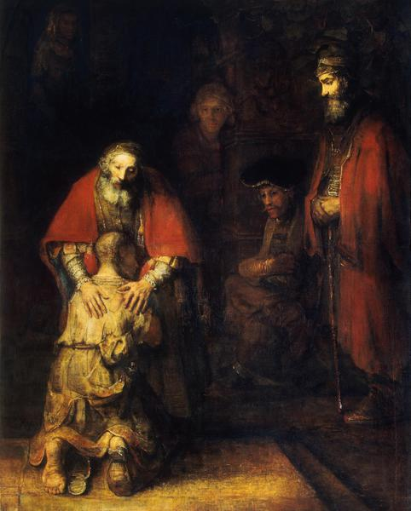
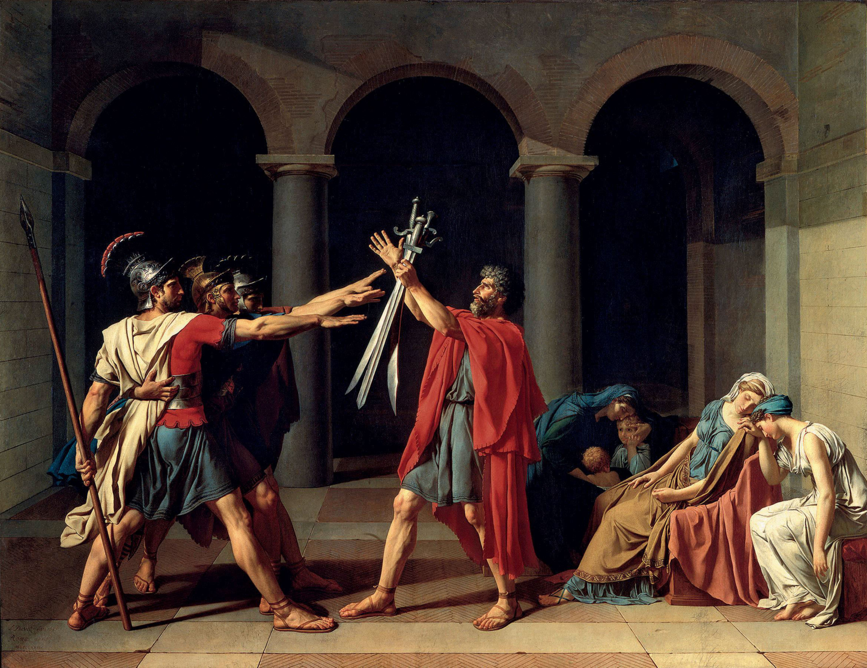
Example Paintings
Science brings us facts about the world
Lesson 18 Biology 2
5

Slide 6
Summary
Science brings us disembodied, decontextualized facts about the world
Art and myth are focused on how embodied humans should act in the real world, which is particular and uncertain
Both left and right-brained thinking is necessary for a world-class scientific enterprise
The scientist is servant to the humanities major
They control how our inventions are used
The Saint Luke Guild helps develop right-brain thinking by bringing high quality reproductions of the greatest works of art in the Western Canon to average students
Developing an appreciation for rapt attention alongside clinical attention
Lesson 18 Biology 2
6

