Slide 1
AI‑Ready Developer Workflows
Reproducible ML, CI/CD, and Data Integrity for LLM Apps

Slide 2






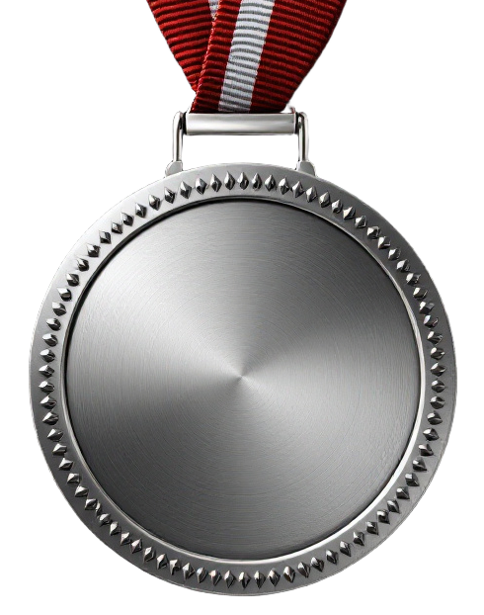




Boston Code Camp Thanks to our Sponsors!
Gold
Silver
In Kind
Hosting Sponsor

Slide 3


AI Workload Operations
DevOps:
DevSecOps:
DataOps:
MLOps:
LLMOps:
Code Reproducibility
Code Validation
Applications Deployment
Secure Design
Secure Code
Secure CI/CD Pipelines
Secure Operations
Data Quality
Team collaboration
Governance
Model Reproducibility
Model Validation
Model Deployment
Model Retraining
Model Discovery
Model Fine-tuning
Model Validation with AI Assisted Metrics
Model Deployment
GenAIOps
Agentic DevOps

Slide 4

GenAI Lifecycle in the real world: Start small and iterate
Managing
ADVANCE PROJECT
Orchestraion Integration Debugging
ADVANCE PROJECT
Security and data privacy
Deploy LLM App, UI, Model, Workflow
Define Metrics Evaluation
Continuous Evaluation & Monitoring Quota & Cost Management
Techniques - Prompt Engineering, RAG, Fine-tuning
BUSINESS NEED
Test Prompts
Choose LLM or SLM
Establish feasibility
Define Use Case
Prove that it works
Building & Augmenting
Deploying & Monitoring
Data
REVERT PROJECT
REVERT PROJECT
Prototyping
Ideating & Explore
Optimizing
Design & Customize
Operationalizing
Manage & Optimize

Slide 5
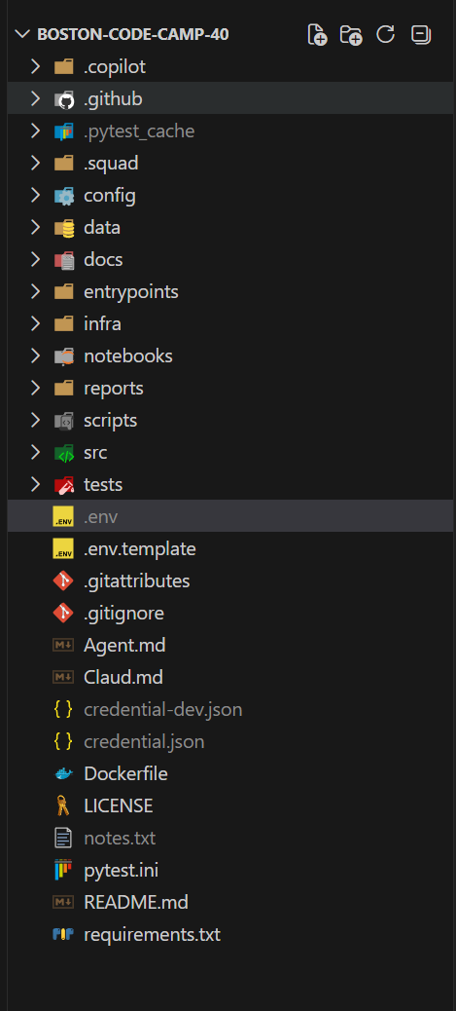
Best Practices
Repeatable Delivery
Automate Everything
Document Everything
Treat Prompts as Code

Slide 6
DEMO

Slide 7
GitHub Copilot CLI - AI for the Terminal
Intent → Command
Turn natural language into shell, git, and automation commands
Explain & Fix
Understand unfamiliar commands and recover from failures fast
Accelerate DevOps Faster inner loop • Less toil • Fewer context switches
Secure by Design Uses existing GitHub identity & policies—no shortcuts around DevSecOps
Agentic DevOps Enabler CLI actions become building blocks for automated, agent‑driven workflows

Slide 8
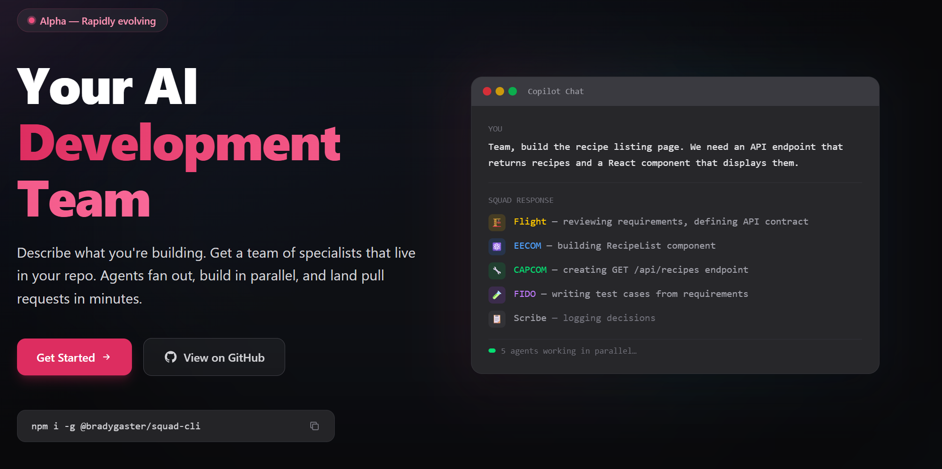
Working With Agents
https://bradygaster.github.io/squad/

Slide 9
DEMO

Slide 10
Mark Russinovic – Azure CTO
Reflections on a recent Sysinternals Project
“This was by far the hardest AI coding task I've ever tackled. It took 4-5 weeks of prompting and testing to generate about 18,000 lines of C++ that handles many different edge cases, including low-contrast and low-entropy images. It's beyond the current capabilities of frontier models to take on without human micromanagement and guidance.”
“All in all, this release reflects the current state of AI-assisted coding: some tasks were trivial for AI while others required my intense direction and oversight. AI constantly made mistakes and unfounded assumptions, some egregious, but I estimate roughly a 10x boost over my own time spent coding this. Without AI, I doubt I would have taken on the complexity of the panorama feature at all. It's an extremely powerful tool in the hands of someone that has the experience and knowledge to use it. ”
https://www.linkedin.com/posts/markrussinovich_the-latest-sysinternals-zoomit-update-has-share-7443102544903659520-1DFc

Slide 11

Thanks!

